Slide 1
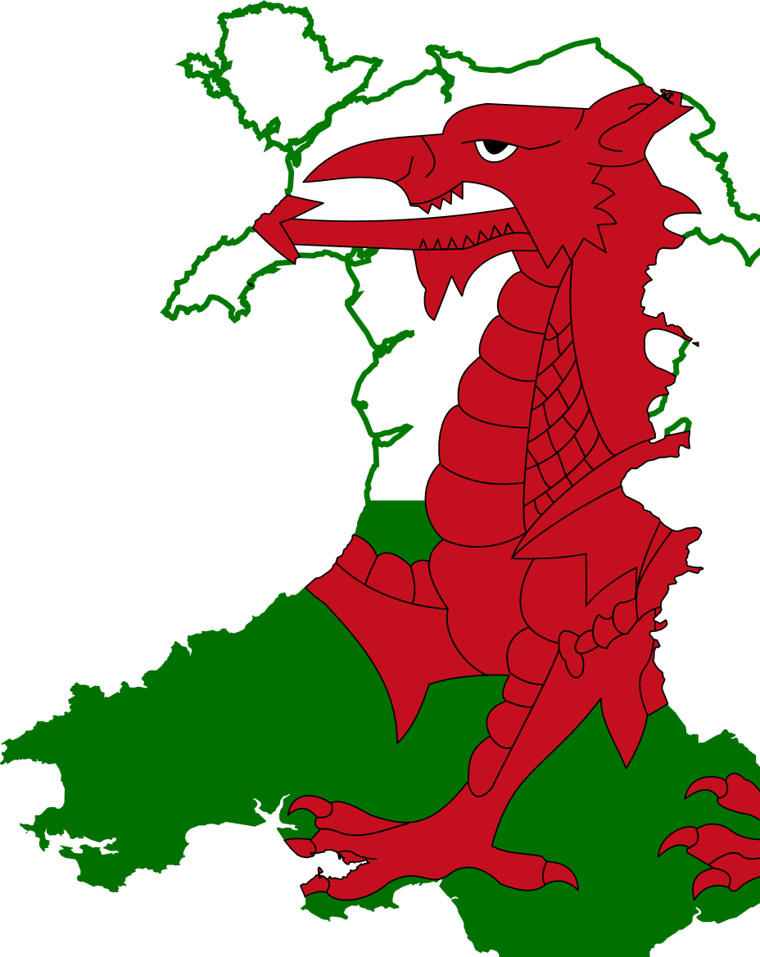

125 reasons to celebrate the geography of Wales!
ANGLESEY
Anglesey is the largest Welsh island , 714 kms².
Llanfairpwyllgwyngyllgogerychwyrndrowlllantysiliogogogoch in Anglesey is the longest place name in the UK.
Anglesey has a population of 68,900 people.
7 out of 10 people on Anglesey speak Welsh.
Holyhead is a ferry port linking Wales and Ireland.
The Welsh name for Anglesey is Ynys Mon.
The Menai Strait separates Anglesey from the mainland.
Menai Suspension Bridge (1826 and pioneered by Thomas Telford) and Britannia Bridge (1850) connect Angelsey to the mainland.
Admiralty Arch, in Holyhead, marks the end of the A5 road that runs from the Marble Arch in London.
Land Rover Defender was invented on Anglesey, nearly 70 years ago, on the sands of Red Wharf Bay.
There are approximately 120 ancient monuments that range from Neolithic or Bronze Age burial chambers to magnificent standing stones.
The three highest points are Holyhead Mountain (220 metres), Mynydd Bodafon (178 metres) and Mynydd Llaneilian (177 metres).
NATIONAL FACTS
Population: 3,113,150 in 2016
Population Density: 150 per km2
Size: 20,782km2
Coastal Path: 1400km
Official Languages are Welsh & English
Canned beer was invented in Wales.
80% of Wales in agricultural.
12% of Wales is woodland.
Cambrian Mountains are the ‘backbone’ of Wales.
In 1999 Wales gained its own National Assembly.
562,000 people speak Welsh.
There are nearly 2,000 kms of cycle tracks.
National Anthem: Hen Wlad fy Nhadau / Land of my fathers.
The world’s first £1 million cheque was signed in Cardiff.
There is a Wales government office in Chongqing, China.
Confucius Institute in Cardiff collaborates with Xiamen University in China.
There are 20 Indian companies in Wales.
Several Bollywood films have been shot in locations throughout Wales.
Wales has the longest established Somali community in Europe.
Wales has over 150 community links with Africa to help deliver the SDGs.
Wales for Africa programme, has 350 active projects in 25 African nations.
NORTH WALES
Llandudno, "Queen of the Welsh Resorts" in 1864, is the largest seaside resort in Wales.
Great Orme summit stands at 207 m.
Great Orme is connected to the mainland by a tombolo.
Great Orme has several large herds of wild Kashmiri goats originally descended from those given by Queen Victoria to Lord Mostyn.
Bangor is the oldest city in Wales and one of the smallest cities in the United Kingdom.
Moel Famau, a famous viewpoint, is the highest point along the Clwydian Hills.
Prestayn and Rhyl are seaside resorts on the North Wales coast.
Conwy is a walled market town with an imposing castle and Telford’s suspension bridge.
Abergele was severely flooded in 1971.
Deeside is home to Tata Steel, Airbus aerospace and Toyota cars.
St Asaph Business Park is a centre for new technology firms.
Pontcysyllte Aqueduct is one of 3 UNESCO World Heritage Sites in Wales.
The longest and fastest zip wire rides in Europe are in Bethesda.
WELSH BORDERS
The Welsh border runs for 257 kms north-south.
Offa’s Dyke long distance path follows the 8th century dyke built by King Offa to separate Mercia & Powys.
The River Dee once formed the border between England and Wales.
The border runs from the Dee estuary in the north to the Severn estuary in the south.
The Welsh Marches (Welsh: Y Mers) is the area along and around the border between England and Wales.
The 1990 earthquake in Shropshire originated on the Welsh Borderland Fault system.
Shrewsbury is a borderlands town with a Welsh bridge and an English bridge over the River Severn.
Charles Darwin was born and educated in Shrewsbury.
NATIONAL PARKS
Snowdon, Yr Wyddfa in Welsh, takes its name from ‘Gwyddfa’ a burial place.
The largest town in Snowdonia is Dolgellau, with a population of 2,688.
Snowdonia is the largest of Wales’ three National Parks.
The large slate quarries of Blaenau Ffestiniog, in the heart of Snowdonia, is not in the National Park.
You can find shell fossils at the summit of Snowdon.
Pembrokeshire Coast at its widest point is about 16km wide, and at its narrowest about 100m.
Skomer Island, off the Pembrokeshire Coast National Park is the only coastal nature reserve in Wales.
Henry VII, born at Pembroke Castle, began his campaign for the English throne at Mill Bay near Dale.
Brecon Beacons is the most populated NP in Wales at 33,344 – about the same population as Morecambe, Bromsgrove or Exmouth.
There are 1250 farms within the Brecon Beacons National Park, farming around a million sheep.
Brecon Beacons National Park is an International Dark Sky Reserve.
Fforest Fawr Geopark in Brecon Beacons National Park is the first Geopark in Wales because of its unique geological history.
MID WALES
Machynlleth was the ancient capital of Wales.
Machynlleth is home to the UK’s leading Centre for Alternative Technology.
Laura Ashley established her global clothing business in Newtown, Powys.
Henrhyd Falls in the Brecon Beacons is Wales' tallest waterfall.
Powys covers a quarter of Wales.
Powys is the most sparsely populated county in England and Wales, with 26 persons per km² in 2017.
The annual Royal Welsh Agricultural Show is one of the biggest events of its kind in Europe.
Plynlimon, Powys is the source of the River Severn, Britain’s longest river.
The RSPB Lake Vyrnwy farm is the largest organic farm in England and Wales.
Lake Vyrnwy, was the wettest place in Wales in 2016, 1,619mm.
The Bible was translated into Welsh at Llanrhaeadr-ym-Mochnant by William Morgan in 1588, an event instrumental in preserving the Welsh language.
Powys is home to the UNESCO Dyfi Biosphere.
Pistillate Rhaeader is one of the seven wonders of Wales.
Robert Owen a founder of the cooperative movement was born in Newtown.
SOUTH WEST WALES
South West Wales region consists of Pembrokeshire, Neath Port Talbot, Carmarthenshire and Swansea.
The Gower peninsula is an area of outstanding natural beauty.
The many sea inlets around South West Wales are called rias, post-glacial flooded river valleys.
Fishguard and Pembroke are 2 ferry ports connecting wales and Ireland.
Eddie Bowen of Swansea invented artificial rain.
Skomer and Ramsey are home to 5000 grey seals, dolphins, porpoises and puffins.
The stones for Stonehenge came from Preseli Mountains.
Freshwater West beach has been a film location for several blockbuster films.
Swansea market is the largest indoor market in Wales.
The 850 acre Margam Park boasts an Abbey, a Cistercian monastery, a Gothic country house and castle.
Multicultural Swansea has a population of 239,000.
Tenby is a Victorian tourist resort.
National Botanic Garden of Wales at LLanarthney has the world's largest single-span glasshouse.
The port of Milford Haven is the UK's largest energy port, and the largest port in Wales.
Aberporth seaside village claims to be the sunniest place in Wales.
The Sea Empress oil spill occurred at the entrance to the Milford Haven on 15 February 1996.
Robert Recorde of Tenby invented the = (equals) sign.
THE VALLEYS
These are a group of industrialised valleys which run north–south, roughly parallel to each other.
Linear settlements run along the valleys with few connections between each valley.
In the 19th and early 20th century the Valleys were the centre of the coal mining and the iron and steel industry in Wales.
The steel industry developed using local coal, iron ore and limestone.
The Valleys have become the symbol of Welsh culture, music, language and politics.
Rhondda Valley is famous for its male voice choirs, and strong masculine cultural ties within a social community.
THE SOUTH
The television and film industries are fast becoming very important in South Wales.
In the Severn estuary, the island of Flat Holm is in Wales, and Steep Holm in England.
Pen-y-Fan escarpment is the highest mountain in Southern Britain - 886m.
The annual Hay-on-Wye Literary Festival is known as “Woodstock of the mind”.
The Hay-on-Wye Literary Festival celebrates its 30th birthday in 2018.
The first community hydro scheme in Wales was built in Talybont on the River Usk in 2006.
The Royal Mint is located in Llantrisant.
Aneurin Bevan based the NHS on health services in Tredegar in 1948.
CARDIFF
In the 1830s Cardiff was the largest coal and iron exporting port in the world.
Roald Dahl was christened in the Norwegian Church.
The Cardiff Bay Barrage has the largest fish pass in Europe.
The city of Llandaff is a city within the City of Cardiff.
The inventor of the daleks was born in Cardiff.
Robert F Scott sailed from Cardiff on his fateful trip to the South Pole.
Cardiff has more parks and open spaces per head of population than any other city in Britain.
Cardiff has more hours of sunlight than Milan despite being 6⁰ further north.
In 1983, Cardiff was the first UK city to be twinned with a Chinese city, Xiamen.
In 2004 Cardiff was named the first Fair trade capital of the world.
Cardiff has the oldest record store in the world – Spiller’s Records established in 1894.
Henry Morgan Captain Morgan rum was born in Cardiff.
The first message ever sent by radio was transmitted by Marconi from nearby Penarth to Flat Holm.
Cardiff City are the only non-English team to have won the FA Cup in 1927 against Arsenal.
Cardiff is home to the fastest growing financial services sector in the UK.

