Slide 1


WELCOME!
WelshWise Quiz 2023
Cwis ‘WelshWise’ 2023
CROESO!

Slide 2


WelshWise Quiz 2023
Cwis ‘WelshWise’ 2023
There are 8 rounds
Each round has 8 questions
Choose one round as your BONUS round. Any round can be chosen except the individual round.
You can only use your BONUS once.
The BONUS round doubles your score for that round so chose wisely!
ENJOY YOURSELF!!
Mae yna 8 rownd
Mae gan bob rownd 8 cwestiwn
Dewiswch un rownd fel rownd BONWS. Gall unrhyw rownd gael ei dewis heblaw'r rownd unigol.
Gallwch ddefnyddio’r BONWS unwaith yn unig.
Mae’r rownd BONWS yn dyblu eich sgôr am y rownd yna, felly dewiswch yn ddoeth!
MWYNHEWCH!!

Slide 3

Round 1
Where am I?
Rownd 1
Ble ydw i?

Slide 4
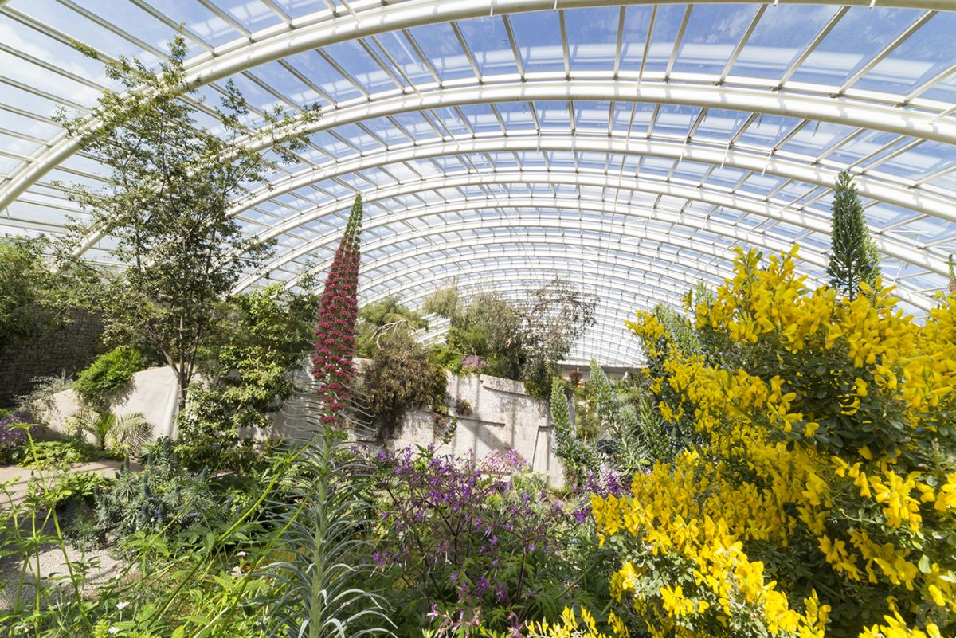
1.

Slide 5
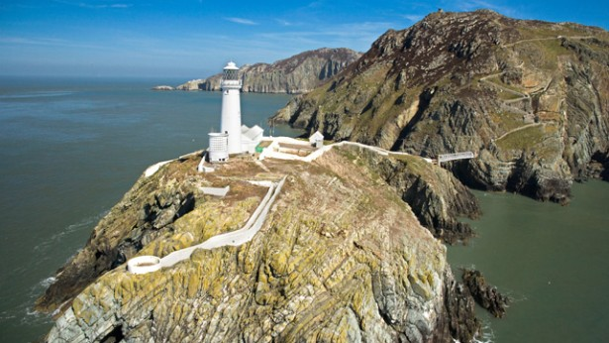
2.

Slide 6
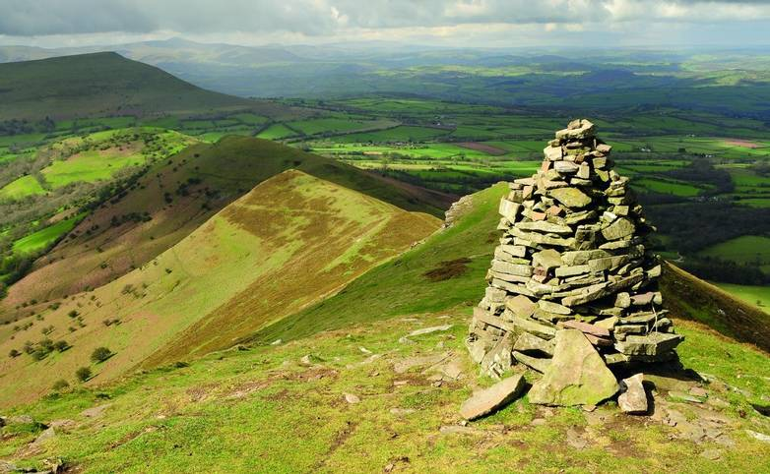
3.

Slide 7
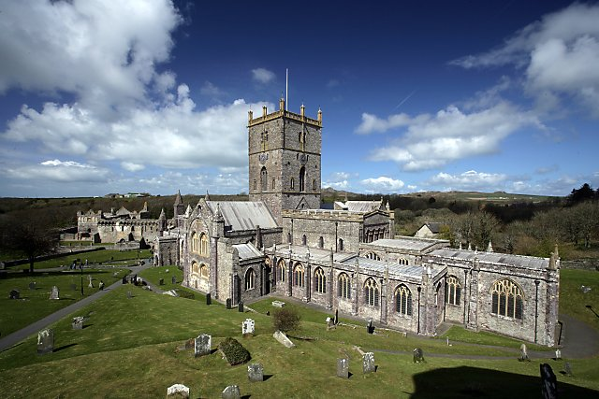
4.

Slide 8
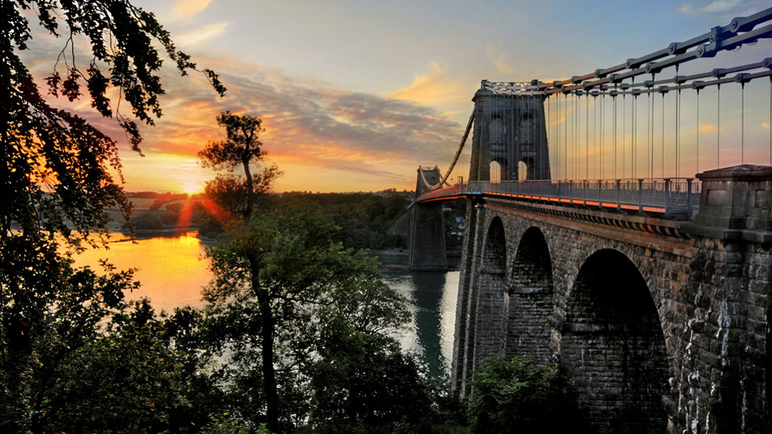
5.

Slide 9
6.

Slide 10
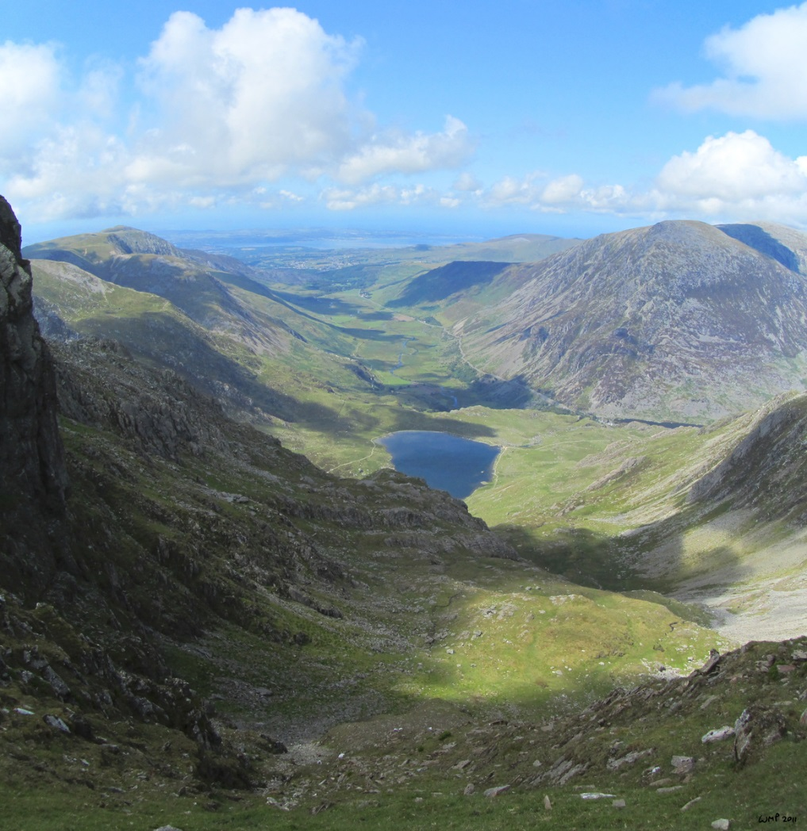
7.

Slide 11
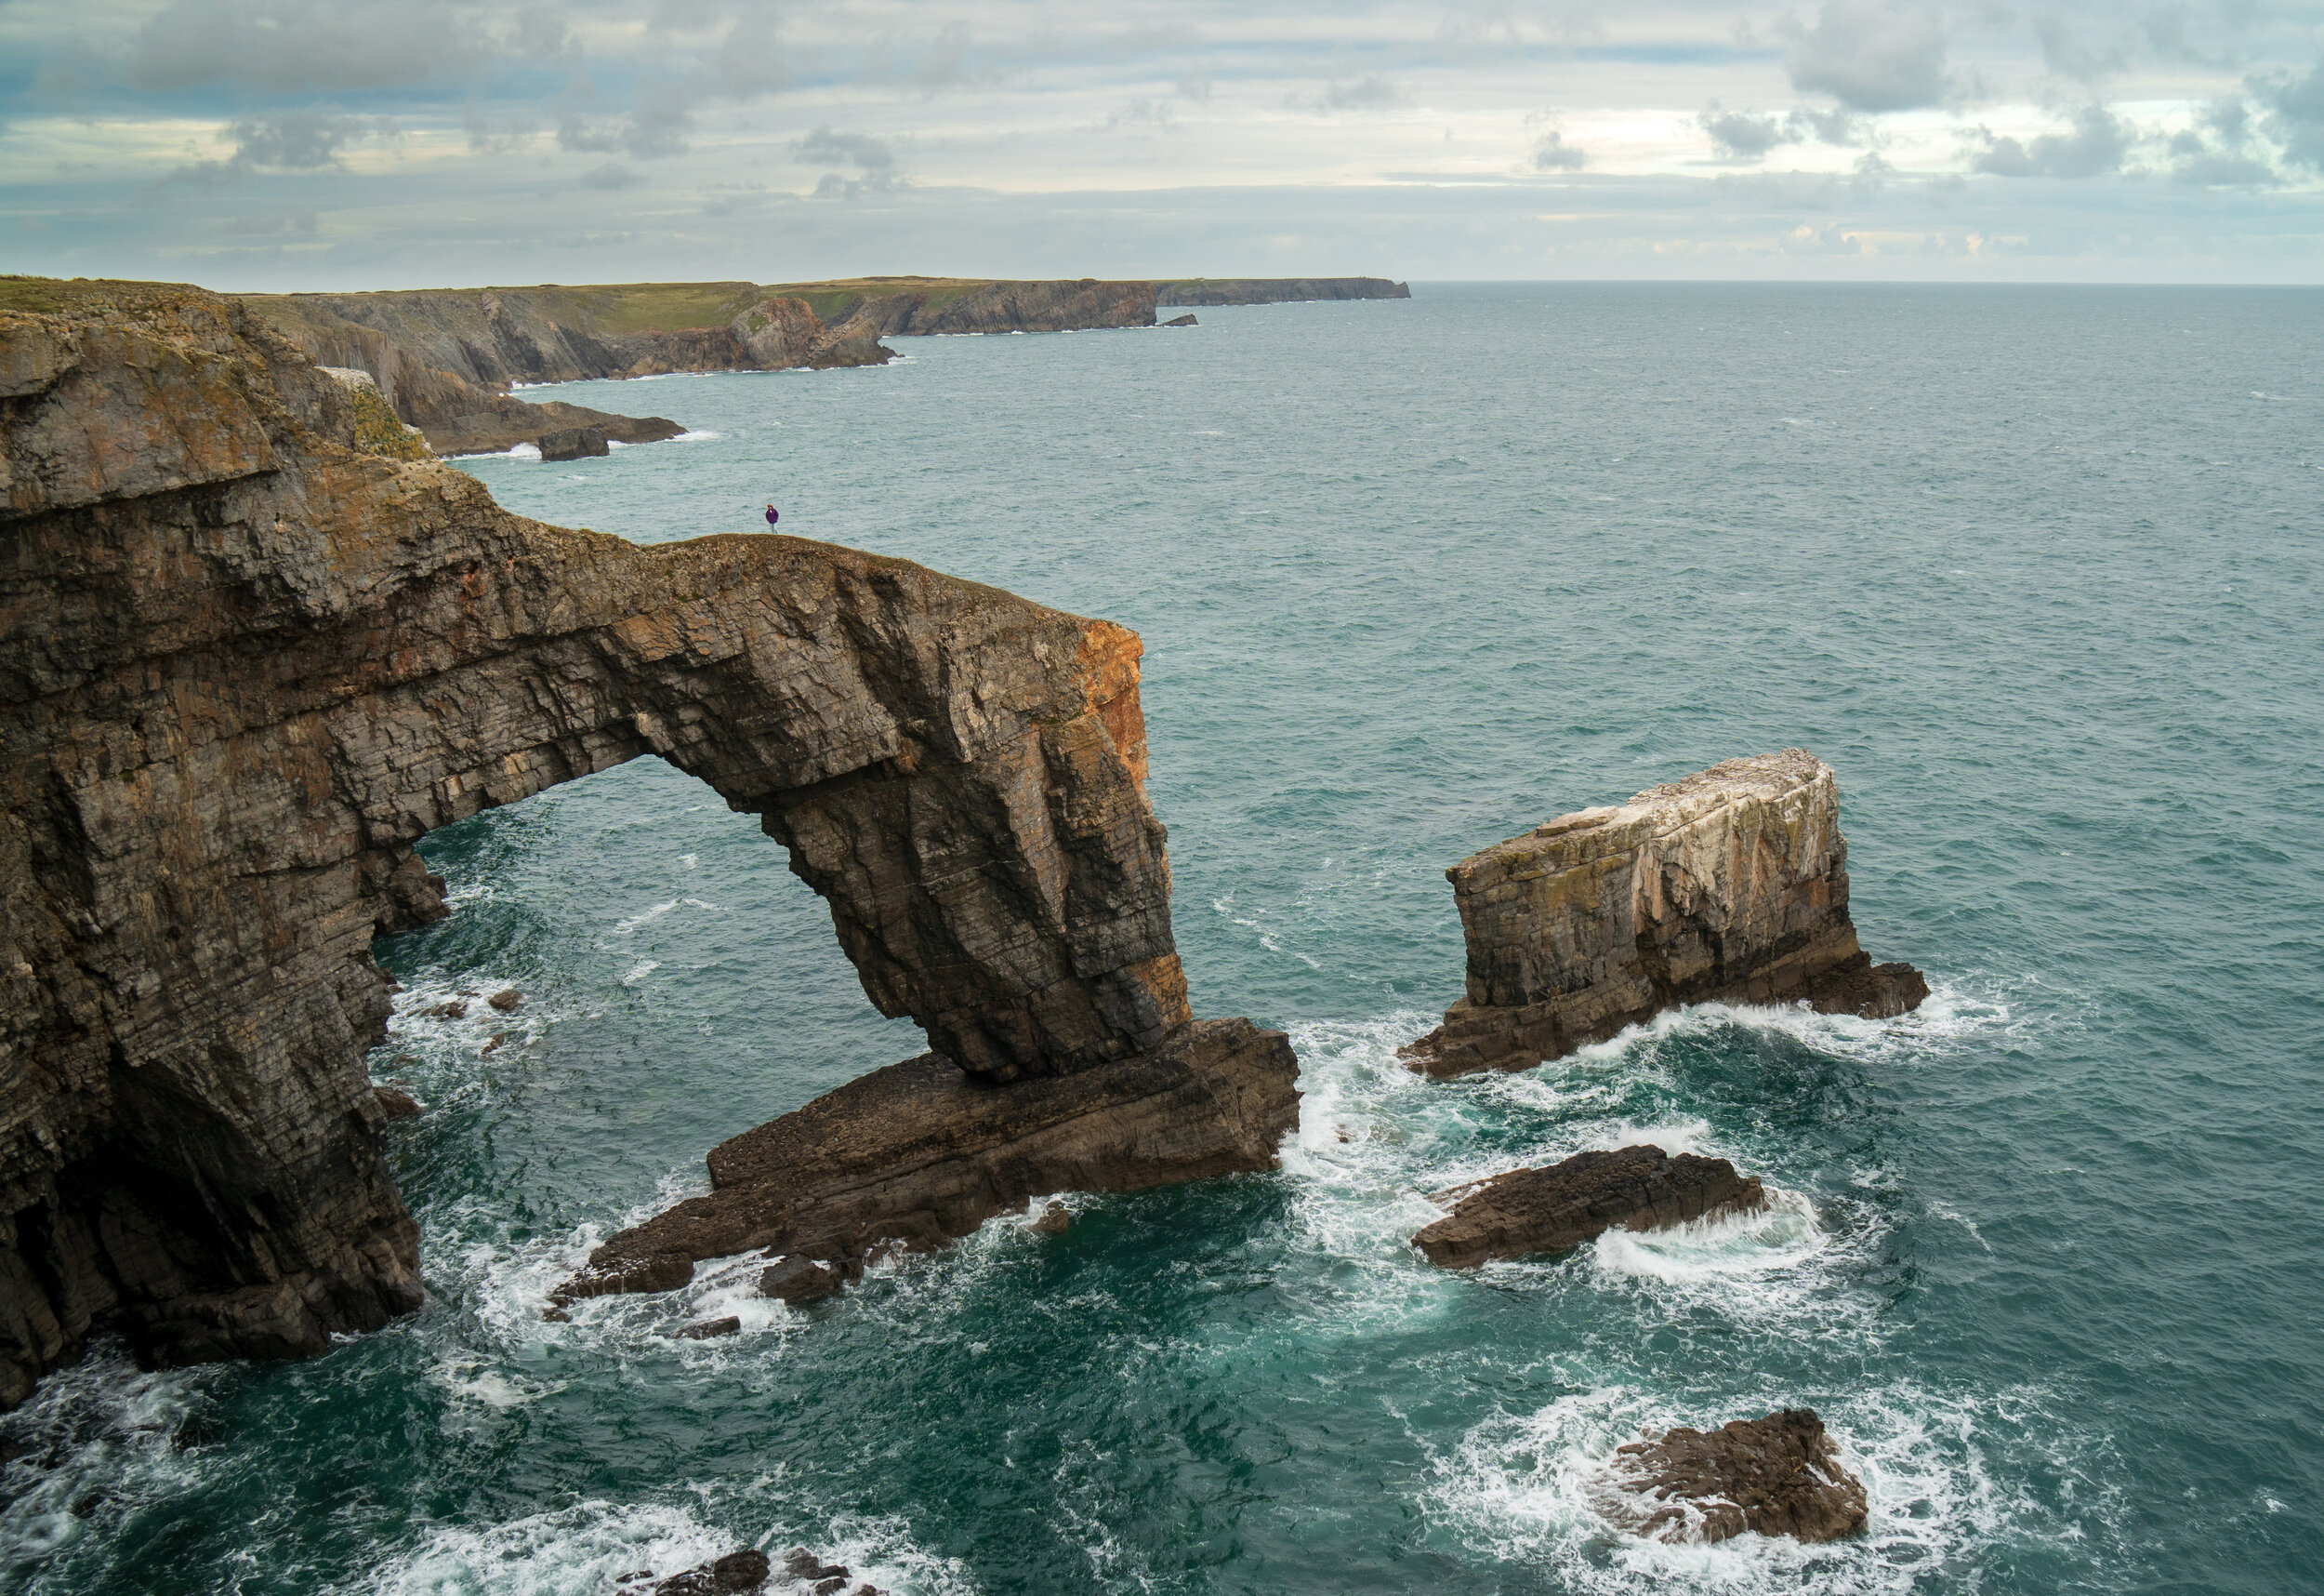
8.

Slide 12

Round 2
Tourism
Rownd 2
Twristiaeth

Slide 13

1. What percentage of the Welsh economy depends on tourism?
A 5%
B 8%
C 21%
D 53%
1. Pa ganran o economi Cymru sy’n dibynnu ar dwristiaeth?

Slide 14
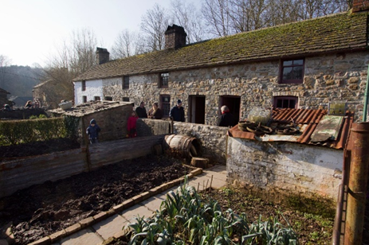
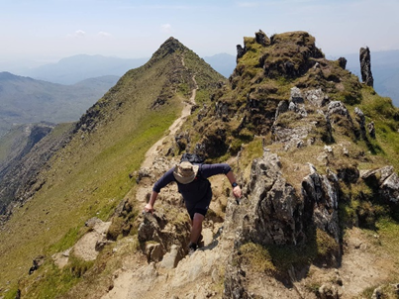
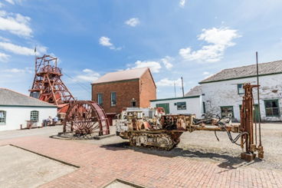
2. Which attraction in Wales has the most visitors each year?
A
B
C
2. Pa atyniad yng Nghymru sy’n derbyn y mwyaf o
ymwelwyr pob blwyddyn?

Slide 15
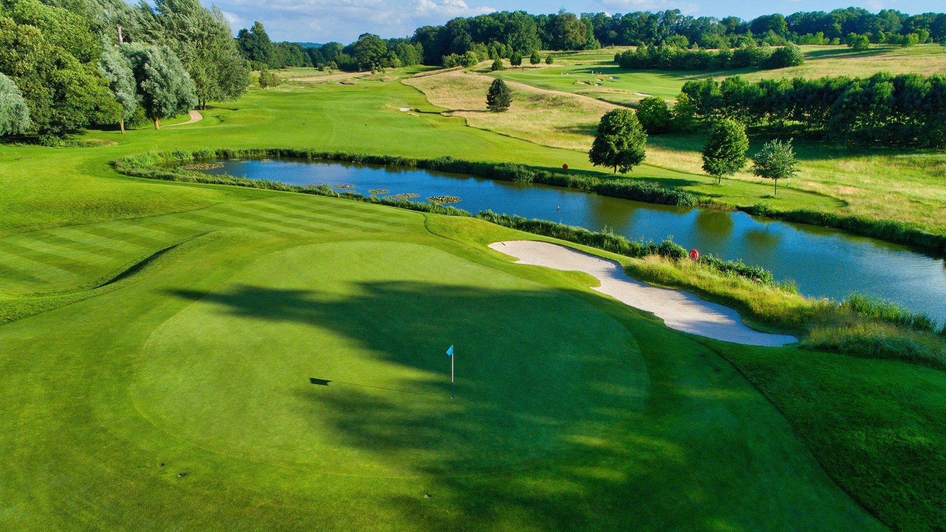
3. Which large resort and spa was built to attract international tourists to the 2010 Ryder Cup golf tournament?
A Porthcawl Golf Resort and Spa
B Marriott St. Pierre
C Celtic Manor Golf Resort and Spa
D Royal St David’s, Harlech
3. Pa gyrchfan gwyliau a sba gafodd ei adeiladu i ddenu ymwelwyr rhyngwladol i gystadleuaeth Cwpan Ryder yn
2010?

Slide 16
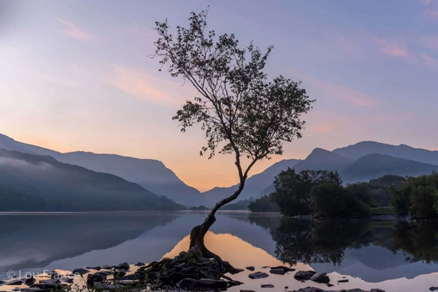
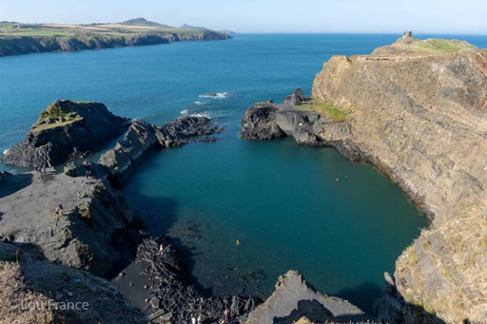
4. Why did these photographs of the lonely tree on
Llyn Padarn Llanberis, and Blue Lagoon Abereiddy, become tourist hotspots?
Lonely tree on Llyn Padarn, Llanberis
Blue lagoon Abereiddy.
4. Pam arweiniodd y lluniau yma o Lyn Padarn a’r Blue
Lagoon at greu cyrchfannau poblogaidd?

Slide 17
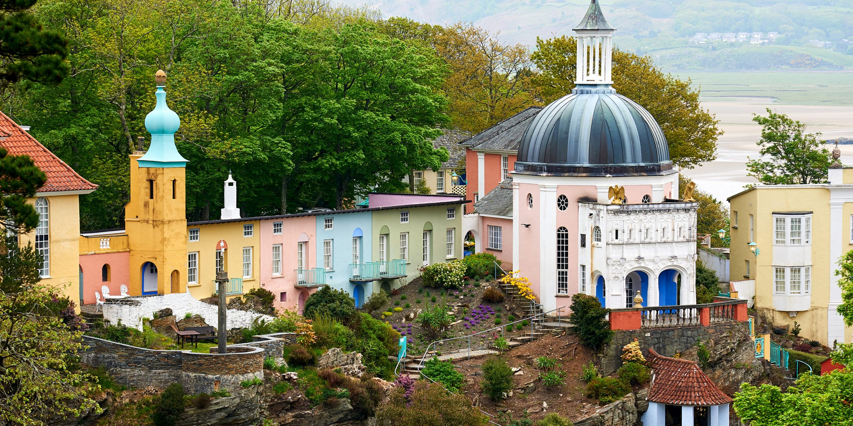
5. Which village near Porthmadog on the west coast of
Wales is famous for its pottery and ceramics?
A Morfa
B Ewenny
C Portmeirion
D Amalfi
5. Pa bentref ar gyrion Porthmadog yng ngorllewin Cymru sy’n enwog am grochenwaith a serameg?

Slide 18
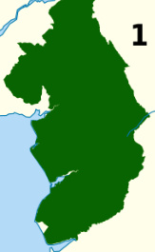

6. What do these areas of Wales, shaded green, have in common?
6. Beth sydd gan yr ardaloedd yma (mewn gwyrdd) yn
gyffredin?

Slide 19
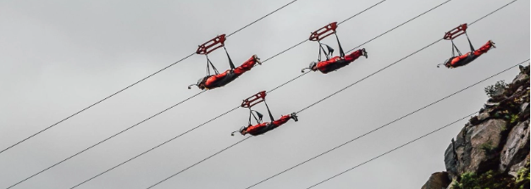
7. Where in Wales can you fly for 1.5kms, over a lake, at up to 125mph?
7. Ymhle yng Nghymru allwch chi hedfan am 1.5km, dros
lyn, ar gyflymder o hyd at 125mya?

Slide 20

8. What visitor attraction do all of these places have in common?
Conwy
Cardiff
Powys
Caernarfon
8. Pa atyniad twristiaeth sydd gan yr ardaloedd yma yn gyffredin?

Slide 21

Round 3 Global connections
Individual round
Rownd 3 Cysylltiadau Byd-eang
Rownd unigol

Slide 22
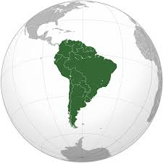
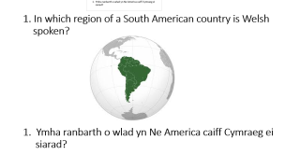
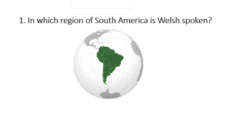
1. In which region of a South American country is Welsh spoken?
1. Ymha ranbarth o wlad yn Ne America caiff Cymraeg ei
siarad?

Slide 23

2. Which BBC TV series has a global audience and has been filmed in Cardiff since 2005?
2. Pa gyfres deledu ar y BBC, sy’n boblogaidd yn fyd-eang,
sydd wedi ei ffilmio yng Nghaerdydd ers 2005?

Slide 24

3. How many countries attend the annual Llangollen
International Eisteddfod? (To the nearest 10)
Faint o wledydd sy’n cymryd rhan yn Eisteddfod Ryngwladol Llangollen bob blwyddyn? (i’r deg agosaf)
Notes:
50

Slide 25
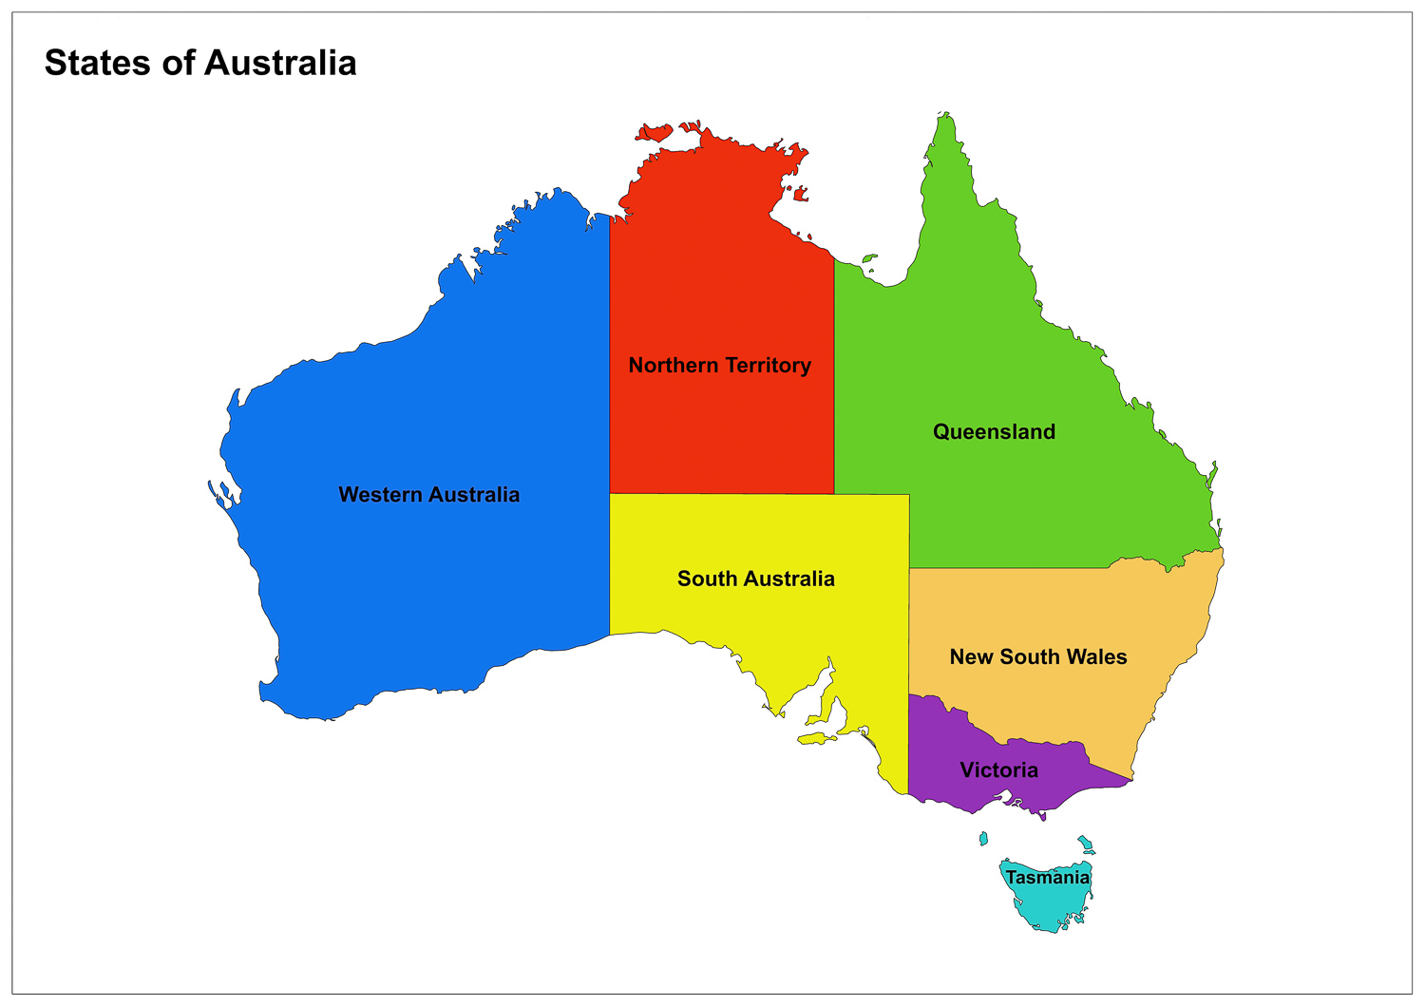
4. Which state in Australia, whose capital is
Sydney, is named after a region of Wales?
4. Pa dalaith yn Awstralia, ble mae Sydney yn brifddinas, sydd wedi ei henwi ar ôl rhanbarth yng Nghymru?

Slide 26

5. Which country was Wales’ largest trading partner in terms of % of exports in 2021?
A USA
B Germany
C Ireland
D France
5. Pa wlad oedd partner masnachu mwyaf Cymru yn
2021 (% allforion)?

Slide 27
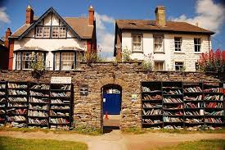
6. Which Welsh town holds an international literary festival every year?
6. Pa dref yng Nghymru sy’n cynnal gwyl lenyddol
lwyddiannus yn flynyddol?

Slide 28
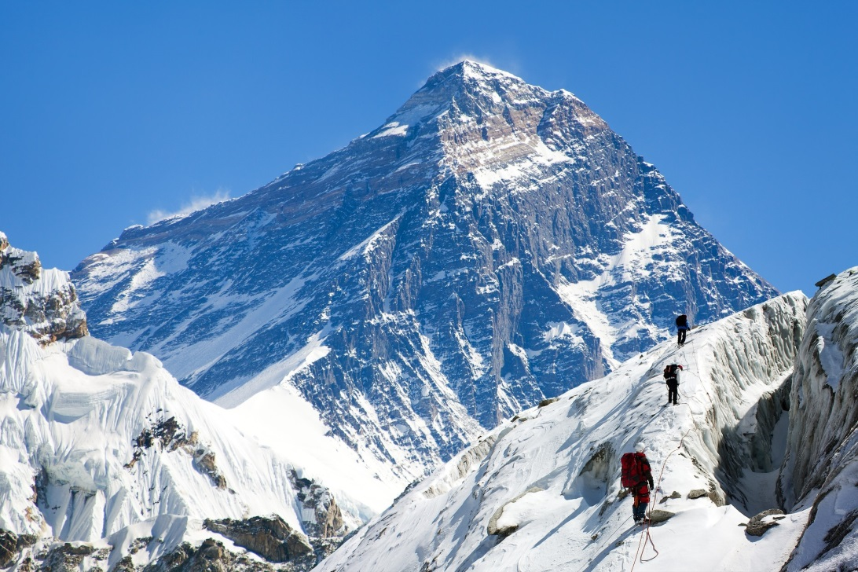
7. Which one of the world’s highest mountains is named after a Welshman?
7. Pa un o fynyddoedd uchaf y byd sydd wedi ei enwi ar ôl
Cymro?
Notes:
Everest

Slide 29
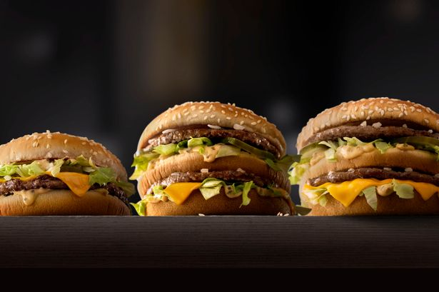
8. Which town is the ‘McDonald’s capital’ in Wales?
8. Pa dref yw prifddinas ‘Prifddinas McDonald’s’ Cymru?

Slide 30

Round 4
Fieldwork alphabet
Rownd 4
Yr wyddor gwaith maes

Slide 31

1. What A measures wind speed?

Slide 32

2. What sampling method gathers measurements at irregular intervals?

Slide 33

3. What Q gathers information from people?

Slide 34

4. What H is a statement to be tested in fieldwork?

Slide 35

5. What T is a line along which data is collected?

Slide 36

6. What type of graph best shows how river speed changes with distance downstream?

Slide 37

7. Which M describes what you actually did in your fieldwork?

Slide 38

8. What R should you consider before going out to do fieldwork?

Slide 39

Break
Egwyl

Slide 40
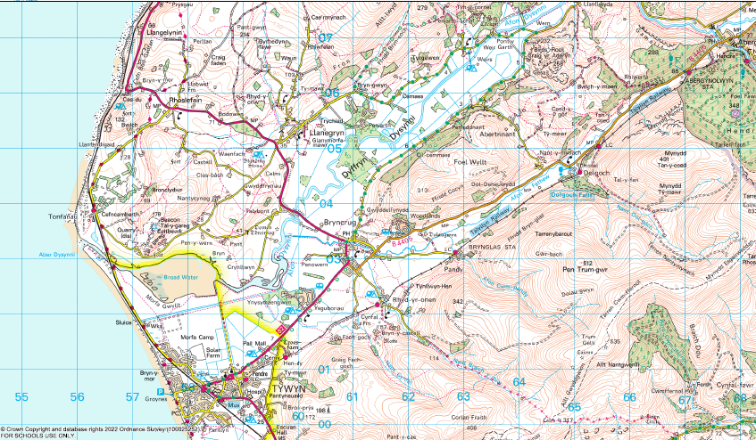
Round 5 Maps
Rownd 5 Gwaith Map

Slide 41
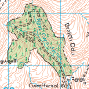
1. What sort of woodland is found in square 6601?
1. Pa fath o goetir sydd yn sgwâr 6601?

Slide 42
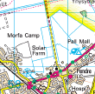
2. Is the drainage in 5801 natural or man-made?
2. A yw’r patrwm traeniad yn sgwâr 5801 yn naturiol
neu o waith dyn?

Slide 43
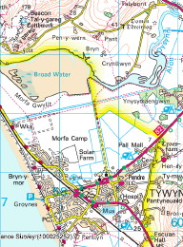
3. What is the significance of the shaded yellow line on the map?
3. Beth yw arwyddocâd yr ardal wedi’i lliwio’n felyn?

Slide 44
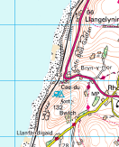
4. How has the railway line been kept level in 5605 and
5606?
4. Sut mae’r rheilffordd wedi ei chadw’n lefel yn 5605 a
5606?

Slide 45
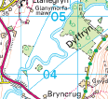
5. What landform is found in square 6004?
5. Pa dirffurf sydd yn sgwâr 6004?

Slide 46
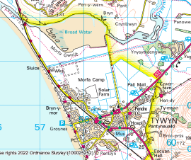
6. What is the most likely type of employment in
Tywyn?
6. Beth yw’r math mwyaf tebygol o waith i bobl Tywyn?

Slide 47
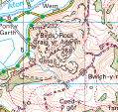
7. What is the danger in square 6406?
7. Beth yw’r perygl yn sgwâr 6406?

Slide 48
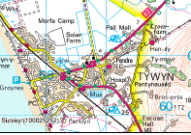
8. How is Tywyn trying to be more sustainable?
8. Sut mae Tywyn yn ceisio bod yn fwy cynaliadwy?

Slide 49
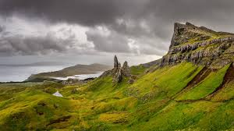
Round 6 Physical geography
Individual Round
Rownd 6 Daearyddiaeth Ffisegol
Rownd Unigol

Slide 50
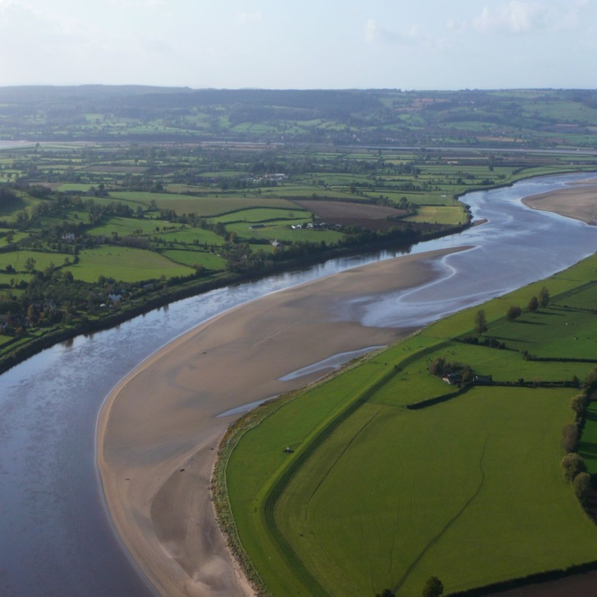
1. What is the name of the longest river wholly or partially in Wales?
Beth yw enw’r afon hiraf sy’n gyflawn neu’n rhannol gyflawn yng Nghymru?

Slide 51
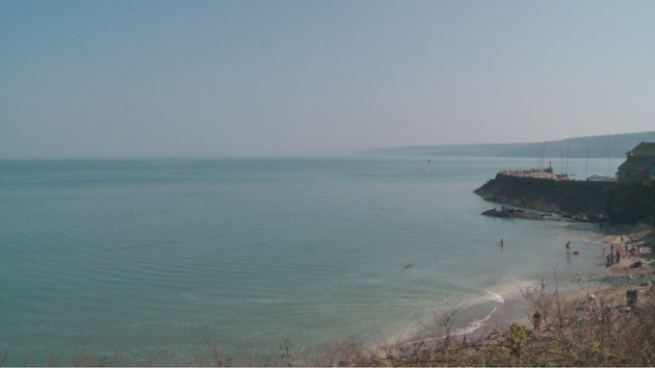
2. Which Bay lies to the west of the Wales coastline?
2. Pa fae sydd i’r gorllewin o arfordir Cymru?

Slide 52
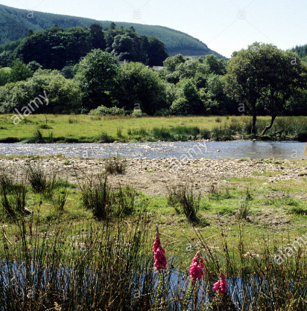
3. What is the name of the flat area on either side of a river?
3. Beth yw’r enw a roddir i’r tir gwastad bob ochr i afon?

Slide 53



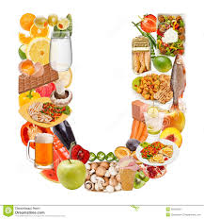
4. Which letter best represents the shape of most valleys in north Wales?
4. Pa lythyren sy’n dangos siap dyffrynnoedd yng ngogledd Cymru orau?

Slide 54

5. Which direction best represents the flow of rivers in south Wales?
North Gogledd
South De
East Dwyrain
West Gorllewin
5. Pa gyfeiriad sy’n cynrychioli llif afonydd yn ne Cymru orau?

Slide 55
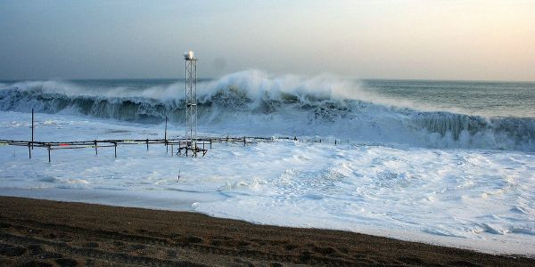
6. Which of the following is the odd one out?
Hydraulic Action
Corrasion
Corrosion
Longshore Drift
Gweithred Hydrolig
Cyrathiad
Cyrydiad
Drifft y Glannau
6. Pa un sydd ddim yn perthyn?

Slide 56
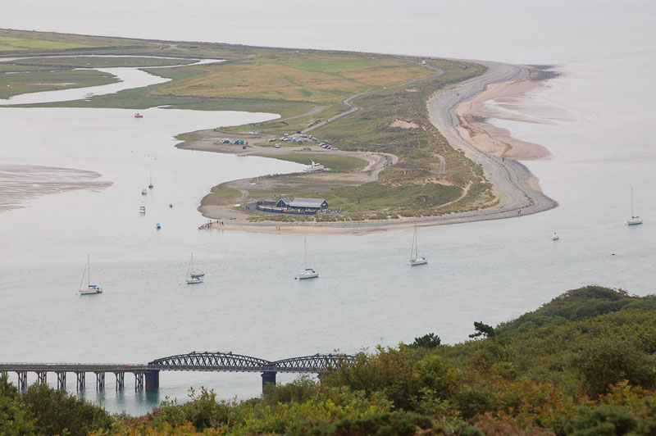
7. Enwch y tirffurf arfordirol yma.
7. Name the coastal landform.

Slide 57
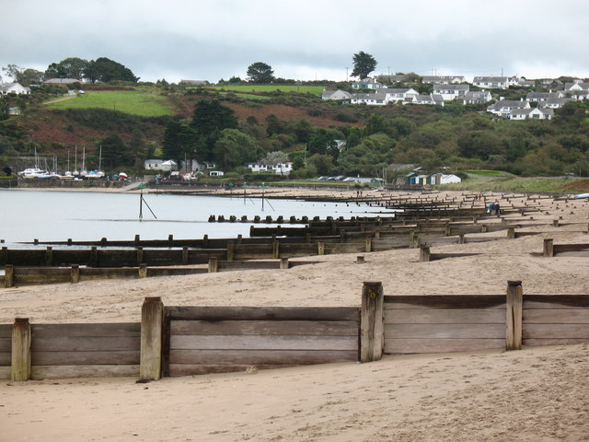
8. What is the name of this type of coastal defence?
8. Beth ydy enw’r strategaeth yma i amddiffyn y
morlin?

Slide 58

Round 7
Sporting Wales
Rownd 7
Cymru mewn chwarareon

Slide 59
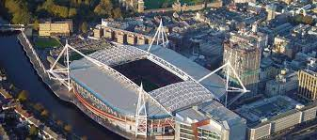
1. What was the original name of the Principality
Stadium in Cardiff?
1. Beth oedd new gwreiddiol Stadiwm y Principality yng
Nghaerdydd?

Slide 60
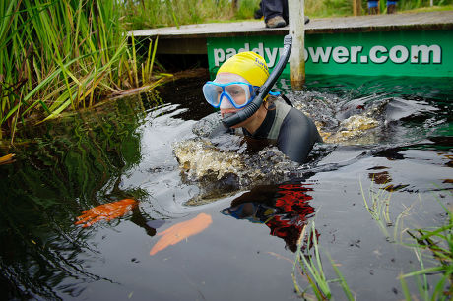
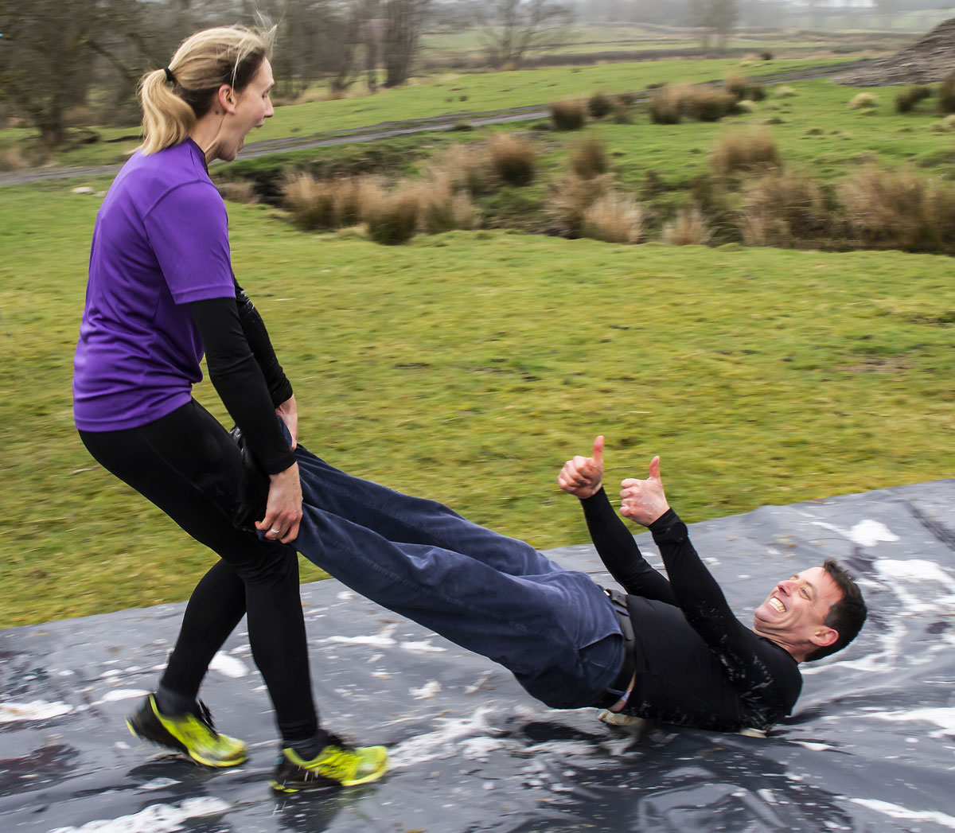
2. Which event held, in mid Wales, features wife carrying, husband dragging, and bog snorkelling?
2. Pa ddigwyddiad yng nghanolbarth Cymru sy’n cynnwys
cario eich gwraig, llusgo eich gŵr a snorclo cors?

Slide 61

3. How many trails are there in BikePark Wales?
A over 20
B over 40
C over 80
D over 100
A dros 20
B dros 40
C dros 80
D dros 100
3. Sawl llwybr sydd yn BikePark Cymru?

Slide 62

4. What is the name of the challenge to reach the summit of the 3 highest mountains in Wales within a
24-hour period?
4. Beth yw enw’r her i gyrraedd copaon tri phigyn uchaf
Cymru mewn 24 awr?

Slide 63
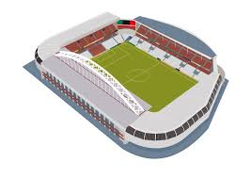
5. Which Welsh city is home to one of the world’s oldest football clubs?
5. Pa ddinas yng Nghymru yw cartref un o dimau
pêl-droed hynaf y byd?

Slide 64

6. How many medals did Wales win in the 2022
Commonwealth games?
A 10
B 15
C 20
D 28
6. Sawl medal enillodd Cymru yng Ngemau’r
Gymanwlad yn 2022?

Slide 65
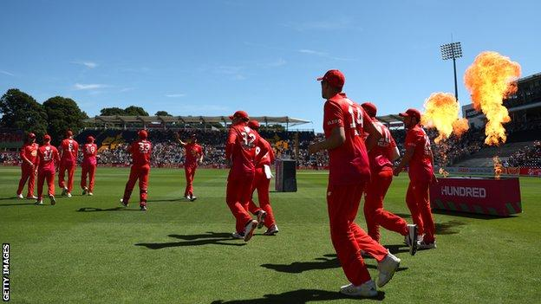
7. Which team, based in Cardiff, participates in "The
Hundred" cricket competition?
7. Pa dim, o Gaerdydd, sy’n cymryd rhan yn y
gystadleuaeth griced ‘Can Pêl’?

Slide 66

8. Which is the only Welsh football team to have won the FA Cup?
8. Pa glwb pêl-droed Cymreig yw’r unig un i ennill
Cwpan F.A. Lloegr?

Slide 67
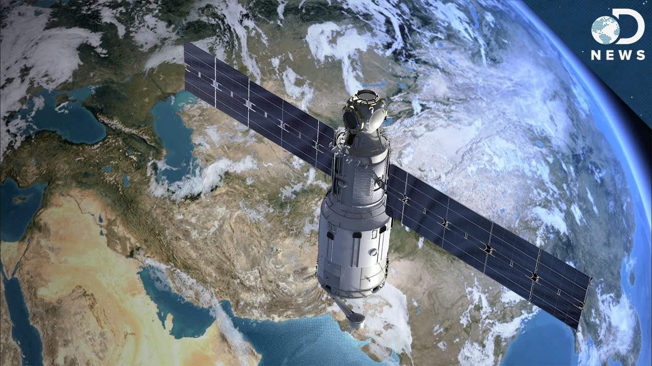
Round 8
Wales from the air
Rownd 8
Cymru o’r awyr

Slide 68
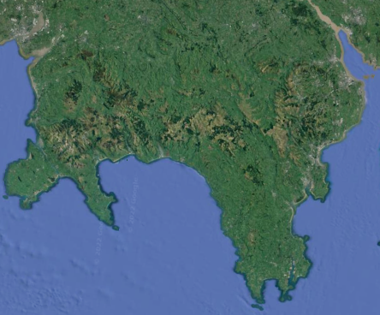
1. In which direction is north on the image below?
B
A
C
D
1. Ymha gyfeiriad mae’r gogledd ar y map uchod?

Slide 69
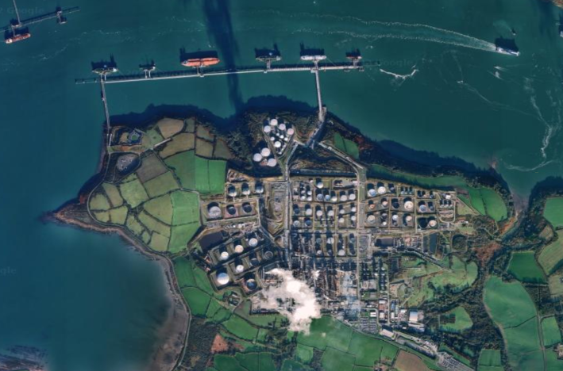
2. What economic activity is shown in this image?
2. Pa weithgaredd economaidd welir yn y llun?

Slide 70
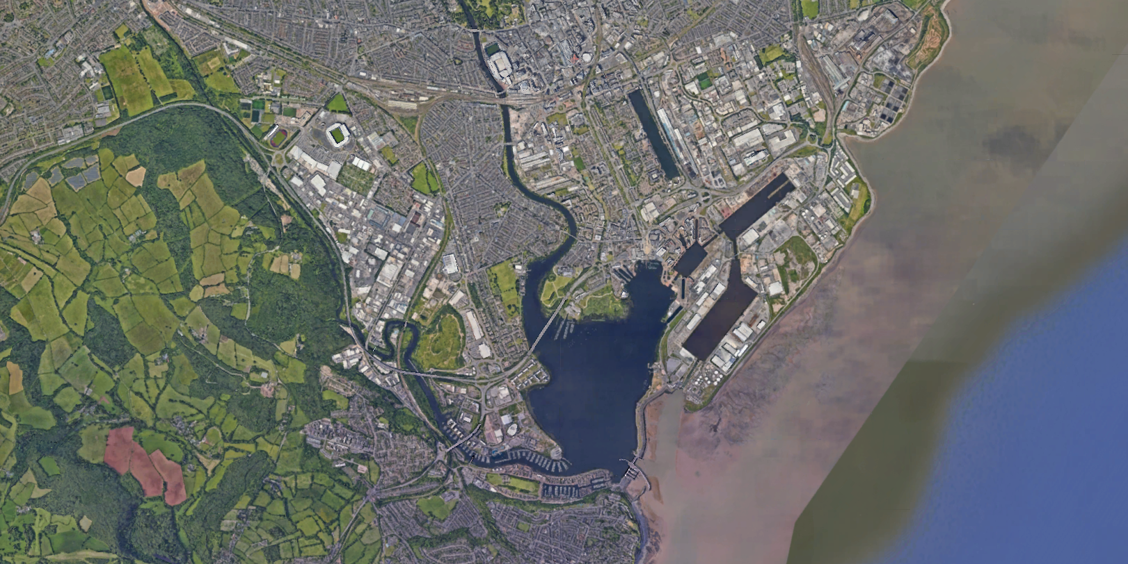
3. What is the construction marked X on the photograph?
X
3. Beth yw’r nodwedd sydd wedi ei farcio gyda X yn y llun?

Slide 71
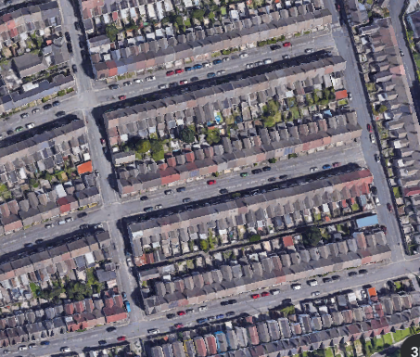

4. Which area of housing is likely to be the oldest?
A
B
4. Pa ardal o dai sy’n debygol o fod hynaf?

Slide 72

5. What is the significance of the dashed line on the map?
5. Beth yw arwyddocâd
y llinell doredig ar y
map?

Slide 73

6. What land use is shown in this image?
6. Pa ddefnydd tir welir yn y llun?

Slide 74

7. What is the name for this pattern of settlement?
7. Beth yw’r enw ar y
patrwm anheddiad yma?

Slide 75

8. What land use is found at point X ?
âr
âr
A arable
B woodland
C pasture
D quarry
A âr
B coetir
C porfa
D chwarel
X
8. Pa ddefnydd tir sydd i’w weld ym mhwynt X?

Slide 76


Well done!
Da iawn!

Slide 77

Tie breakers / Gwahanu’r goreuon!

Slide 78

1. In the World Wide Web what is the domain name for a welsh based website?
1. Ar y We Byd-eang beth ydy’r enw a roddir i wefan a sefydlwyd yng Nghymru?

Slide 79

2. Which two lines of latitude lie across Wales?
51⁰N and 52⁰N
52⁰N and 53⁰N
53⁰N and 54⁰N
2. Pa ddwy linell lledred sy’n gorwedd ar draws Cymru?
a) 51⁰G and 52⁰G
b) 52⁰G and 53⁰G
c) 53⁰G and 54⁰G

Slide 80

3. Which village in South Wales saw a coal mine disaster in 1966 that killed 166 of the village’s school children?
3. Ym mha bentref yn Ne Cymru yn 1966 y gwelwyd
trychineb lofaol a laddodd 166 o blant ysgol y pentref?

Slide 81

4. Which King built a large, linear earthwork between
Wales and England in the 8th Century?
4. Pa frenin adeiladodd glawdd rhwng Cymru a Lloegr yn yr
8fed ganrif?

Slide 82

5. Name the stadium in which the Ospreys rugby team play.
5. Enwch y stadiwm lle mae tim rygbi’r Gweilch yn chwarae.

