Slide 1


Retrieval practice: How can students use it metacognitively to monitor and improve their learning in Geography
Dr J Campbell
Subject Leader for Geography at President Kennedy School
MA in Teaching Studies
campbellj@pks.coventry.sch.uk
@jennycampbell90

Slide 2

The power of retrieval practice
Helps with the activation of prior knowledge, helping to free-up the working memory.
Self-testing is also a way for students to learn.
Not just for recalling facts – evidence suggests it helps with systemic and synoptic thinking.
It is a crucial revision tool.
Schema building.
Opportunity for check-in.
Notes:
MA research, helps with knowledge retention, making links, revision (spaced practice)
Schema – we draw on our prior knowledge to help us make connections and create meanings (which helps us to remember new information more easily)

Slide 3
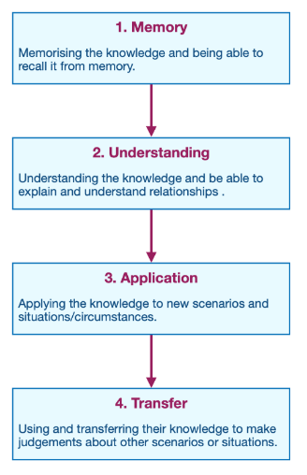
The power of retrieval practice
Retrieving information is not just useful for recalling facts, but is used when explaining or analysing a concept, transferring knowledge to solve a new problem and when stimulating new ideas (Karpicke and Grimaldi, 2012).
The four domains of learning, adapted from Krathwol et al. (1964).
Notes:
MA research, helps with knowledge retention, making links, revision (spaced practice)
Schema – we draw on our prior knowledge to help us make connections and create meanings (which helps us to remember new information more easily)

Slide 4
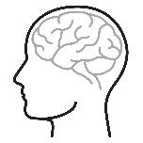
Metacognition vs cognition
Cognition is the process of learning
Metacognition is ‘the ways learners monitor and purposefully direct their learning’ (EEF, 2019)
It is students learning how to learn.
It teaches students to become self-regulated learners, actively engaging in and reflected on their own learning.
Metacognition enables students to use cognitive strategies such as retrieval practice to help regulate their own learning
Notes:
Common misconception
High impact, low economic cost
Highly useful for disadvantaged and SEND students

Slide 5
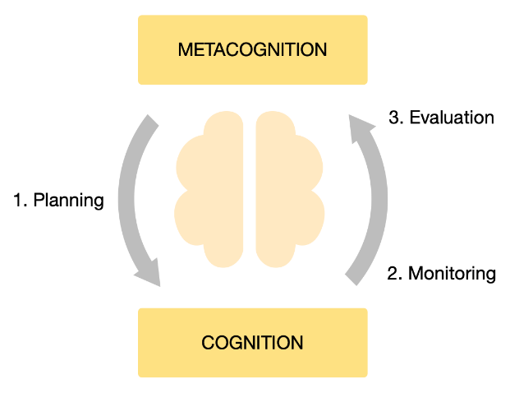
Metacognition
Planning— encouraging pupils to think about the goal of their learning how they will approach the task
Monitoring—the need, while undertaking the learning task, for pupils to assess the progress they are making
Evaluating—appraising the effectiveness of their learning and the strategies used
(EEF, 2019)

Slide 6
Metacognition and retrieval at home
Students often have little idea about the most effective way for them to learn/revise at home (Karpicke, Butler and Roediger, 2009; EEF, 2019).
Students choose comforting/less challenging techniques of re-reading and highlighting when revising, giving them an ‘illusion of competence’ (Karpicke, Butler and Roediger, 2009, p. 471)
Retrieval is one of (if not the) most effective revision tools.
Taking ownership of learning, evaluating areas of strength together with areas which need revisiting.

Slide 7
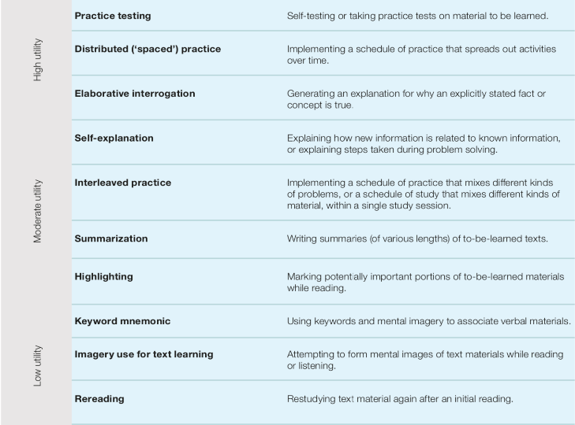
Metacognition and retrieval at home
(EEF, 2019)

Slide 8
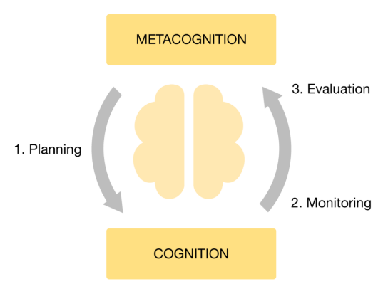
Metacognition through retrieval
Evaluation
Make sure when students have completed and marked a retrieval task in class they have time for reflection, asking themselves:
  Which questions did I get right? Why?
  Which questions did I get wrong? Why?
  What do I now need to go away and revisit/revise?
  How do I do this?
Notes:
Start in class (evaluation is the easiest stage)
Check-in and context

Slide 9
Retrieval practice in the classroom
What is energy security?
State two benefits of renewable energy.
What is the role of a decomposer in an ecosystem?
Explain one negative impact of deforestation.
Why does soft rock erode more easily than hard rock?
State two physical causes of flooding.

Slide 10

Metacognition through retrieval practice
Planning
Students are involved in building their own quizzes
The question design will need modelling in the classroom, and will take time before students can do this independently
Students will need to have completed retrieval regularly in class, to buy-in to the strategy
Notes:
Modelling which questions to ask themselves
If they are not used to retrieval and it’s effectiveness they will quite simply cheat and not do it properly

Slide 11
Metacognition through retrieval practice
Monitoring
Once a student has designed their own quiz, they will need to wait 3 days and answer the questions from memory.
Once the quiz is completed, they can then mark their answers using their class books/revision guide.

Slide 12
Metacognition through retrieval practice
Evaluation
Make sure once students have completed and marked the quiz, reflect, asking themselves:
  Which questions did I get right? Why?
  Which questions did I get wrong? Why?
  What do I now need to go away and revisit/revise?
  How do I do this?

Slide 13
Metacognition through retrieval practice
Students in my GCSE and A level classes now complete this cycle at home once a week.
It is their main form of revision.
Plan
Design the quiz
Monitor
Complete and mark the quiz
Evaluate
What do I now need to revise?

Slide 14
Metacognition through retrieval practice
This is the students actively monitoring and improving their own learning.
It is important to note:
  This will take time – it is not a quick process
  Retrieval needs to be embedded in the classroom first – students need to see the results before they do it independently.
  Conversations in the classroom are crucial to ensure students are carrying it out effectively.
  The marking is not the final step of the process – they must use this to target additional revision.
This should be their main form of revision.
Notes:
Conversations need to continue in lesson once the students are doing it independently
They can reuse quizzes

Slide 15
Key findings
The use of metacognition through retrieval practice has a positive impact on both confidence and long-term learning of KS4 students in Geography when used regularly and consistently.
Students commented on the importance of being able to identify their own strengths and weaknesses without relying on teacher support.
They highlighted that once they realised the benefits in using retrieval practice, they became more confident using it at home, monitoring and evaluating their own learning effectively.
Retrieval practice needs to be carried out regularly to have the greatest impact.
The need for motivation and engagement is crucial for retrieval practice at home to work; the effort needs to come from the student.

Slide 16
Key findings
Students thought that retrieval practice had improved their progress in Geography, including:
  their ability to recall knowledge
  applying that knowledge in exam questions
  forming links between different concepts, a critical skill for Geographers.
The study suggests that those students who practised retrieval at home had a greater improvement in their confidence and academic learning than those who only practised it in lessons.
Students in this study opted to conduct retrieval practice when revising for other subjects, as they believed that it had really benefitted them in Geography.

Slide 17
Pupil voice
‘Forming my own questions helped me to interpret and understand the topics in my own way, meaning I remember them better.’
‘I started to understand Geography better, I love it a lot more. I’ve got a lot more passion for the subject and it is really is very interesting to me. I want to learn more!’
‘before, I relied on the teacher, but now I can do it myself, it makes me a lot more confident’
‘to start with I found it hard and didn’t really like it. But actually, due to my improvements I got more confident’
‘It has played a significant part towards helping me strengthen my memory, as well as tackling my weaker areas in Geography.’
‘making your brain work like hard to recall the erm information helps you to remember if for longer.’
‘the more confident and say like comfortable you get with it, the more you feel you can like change it to suit you’

Slide 18
Key findings - modelling
Modelling is a fundamental element for helping students to use retrieval practice to apply the knowledge they are recalling.
The modelling, scaffolding and support gave the students the confidence to use metacognition at home, initially through homework, but eventually through their own choice.
The students can only be successful in self-study if they are shown how to effectively conduct retrieval practice independently.
This includes showing students how to select questions/topics, and what do do once they have marked their answers.
This scaffolding then needs to be gradually removed.

Slide 19

Key take-aways
Consistency both in and out of the classroom
Buy-in in the classroom before trying it independently
Scaffolding/modelling is critical
It takes time!
Any questions?
campbellj@pks.coventry.sch.uk
@jennycampbell90

