Slide 1
Fieldwork in the new normal
Andy Owen | Principal Moderator OCR | 09/04/2021

Slide 2
Aims of this workshop
How can and why should we return to fieldwork in the post-Covid era?
This workshop will explore:
How fieldwork can make sense of recent events.
The need for progression in planning fieldwork from KS3 to NEA.
Safe strategies for real and virtual fieldwork using the local area.

Slide 3
Why should we return to fieldwork?
□ Fieldwork enquiry provides a context for a number of research and enquiry skills.
It consolidates numeracy, graphical, and analytical skills.
It provides a context for critical thinking skills such as the ability to select, justify and evaluate.
□ Lockdown has created opportunities for geography to re-examine specialised concepts such as space and place.
□ Fieldwork allows students of all ages and abilities to engage with contemporary issues affecting their local place.

Slide 4
Section 1
How fieldwork can make sense of recent events

Slide 5
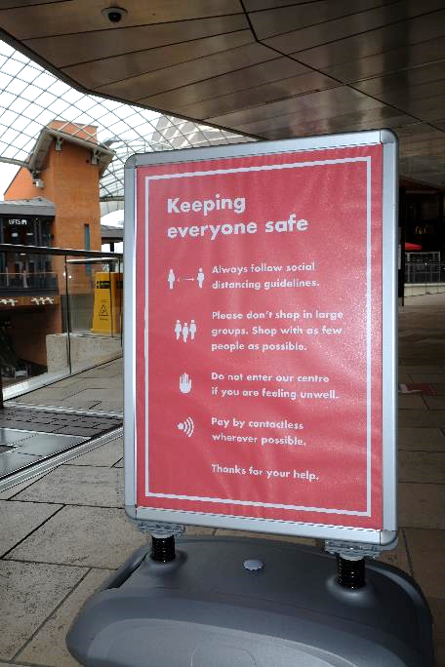
The concept of space is now more widely understood
Our perception of space has changed / come into sharper focus. We have become aware of the concept of social distancing in various geographically defined spaces, for example, in:
□ Enclosed spaces
Public spaces, especially in the high street and around public transport hubs
Open spaces such as beaches or urban green spaces
Public behaviour has also been scrutinised in these spaces.
For example:
□ Whether the use of space causes conflict between users, for example, whether joggers or cyclists should wear masks
□ Whether a vigil or demonstration is ethically acceptable during lockdown restrictions.
Mitigation of risk
Space
Inequality
Photo © Andy Owen

Slide 6
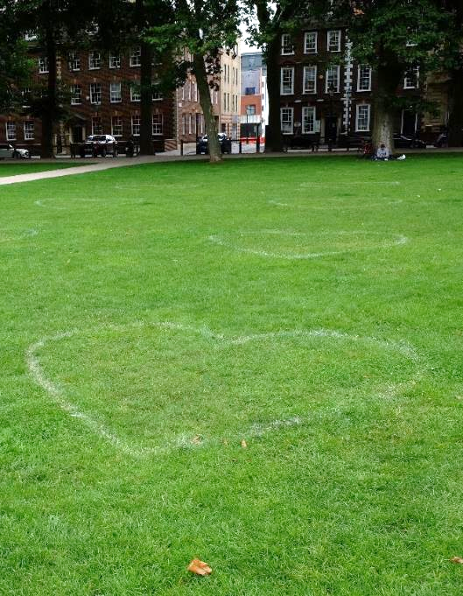
Geographical space in the headlines
‘ “Kill the bill” protesters clash with police again in Bristol.’ The Guardian 4 April 2021
‘Sarah Everard vigil: Met accused of “institutional sexism” after review finds police “acted appropriately”.’ The i News 30 March 2021
‘Joggers should wear face masks when running past others, scientists say.’ The Independent 2 March 2021
Photo © Andy Owen

Slide 7
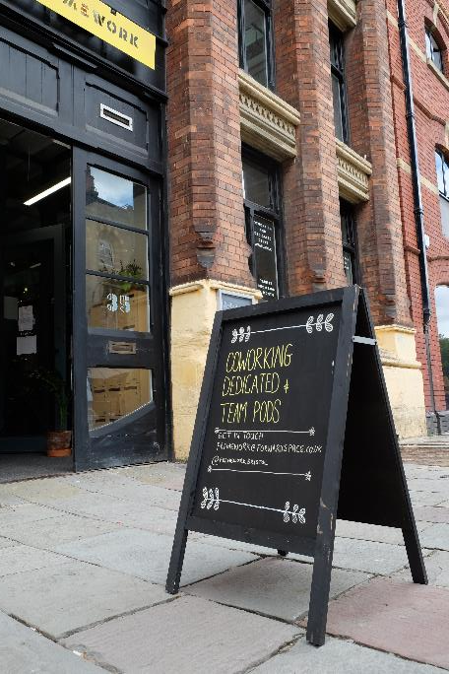
Changing patterns of work
How many people will continue to work from home when restrictions ease?
Will there be a demand for city centre office space in the future?
If people continue to work from home what might be the impact on where people choose to live? Might we see reduced demand for apartments in inner city locations and increased demand for homes in the countryside?
‘Covid-19 has changed working patterns for good, UK survey finds.’ The Guardian 5 October 2020
Gentrification
Commuting
Regeneration
Counter-urbanisation
Photo © Andy Owen

Slide 8
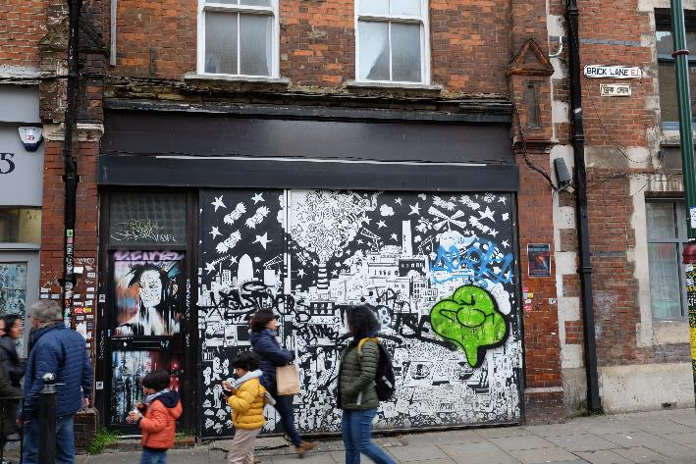
Decline of the high street
In 2020 17,500 stores were closed in Great Britain and 7665 new stores opened.
Net loss = 9,877 stores.
Lockdown restrictions accelerated an existing trend caused by online retailing.
How will hospitality businesses respond when restrictions are eased?
Will the night time economy recover?
How will town centres adapt to these changes?
Regeneration
Place
Photo © Andy Owen
Identity
Rebranding

Slide 9
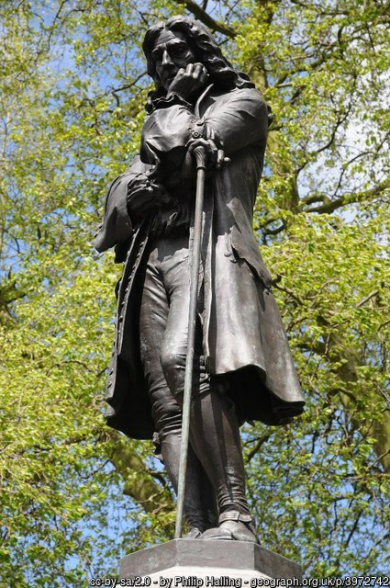
Black lives matter / decolonisation
The death of George Floyd in America triggered BLM protests in many countries, in spite of lockdown.
In Bristol, the statue of slave-trader Edward Colston was toppled.
The event has triggered a discussion about institutional racism, the impact of the colonial past on UK identity and decolonisation of the curriculum.
Further reading:
https://blogs.sussex.ac.uk/snapshotsofempire/2021/04/01/comments-on-the-report-of-the-commission-on-race-and-ethnic-disparities/
Inequality
Place
Identity
Informal representation
Further reading:
https://blogs.sussex.ac.uk/snapshotsofempire/2021/04/01/comments-on-the-report-of-the-commission-on-race-and-ethnic-disparities/
Notes:
© Copyright Philip Halling and licensed for reuse under this Creative Commons Licence

Slide 10
Section 2
The need for progression in planning fieldwork from KS3 to NEA.

Slide 11
What is fieldwork enquiry?
Plan
Collect
Present
Apply
Review
A geographical enquiry is a cyclical process used by the student to answer a research question through the analysis of relevant data.
A fieldwork enquiry requires the use of some primary data.
Primary data includes photographs and ‘big data’ (such as census data) that have not been processed.

Slide 12
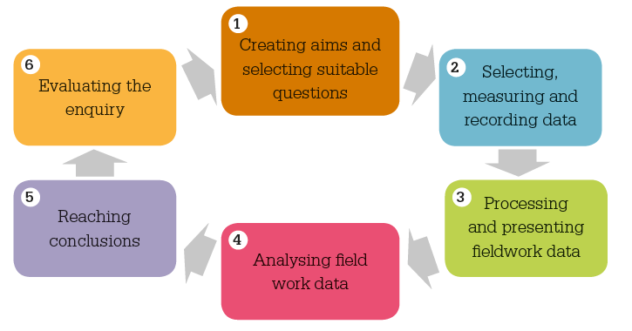
What is a quality fieldwork enquiry?
In a quality fieldwork enquiry students are actively engaged in each stage of the enquiry process.
Students become critical thinkers rather than passive participants.
Students are involved in decision making during each stage of the process, including creating aims/posing research questions.
Students are able to:
  Justify their decisions/methods
  Evaluate the process

Slide 13
Models of fieldwork enquiry (after M. Roberts)
Three models of enquiry
Increasing levels of student independence
 | Closed enquiries | Framed enquiries | Semi-independent enquiries | Independent enquiries
Question | A task is presented. Questions are not explicit. | Explicit enquiry questions are set by teacher. Students may select and justify their choice of enquiry questions. | Students decide enquiry questions, framed by teacher’s choice of context and location for the fieldwork. | Students select and justify enquiry questions.
Data | Decisions about data and learning process made by teachers. Data are given as authoritative. | Decisions about which data are collected how it is collected and are made mostly by teachers. Students learn to justify these decisions. | The teacher plays a vital role in facilitating data collection and sampling strategy. Students are involved in key decisions about data and its collection. | Students make key decisions about data and sampling strategies – although data may be collected collegiately
Make sense | Activities devised by teacher to achieve objectives. Students follow instructions. | Ways of representing data are open to discussion and choice. Students justify their decisions. | Teachers facilitate methods of quantitative/ qualitative analysis. Students analyse evidence independently. | Students analyse evidence and reach conclusions independently.
Reflect | Predictable outcomes – what the teacher wanted. | Teacher structures the process. Students evaluate the process and methods used. | Teacher structures the process. Students discuss the validity and reliability of the data. | Students independently consider validity / reliability of evidence / data, methods.
Adapted from the original source: Based on Margaret Roberts, ‘Geography through enquiry’, Geographical Association

Slide 14
Skills that students need to demonstrate during fieldwork enquiry
select
collect
interpret
present
Reading the data and inferring meaning
Knowledge of research frameworks - their reliability, accuracy and validity
Understanding data types and a range of suitable methods
Selecting and justifying appropriate (or suitable) methods of data presentation

Slide 15
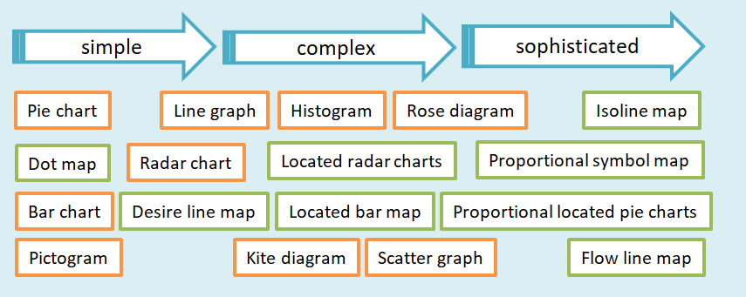
Simple or sophisticated?
What maps/graphs do students need to be able to use?
At which key stage do we introduce them?
Source: Andy Owen (2019) A Level Geography Independent Investigation. Insight and Perspective

Slide 16
Planning skills progression
Interpretating an isoline map
Simple text analysis
Interpreting a choropleth
Plotting an isoline map
Coding
Plotting a choropleth map
Interpretating a scatter graph
Annotation
Plotting a scatter graph
Calculating Spearman’s Rank Correlation Coefficient

Slide 17
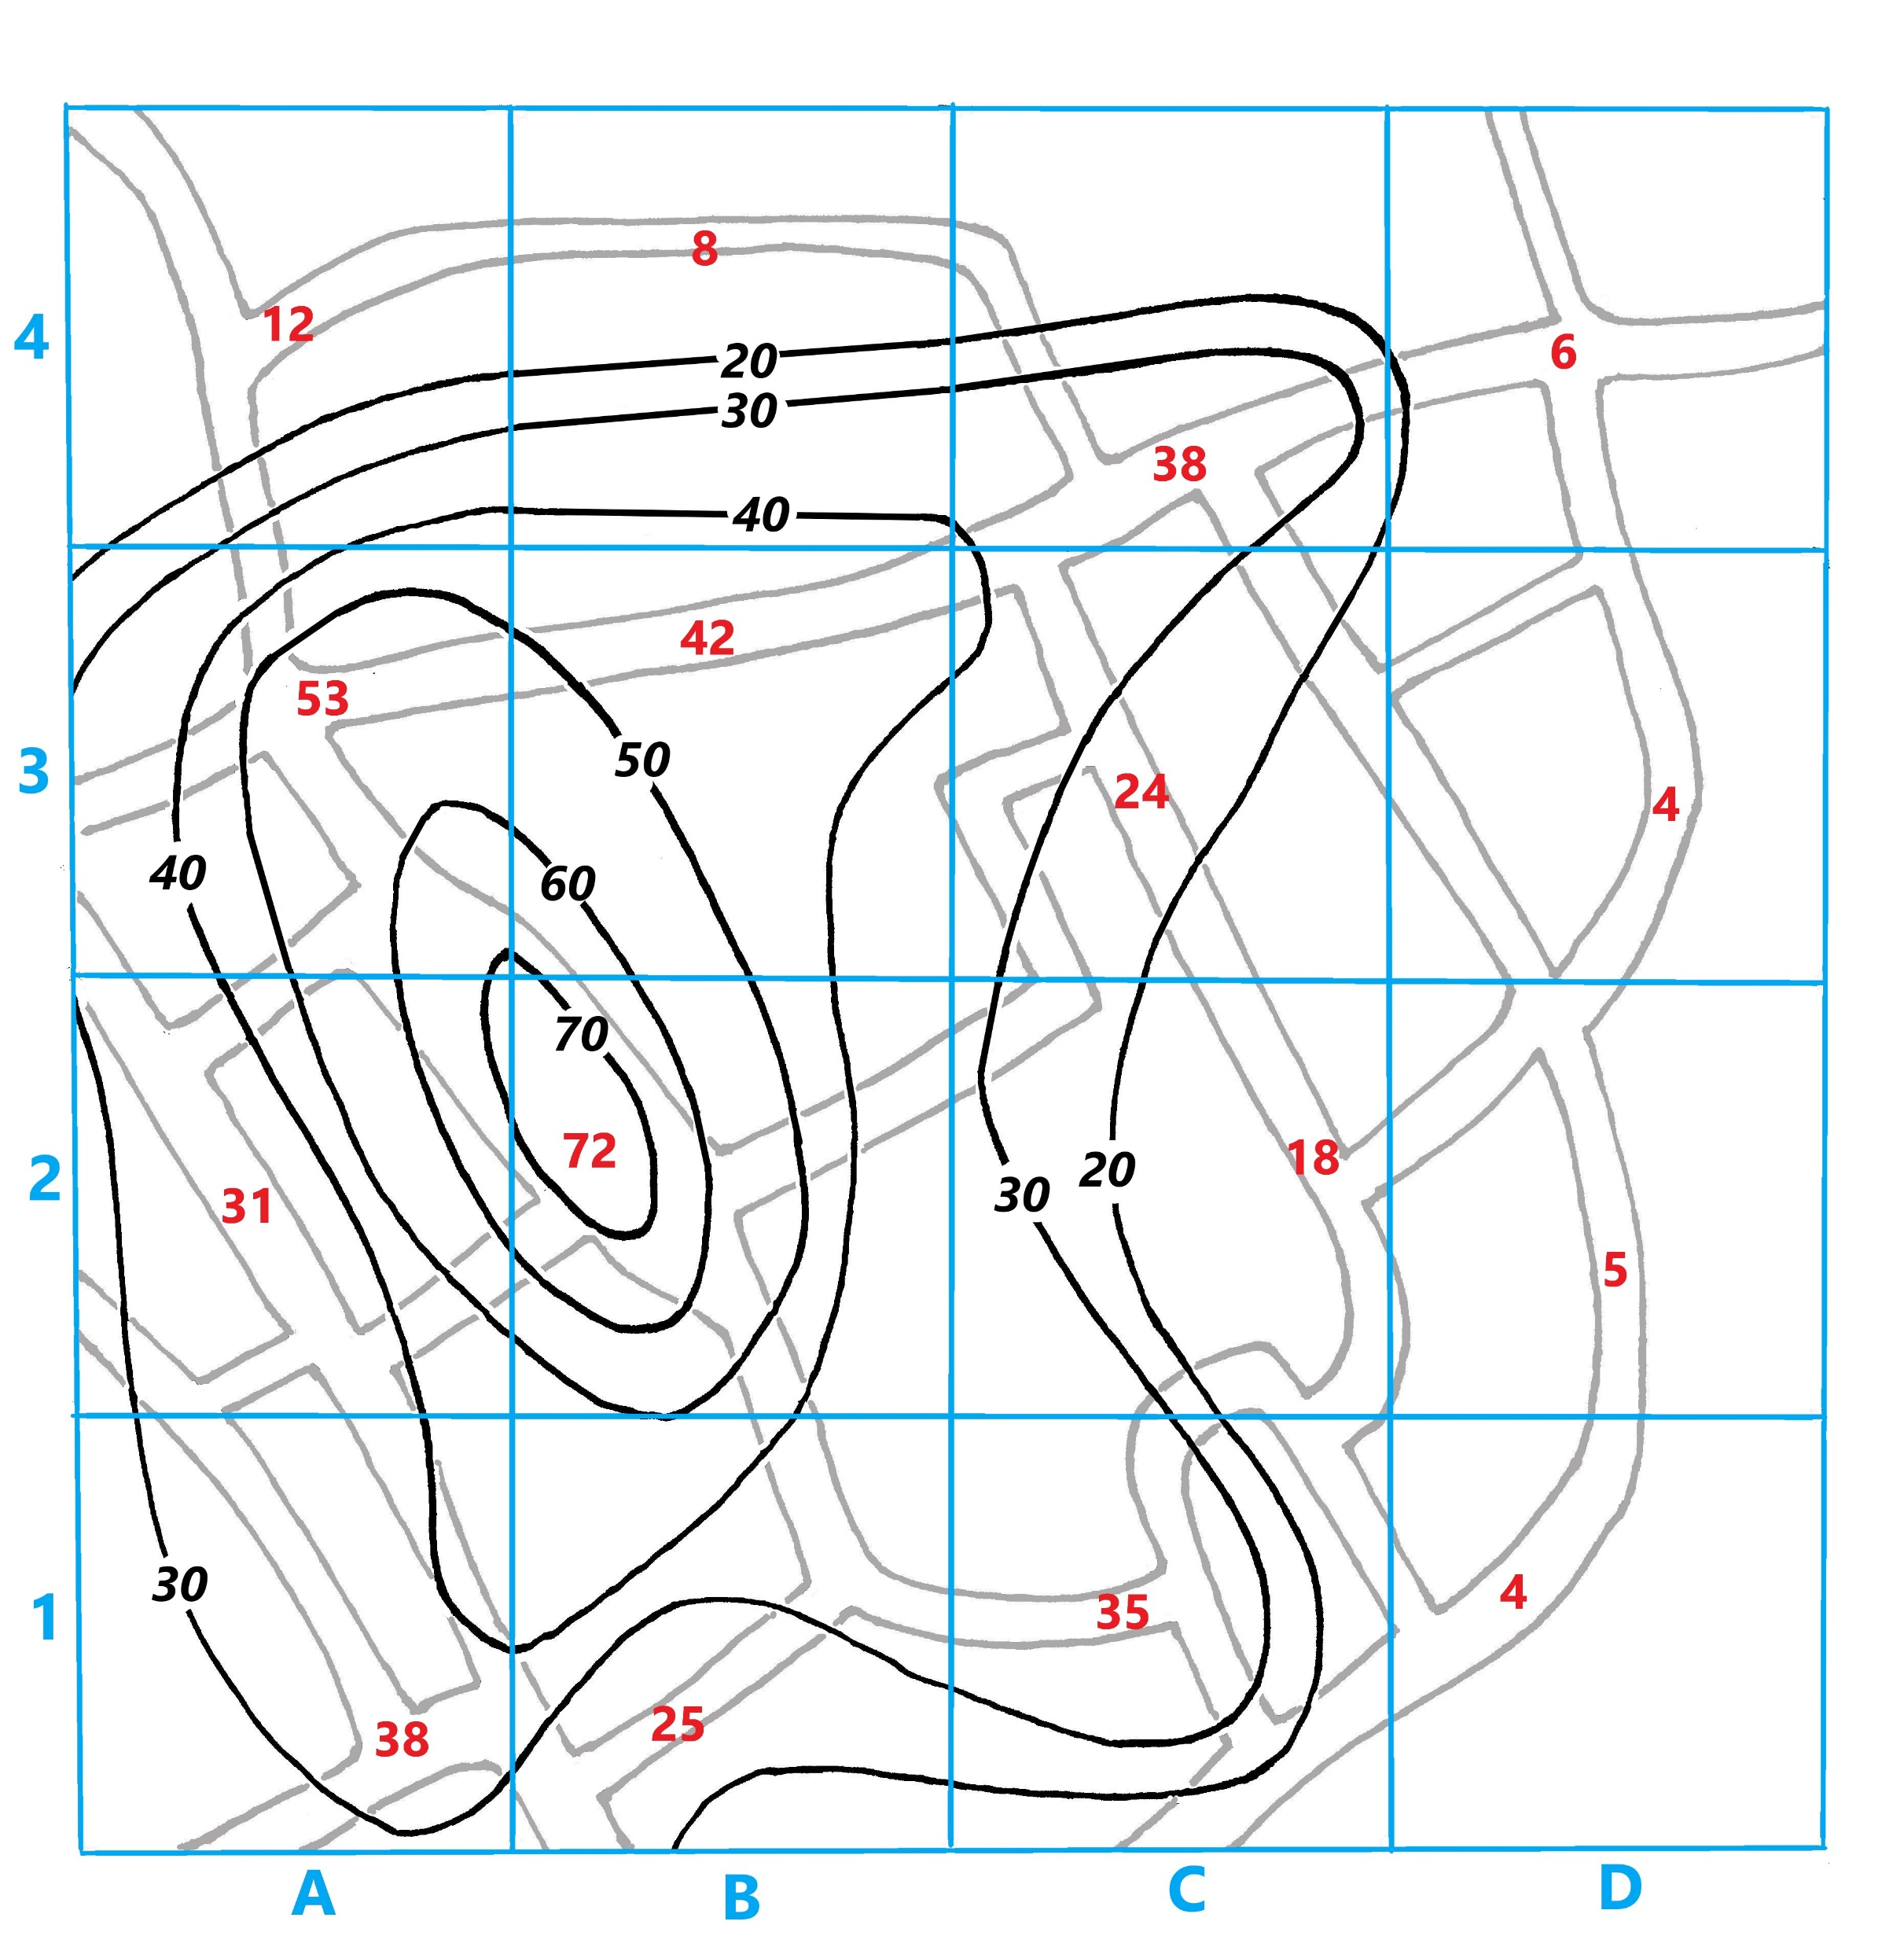
Key questions for the geography department
Has the department planned progression through KS3 to GCSE of numeracy and graphical/cartographic skills?
As well as teaching students how to draw (a list) of graphical techniques have we given them the information they need to select an appropriate technique?
Do students have regular opportunities to practice numeracy and graphical skills?

Slide 18
Section 3
Safe strategies for real and virtual fieldwork using the local area

Slide 19
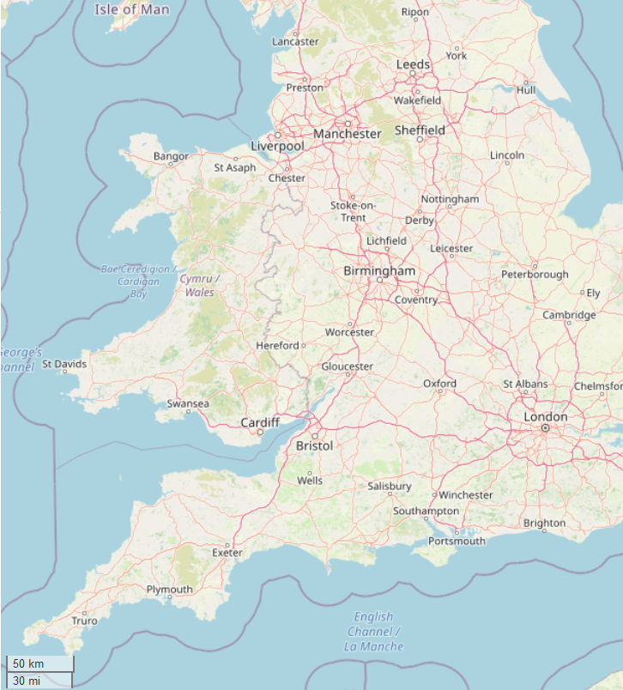
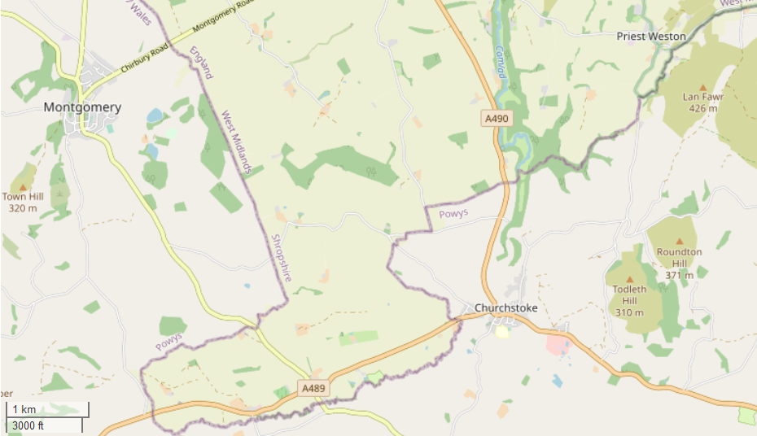
Stay local
Lockdown has had an impact on our sense of scale – the absence of travel has had the opposite effect of time-space compression that we normally experience. Consequently, we are all becoming more aware of our local place.
©OpenStreetMap contributors
Notes:
https://www.openstreetmap.org/copyright

Slide 20
Photographs
Photographs
TIP Use a free digital survey tool such as Survey Monkey or Smart Survey, or a video conferencing tool such as Zoom or Microsoft Teams, to avoid face-to-face meetings.
Students can use photos in several different ways. They can:
□ Show photos of particular places that are of relevance to the investigation to participants of a survey and ask them to respond to them emotionally or as part of an interview.
□ Take photos of places and then annotate them. Annotation is important – it demonstrates interpretation of evidence in the photo which is a key analytical skill.
□ Find photos of places from a secondary source that were taken in the recent past and then visit that location and take a new photo (a technique called re-photography).
If it is not possible to make an actual field visit, students could make a virtual visit using Google Street View and take screen shots to collect their photos.
TIP You could use Google Street View to compare the current street scene to a recent historic date (i.e. pre Covid-19). If you are shielding you could use Street View instead of an actual visit.

Slide 21
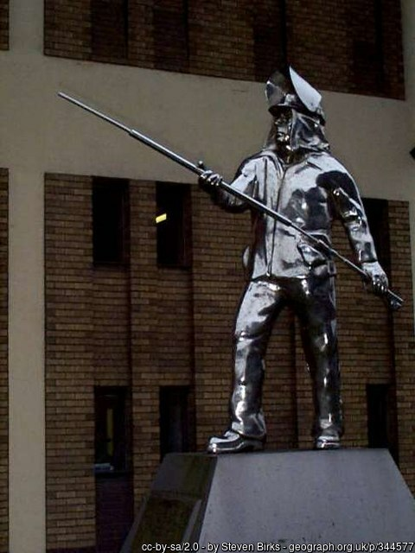
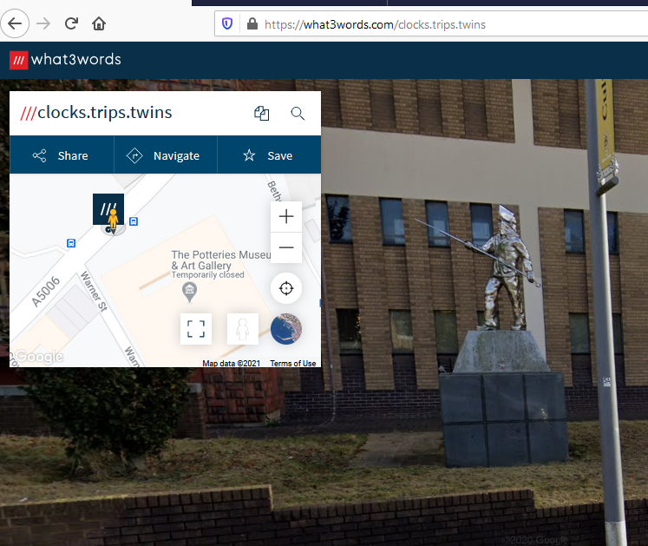
Virtual fieldtrips
The use of What 3 Words allows students to visit specific locations in a virtual world or create their own fieldtrips.
Notes:
"The Steel Man", Hanley
cc-by-sa/2.0 - © Steven Birks - geograph.org.uk/p/344577

Slide 22
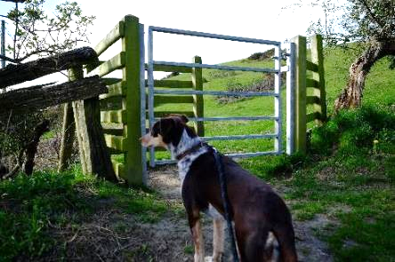
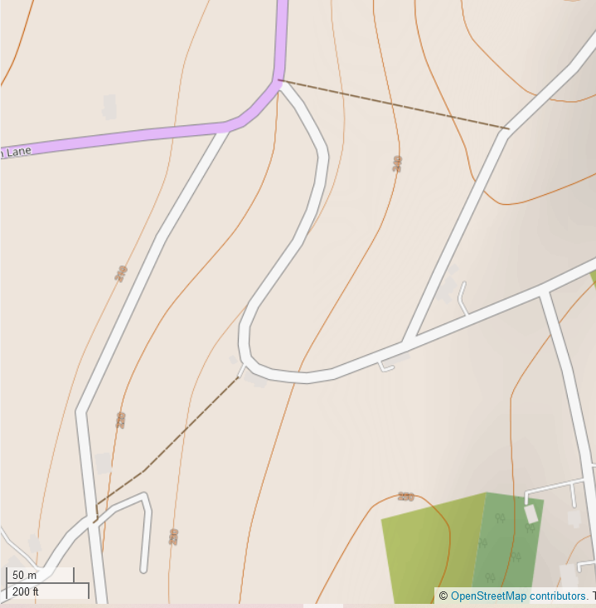
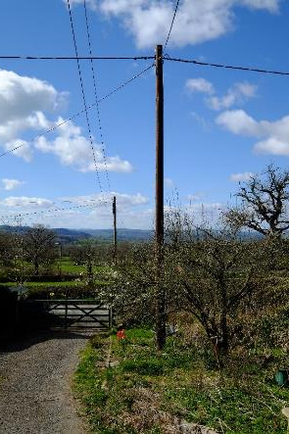
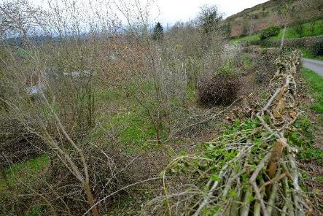
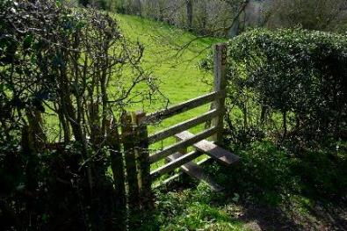
Photo elicitation
Freedom
Photo © Andy Owen
Resignation
Photo © Andy Owen
Pride
Photo © Andy Owen
Frustration
Photo © Andy Owen

Slide 23
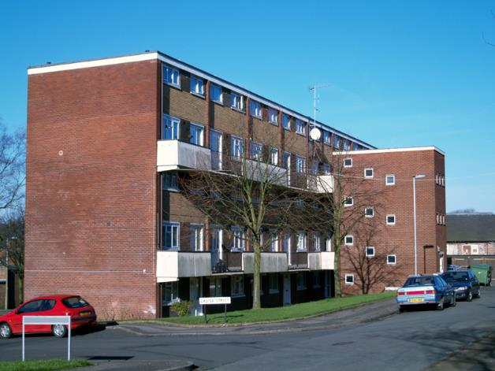
Student voice and empathy
Students can use their own photos to map the perception of the college site – student voice.
Photos can be collected remotely from students, family members or local residents to map perception of the local area – encouraging empathy for the views of others
Photo © Andy Owen

Slide 24
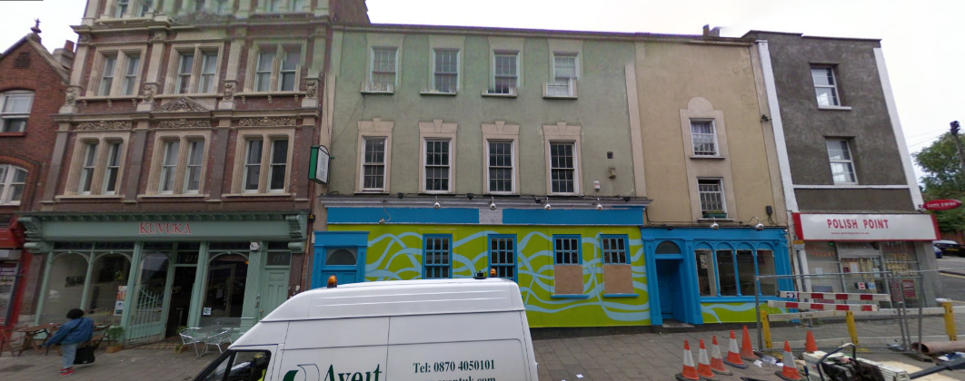
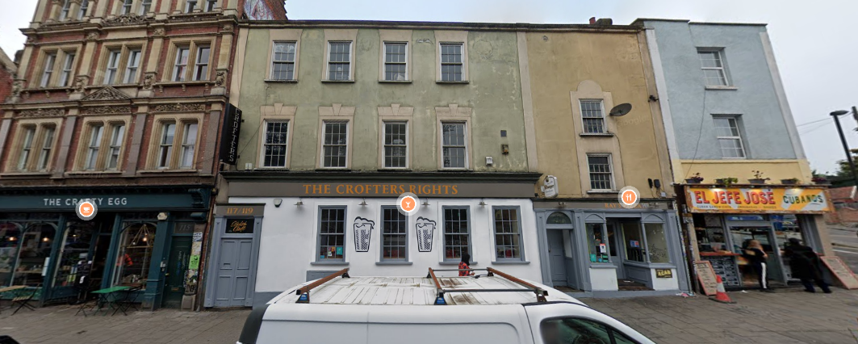
Stoke’s Croft
2008 - 2020
2008
Images from Google Street View
What3words
geo-location: scores.rushed.organ
2020

Slide 25
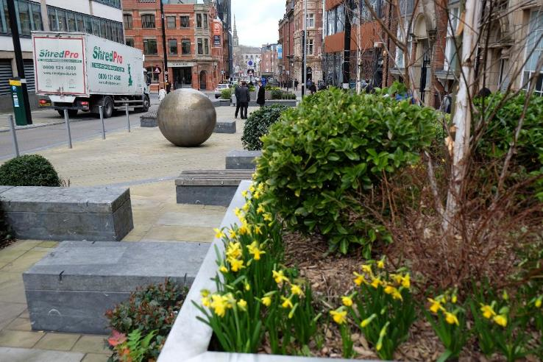
Annotation is a form of analysis
Delivery van parked partly on the pavement
… so space is restricted for pedestrians. This means that partially sighted pedestrians or people in wheelchairs may find the pavement inaccessible.
Trees have been planted
… so some particulates from vehicles will be absorbed by the vegetation. This means that local residents will benefit from better air quality.
Photo © Andy Owen

Slide 26
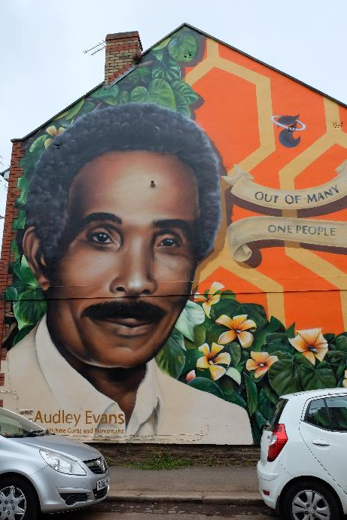
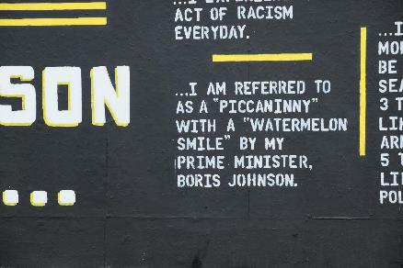
Investigating place and identity
Street art, monuments, statues and even street names help to ‘make’ places and create identity – sometimes places have strong connections to a colonial past.
This is one of seven murals in Saint Paul’s, Bristol to celebrate the contribution of black Bristolians.
Students might use:
□ their smart phones to photograph street art and record its geo-location so they can create a walking tour
□ word association to record how the urban environment makes them feel
Photo © Andy Owen
Photo © Andy Owen

Slide 27
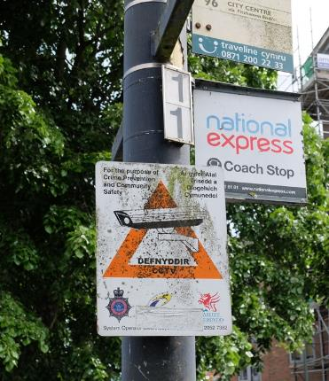
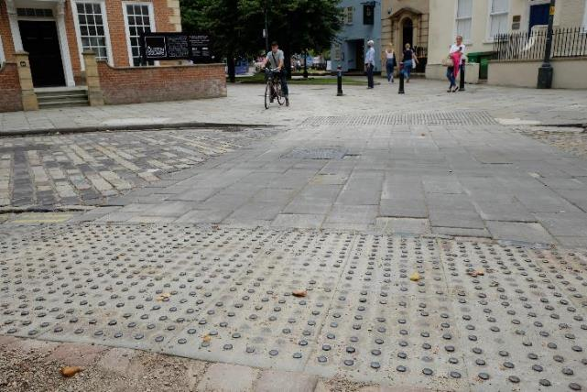
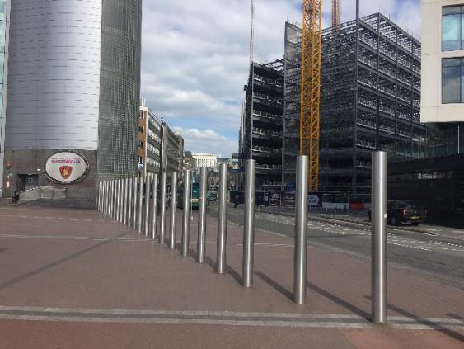
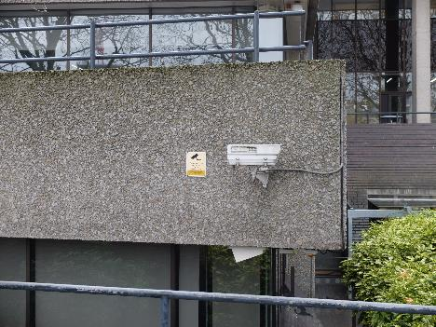
Making spaces safer in the local context
Fieldwork can be used to investigate the ways in which streets can be made safer for the public, for example:
□ Accessibility
□ Textured paving
□ Use of CCTV or street lighting
Photo © Andy Owen
Photo © Andy Owen
Photo © Andy Owen
Photo © Andy Owen

Slide 28
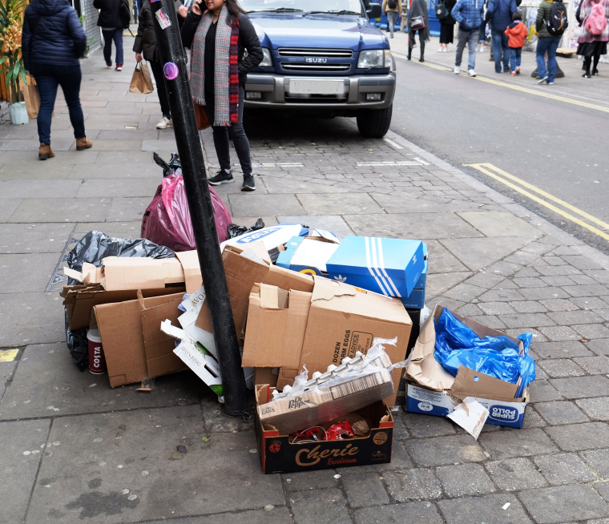
Simple fieldwork strategies
Students might use:
□ an Accessibility Index to assess how easily and safely people can access aspects of the urban landscape
□ a Cleanliness Index to assess the amount of litter, graffiti and fly posting
□ sound mapping to record their experience of different urban environments such as pedestrianised streets, urban parks, towpaths.
□ photography to record their own perceptions of place identity, for example, by photographing iconic buildings (traditional and contemporary), public works of art, or landscape details that indicate a cultural or historical significance
Photo © Andy Owen

Slide 29
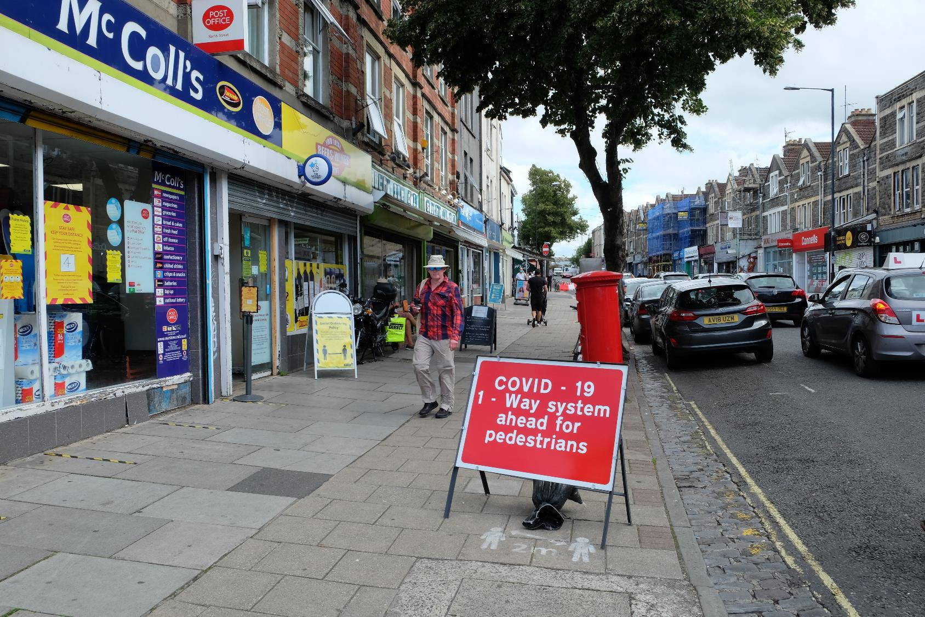
Pedestrian behaviour in a local context
Students could count flows of pedestrians or traffic in a number of contexts:
□ In an investigation of how people respond to social distancing on a pavement.
□ In an investigation of a high street that has vacant shops.
□ In an investigation of an area undergoing gentrification or regeneration.
Covid-19 has led to the adaptation of some streets and pavements by local councils who are keen to allow pedestrians free movement.
Photo © Andy Owen
Geo-location: mouth.views.pull

Slide 30
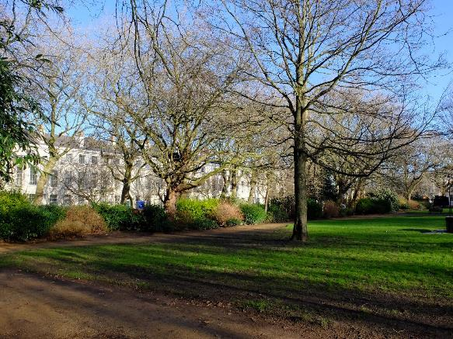
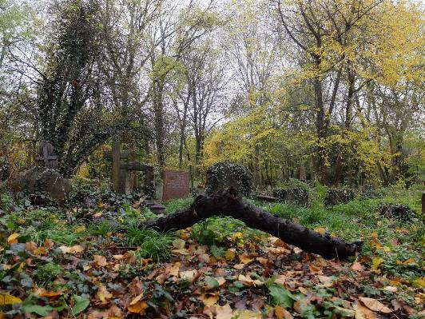
Carbon stores in a local context
Students could measure the girth of trees as a simple indicator of the carbon content of trees in a number of urban contexts.
□ In urban parks or gardens, such as this one in Liverpool (top).
□ In a churchyard, such as this one in East London (bottom).
□ In a green corridor through a town, such as alongside a canal or river bank.
□ On a suburban recreation field or play area.
Photo: Andy Owen
Geo-location: crops.tower.tops
Photo: Andy Owen
Geo-location: gates.glare.tubes

Slide 31
Ethical considerations
Students must consider the ethical dimension of your research. In particular, students must respect the:
□ dignity, safety and well-being of others
□ integrity of the place they are researching
If students can foresee a way in which the research might cause any offence, distress, or concern they will need to think of ways in which the research can be modified so these issues are removed. For example:
maintain social distancing
avoid obstructing narrow pavements when collecting data
□ wear a face covering if collecting data in a public place

Slide 32
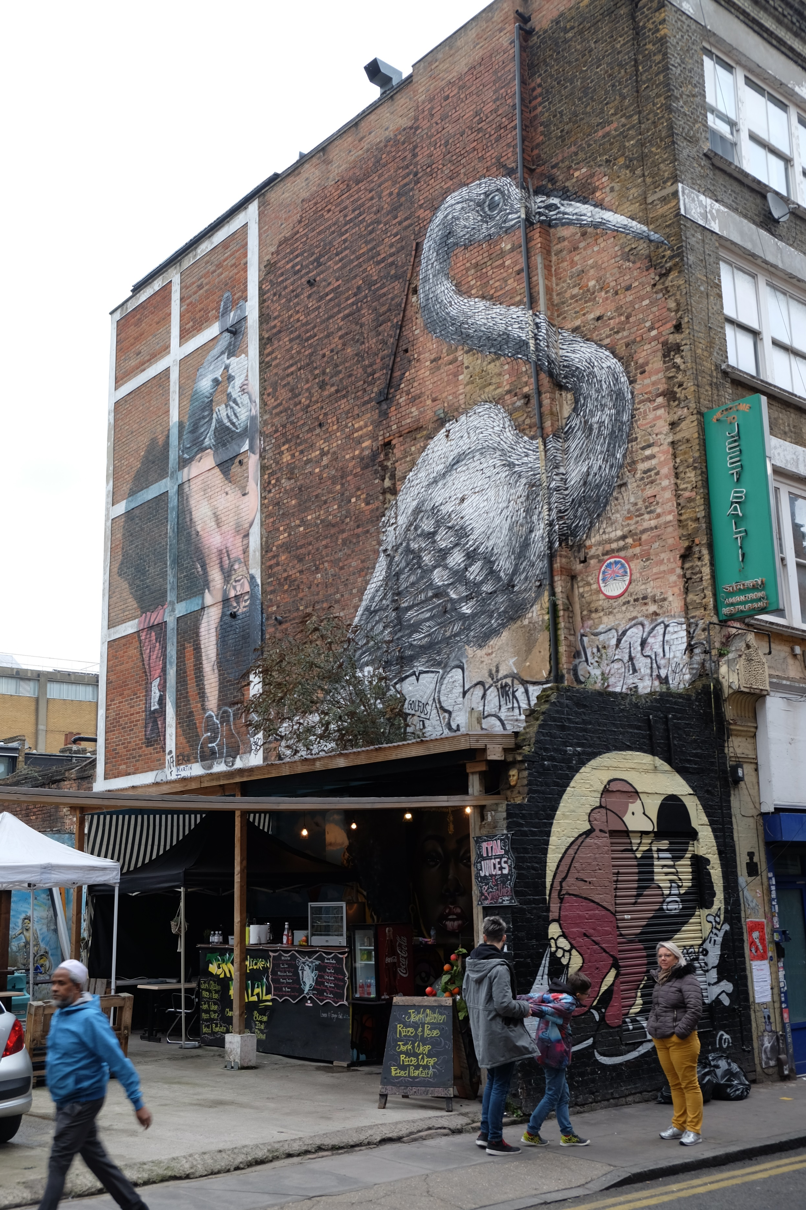
How can and why should we return to fieldwork in the post-Covid era?
□ Fieldwork enquiry requires the development of a number of research skills, numeracy and graphical skills and critical thinking skills such as the ability to select, justify and evaluate.
□ These skills need to be drip fed into the geography curriculum with consideration for progression of the learner.
□ The local environment provides opportunities for the development of these skills.
□ Blended learning may be used to develop fieldwork enquiry skills using virtual and actual fieldtrips.
□ Lockdown has created opportunities for geography to re-examine specialised concepts such as space and place.
□ While these concepts are considered to be ‘A level’ they can be used in other key stages.
Photo © Andy Owen

Slide 33
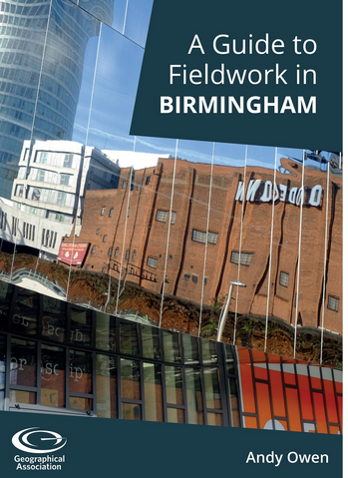
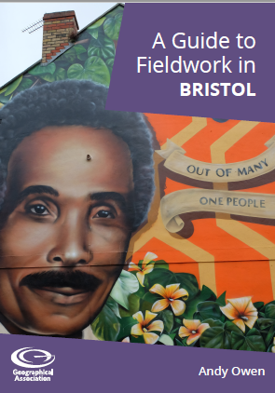
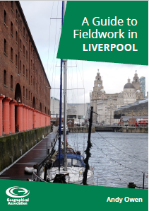
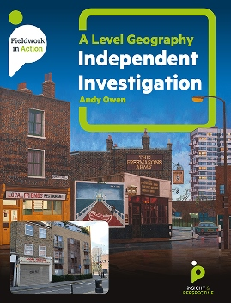
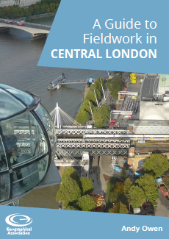
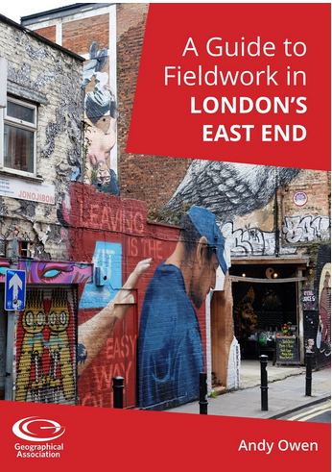
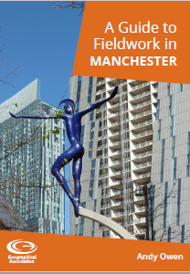
Andy Owen is a Consultant to the GA and author.
The GA has published a number of guides suggesting fieldwork activities in various UK cities. These e-books are available to download from the GA website.
Andy’s book, ‘A Level Geography Independent Investigation’ is published by Insight and Perspective.

