Slide 1



Adding mastery, breadth and depth to the curriculum through homework
Jen Monk
Head of Geography,
Golborne High School
Twitter - @jennnnnn_x

Slide 2

‘The evidence shows that the impact of homework, on average, is five months' additional progress.’ EEF April 2020
However,
homework is most effective when used as a short and focused intervention.
Benefits are likely to be more modest, up to two to three months' progress on average, if homework is more routinely set
https://educationendowmentfoundation.org.uk/evidence-summaries/teaching-learning-toolkit/homework-secondary/

Slide 3
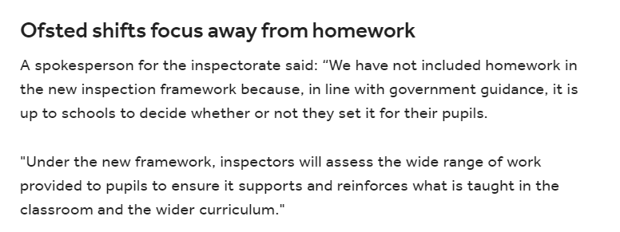

Under the last inspection regime, Ofsted grade descriptors for "outstanding" schools said teachers would “set challenging homework, in line with the school’s policy and as appropriate for the age and stage of pupils, that consolidates learning, deepens understanding and prepares pupils very well for work to come”.

Slide 4

Most homework teachers set is crap.”
Dylan Wiliam, ResearchEd 2014.
Homework is seemingly most effective when it involves practice or rehearsal of subject matter already taught.
Complex, open ended homework is often completed least effectively; whereas, short, frequent homework, closely monitored by teachers is more likely to have more impact.
I think in September 2017,
we were here.
https://researchschool.org.uk/huntington/news/homework-what-does-the-evidence-say

Slide 5
Our Key Stage 3 homework journey…
Homework was set because we had to…
Homework was completed badly by students…
Homework added to staff workload…
Homework is now meaningful…
Doesn’t add hugely to staff workload…
Allows students to build on and apply their knowledge…

Slide 6
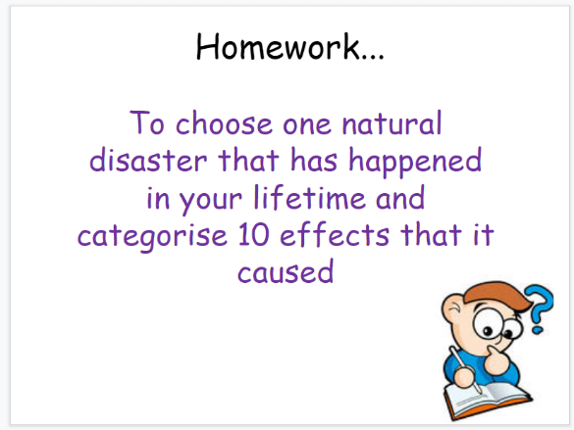
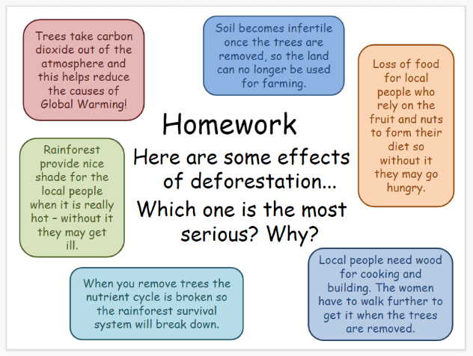
Where we were…
Finish your work from today…
Revise for your assessment…

Slide 7

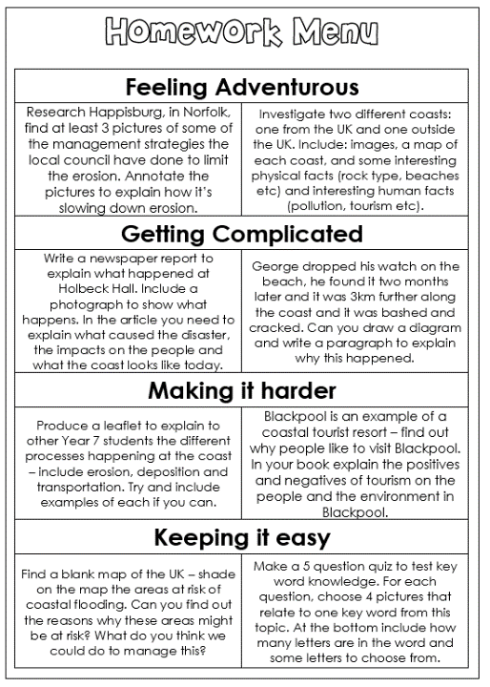
Homework menu examples…

Slide 8
So what makes homework effective?
Cathy Vatterott (2010) identified five fundamental characteristics of good homework: purpose, efficiency, ownership, competence, and aesthetic appeal.
Purpose: all homework assignments are mean­ingful & students must also understand the purpose of the assignment and why it is important in the context of their academic experience (Xu, 2011).
Efficiency: homework should not take an inordinate amount of time and should require some hard thinking.
Ownership: students who feel connected to the content and assignment learn more and are more motivat­ed. Providing students with choice in their assignments is one way to create ownership.
Competence: students should feel competent in completing homework. In order to achieve this, it’s benefi­cial to abandon the one-size-fits-all model. Homework that students can’t do without help is not good homework.
Inspiring: A well-considered & clearly designed resource and task impacts positively upon student motivation.
https://researchschool.org.uk/huntington/news/homework-what-does-the-evidence-say

Slide 9
So in order for homework to be effective we need to ask ourselves…
Has the purpose of the homework been made clear to students?
Are the students in possession of all the resources require to undertake the task independently?
What are the existing beliefs about home learning (students & teachers) that we need to recognise/​challenge?
How can we best leverage parental support for home learning that is effectively communicated?
How do you plan to provide specific and timely feedback to students on their home learning?

Slide 10


With some inspiration from @InternetGeog…

Slide 11
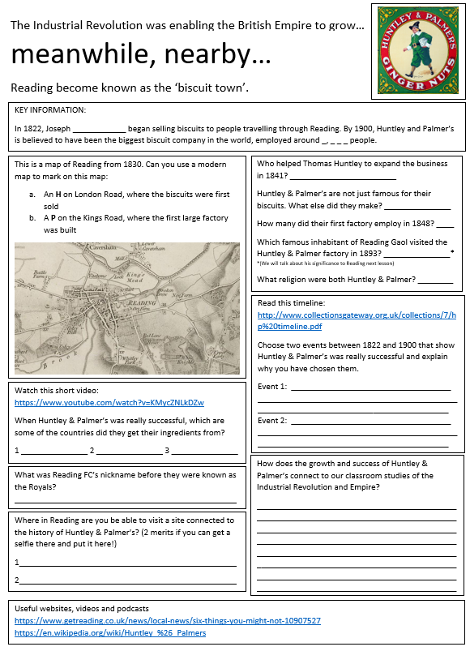
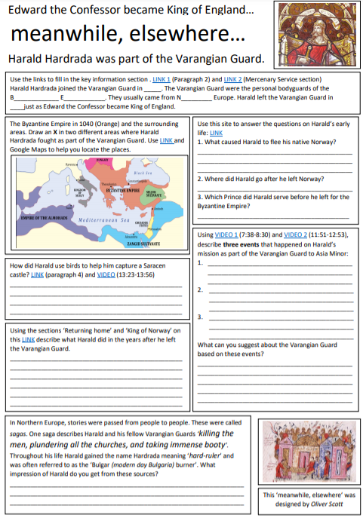
And some more inspiration from History –
Meanwhile Elsewhere

Slide 12

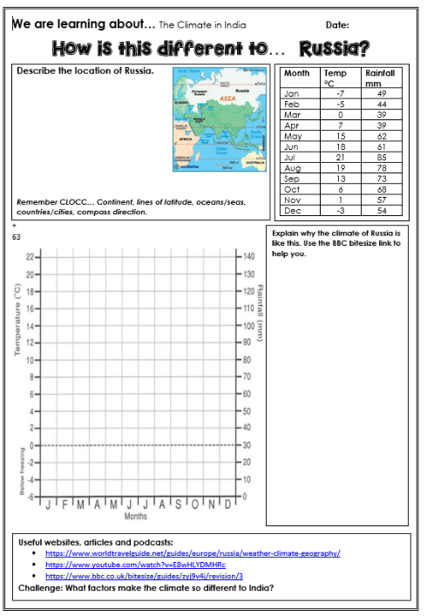
Where we began…

Slide 13
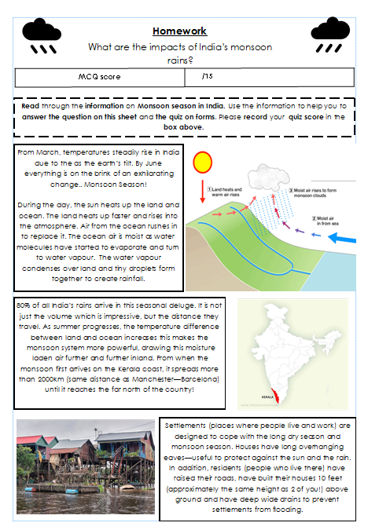
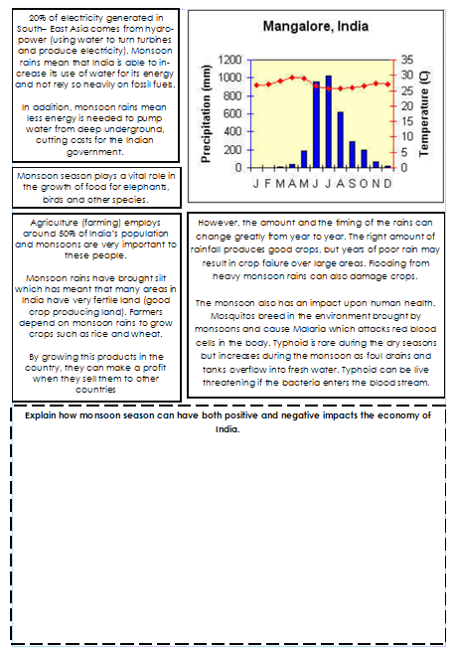
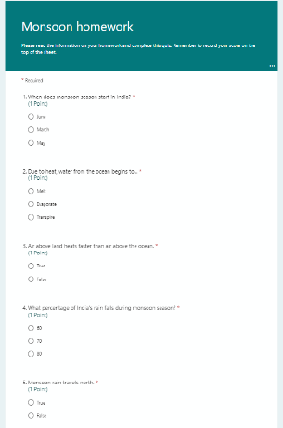
Where we are now…

