Slide 1
Simran @GeographiaUK
#GAConf21
Geography reading in the classroom
Simran Jouhal
Twitter: @GeographiaUK
Blog: geographiauk.wordpress.com
Senior Teacher at The Archer Academy, North London

Slide 2
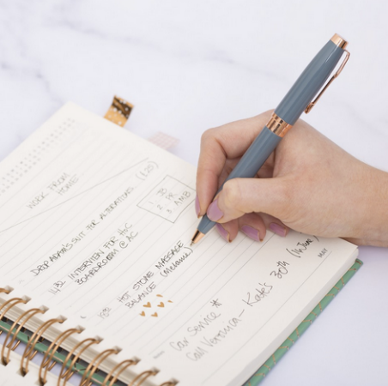
Simran @GeographiaUK
#GAConf21
Resources:

Slide 3
Simran @GeographiaUK
#GAConf21
Does reading have a place in the geography curriculum?
How so?
What are your favourite forms of text in the geography classroom?
What are the barriers to reading in the geography classroom?

Slide 4
Simran @GeographiaUK
#GAConf21
Why read in the classroom?
Reading for pleasure;
Reading issues (such as poor decoding, weak comprehension, dyslexia, and the readability and accessibility of texts for our students);
Academic vocabulary;
Teacher explanations, talk and questioning;
Improving writing;
Improving spelling and writing accuracy;
Speaking and listening;
Enhancing teacher knowledge and providing training for all of the above;
Developing parents’ knowledge and understanding of all of the above.
https://www.theconfidentteacher.com/2017/06/why-whole-school-literacy-fails/

Slide 5



Simran @GeographiaUK
#GAConf21
Literacy
Reading
Writing
Speaking

Slide 6
Simran @GeographiaUK
#GAConf21
Why read in the geography classroom?
Improve geographical vocabulary
Enhance case study knowledge
Foster a love for geography
Improve geographical writing and speaking
Building learners to be critical of what they read in the news/papers/social media
Creating curious learners about the world they live in
Raising awareness of a sense of space and scale
…ultimately making better geographers

Slide 7
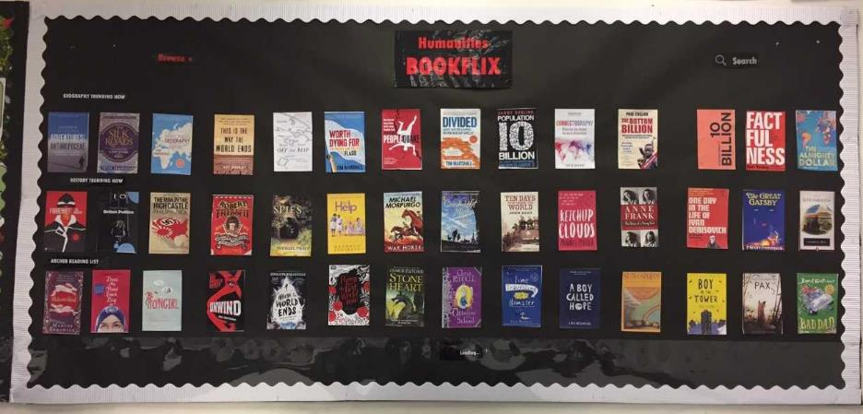
Simran @GeographiaUK
#GAConf21
Where to start? Geographical texts

Slide 8
Simran @GeographiaUK
#GAConf21
Where to start?
Start simple:
Read books
Read the news
Divide it across your department
Keep note
Build realistic and manageable goals to read, and then to embed reading into your curriculum. 3 year plan?

Slide 9
Simran @GeographiaUK
#GAConf21
Task 1:
Let’s start with KS3. List your topics taught across years 7-9.
Term |  | Y7 topic | Y8 topic | Y9 topic
Autumn | 1
 | 2
Spring | 1
 | 2
Summer | 1
 | 2

Slide 10


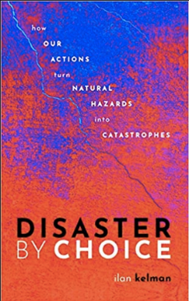

Simran @GeographiaUK
#GAConf21
Where to start?
Some popular books – and some of my favourites!
Review these against your KS3 curriculum

Slide 11

Simran @GeographiaUK
#GAConf21
Where to start?
Books with a broader range of content

Slide 12
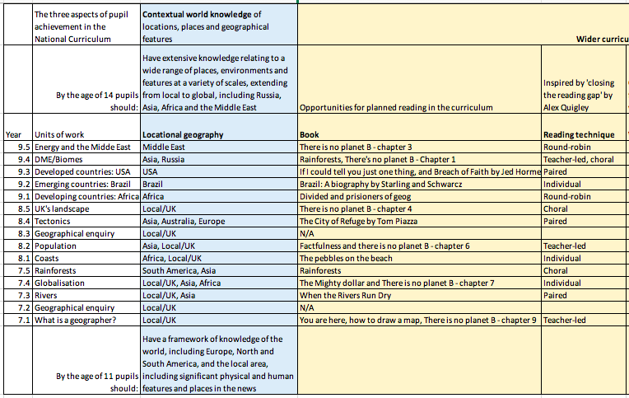
Simran @GeographiaUK
#GAConf21
Divide across your curriculum
https://geographiauk.wordpress.com/2020/04/18/curriculum-planning-grid-geography-from-ga-conference/

Slide 13

Simran @GeographiaUK
#GAConf21
Reading in class:
Share author info on the board
Share Amazon link with homework task
Read extract of the book
Guided reading activity
As reading the info, students complete the timeline of events of the case study

Slide 14
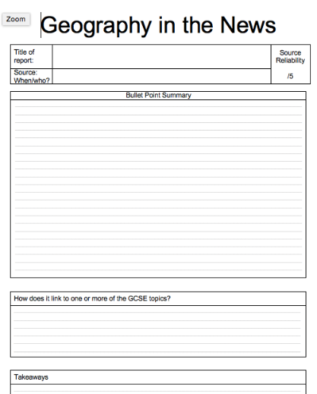
Simran @GeographiaUK
#GAConf21
Geography in the news
Articles
Up to date case study knowledge
Stretch and challenge
Motivation and enjoyment
Cultural capital
Exposure to wider literary texts

Slide 15
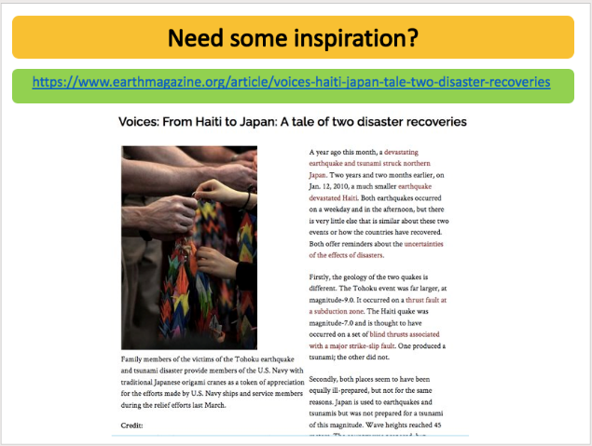
Simran @GeographiaUK
#GAConf21
Geography in the news
To get to grips with the writing style
To learn subject knowledge
To see updates and changes
To go beyond the curriculum

Slide 16
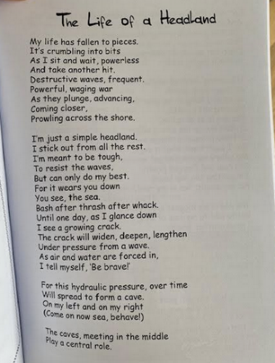

Simran @GeographiaUK
#GAConf21
Poetry
Learn geography
Follow up with a creative task
Describing key processes
Solidifying understanding of key processes

Slide 17
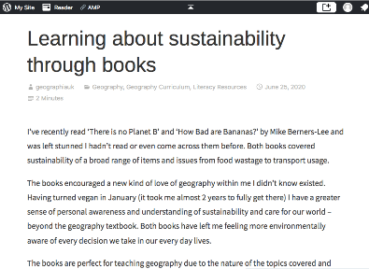
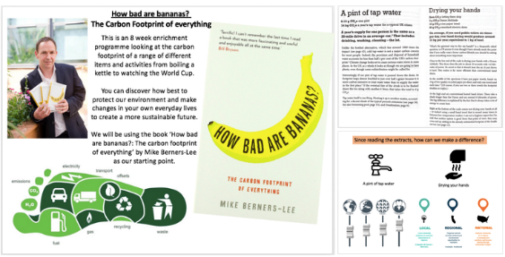
Simran @GeographiaUK
#GAConf21
Reading to teach a particular focus
https://geographiauk.wordpress.com/2020/06/25/learning-about-sustainability-through-books/

Slide 18
Simran @GeographiaUK
#GAConf21
What’s your number 1 priority for embedding reading into your classroom?
Do you have any other top tips for others to learn from?

Slide 19
Simran @GeographiaUK
#GAConf21
Key points
Be realistic
Make it manageable
Share across your department team and over time
Be smart with the text you use to start with
Make sure it enhances geographical learning (time, space, place)
Make sure you (or a team member) as genuinely read the text - shoe horning won’t work…trust me!
Be authentic

Slide 20
Simran @GeographiaUK
#GAConf21
Get in touch?
Simran Jouhal
Twitter: @GeographiaUK
Blog: geographiauk.wordpress.com
Senior Teacher at The Archer Academy, North London

