Slide 1

My place or yours?

Slide 2
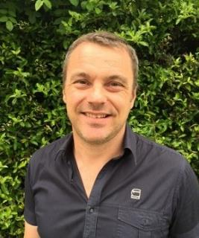
Session overview: My place or yours?
This workshop explores supporting pupils to know how to find out more about places, especially those that are unfamiliar, unknown and probably far away. It will also consider that how one person interacts and perceives any single place is in all likelihood very different to how others experience and interpret it across both time and space.
‘Many schools tried to cover too many places, using each one to typify just one issue or phenomenon. At times, the resources used gave an outdated and inaccurate representation of places. This led to pupils learning ‘single stories’ about each place. Other schools reduced places to disconnected lists of facts. Few schools taught place through regional studies.’
Ofsted Geography Report, September 2023
jcannell@geography.org.uk
Notes:
Introductions… consultant/position with GA… professional experience. This could be a repeat of your bio information on the GA website

Slide 3
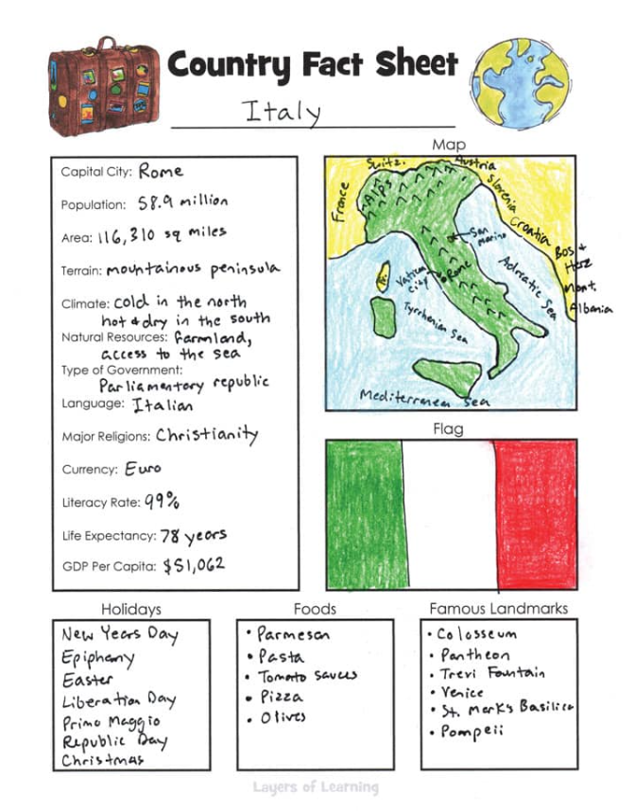

Activity
Providing context and depth
What features define a capital city?
What challenges does this present?
How does this compare to the UK?
How do these effect life and livelihood?
How might this be improved?
Is this spread evenly?
Why are these food found here?
Free Printable Country Fact Sheet For An Easy Geography Lesson - Layers of Learning (layers-of-learning.com)
Notes:
In a time poor environment the key is to deepen learning around core expectations- contextualizing disconnected lists of facts and adding geographical meaning

Slide 4
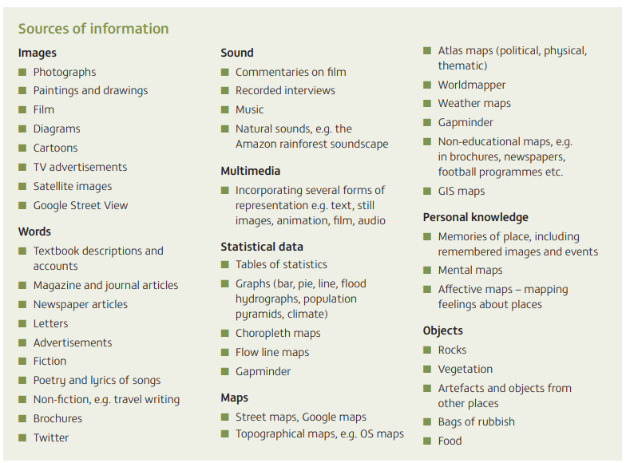
Many of the place studies lacked depth, with much of pupils’ information simply being copied from single sources -often websites- and being accompanied by a single stereotypical image.
Moderators’ Report 2022
However, in some schools, enquiry meant that pupils would find things out for themselves. This usually resulted in pupils searching on the internet for information about a place, and then copying what they had found into a table or other document.
Ofsted Geography Report, September 2023
Planning your coherent 11–16 geography curriculum: a design toolkit David Gardner: Geographical Association

Slide 5
Possible ‘geographical rationale’ for a regional/area study
‘Geographical’: topography, population, administrative, plate tectonics…
Land use: human & physical features, rural, urban, spatial variation…
Cultural: sport, music, religion, language, food, buildings…
Trade: fair, industry, economic, interconnections, interdependence…
Weather & climate, seasons, latitude, altitude, water cycle…
Diversity: people, biomes, vegetation, land use…
Comparison: contrast, similarity, difference, change…
Processes: erosion, tectonic, migration, settlement…
Resources: water, energy, minerals, scarcity, sustainability…
A region is an area of land that has common features. These features can be natural, such as climate or landscape. They can also be artificial, such as language or religion.
National Geographic
In geography, a region is defined as a large area with common physical or human impact characteristics. Geographers often group places or areas based on shared or common features.
World Atlas

Slide 6
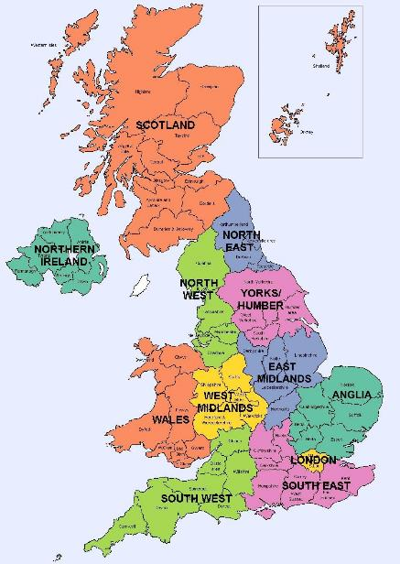
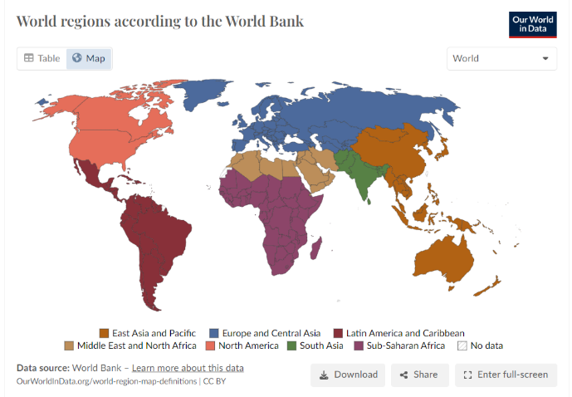
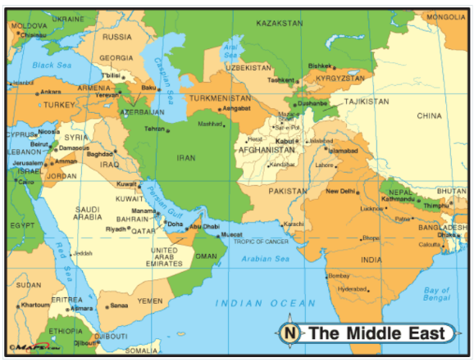
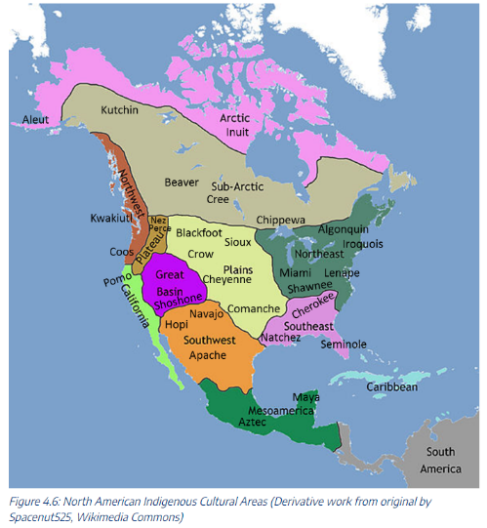
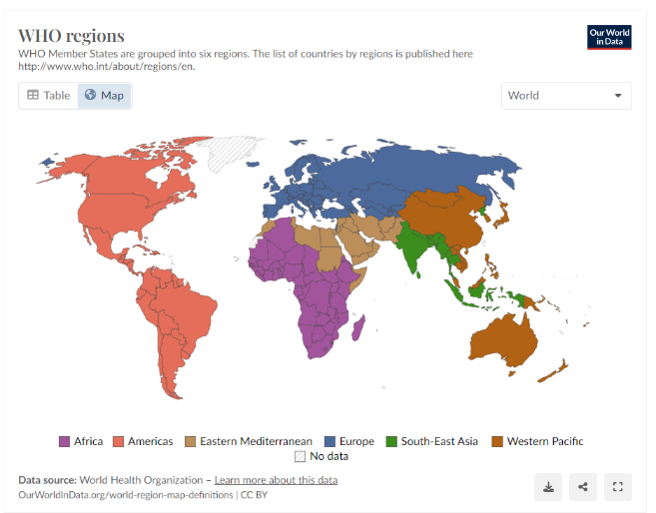
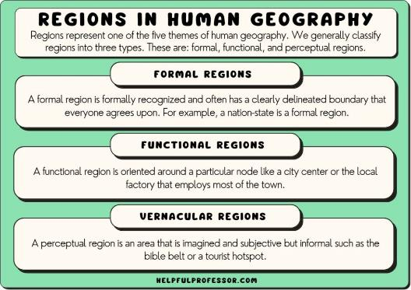
https://geography.name/middle-east/
https://ourworldindata.org/world-region-map-definitions
https://ukmap360.com/united-kingdom-(uk)-region-map
https://helpfulprofessor.com/types-of-regions/
https://pressbooks.nscc.ca/worldgeo/chapter/north-america/

Slide 7
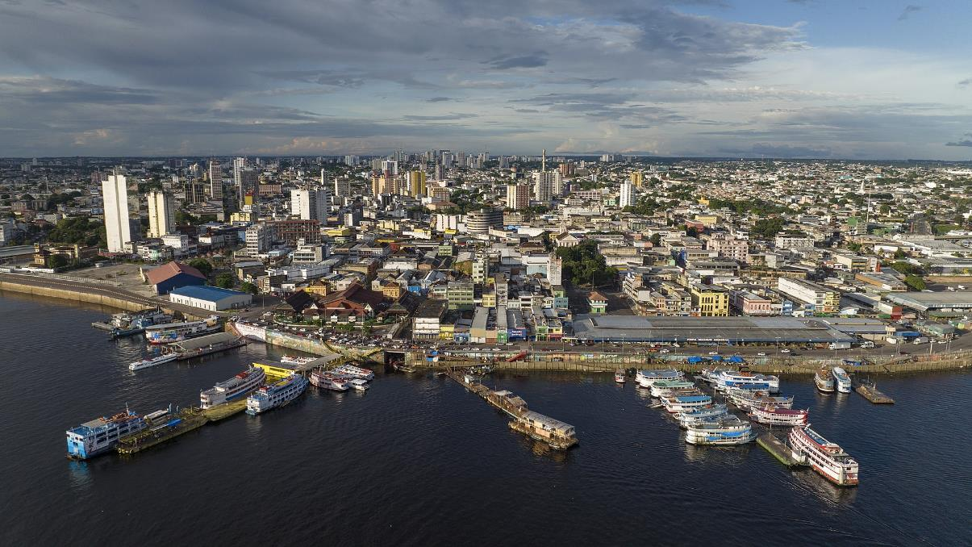
Where might this be?
By Arne Müseler / www.arne-mueseler.com, CC BY-SA 3.0 de,
https://commons.wikimedia.org/w/index.php?curid=116937423

Slide 8
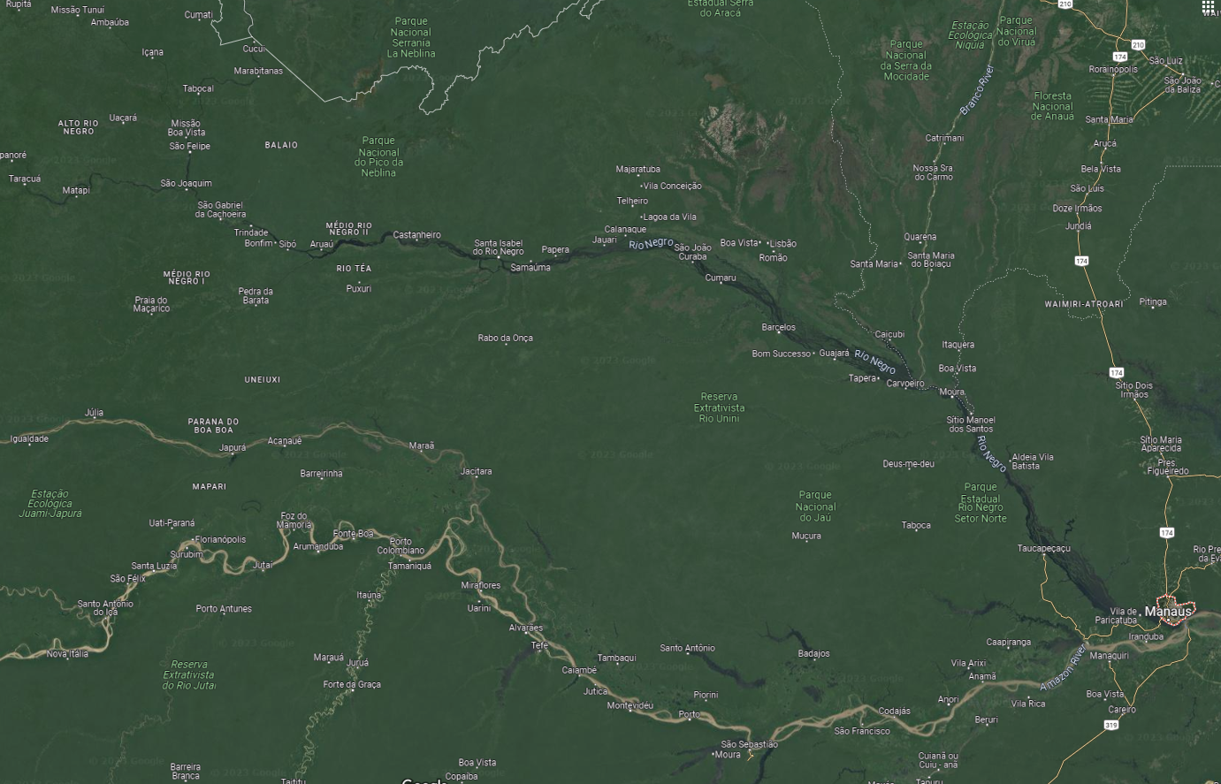
One word to describe?
Green
Forest
Trees

Slide 9
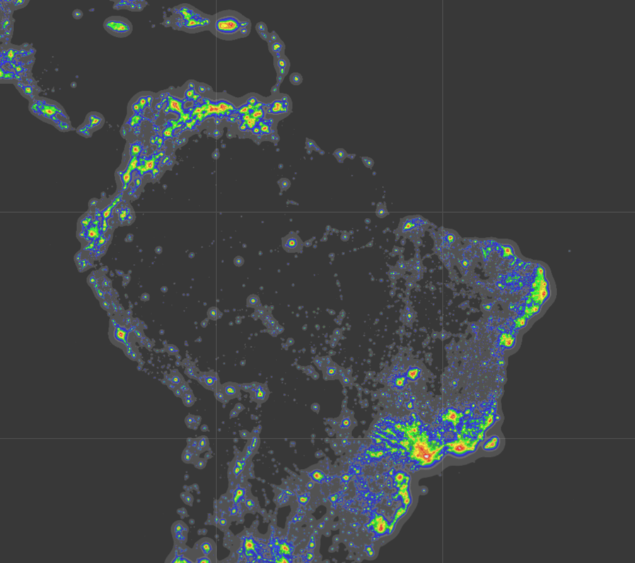
Is there a pattern?
The population density for Amazonas is around 2.23 people per KM²
2.7 million live in the metropolitan area of
Manaus…
…can you spot it?
How does that compare to UK cities?
The second largest UK city is… Birmingham with 2.5 million inhabitants.
https://www.worldatlas.com/articles/brazilian-states-by-population.html
https://darksitefinder.com/maps/world.html#4/-5.52/-55.99

Slide 10
2.7 million live here…
…so what?
https://darksitefinder.com/maps/world.html#4/-5.52/-55.99

Slide 11
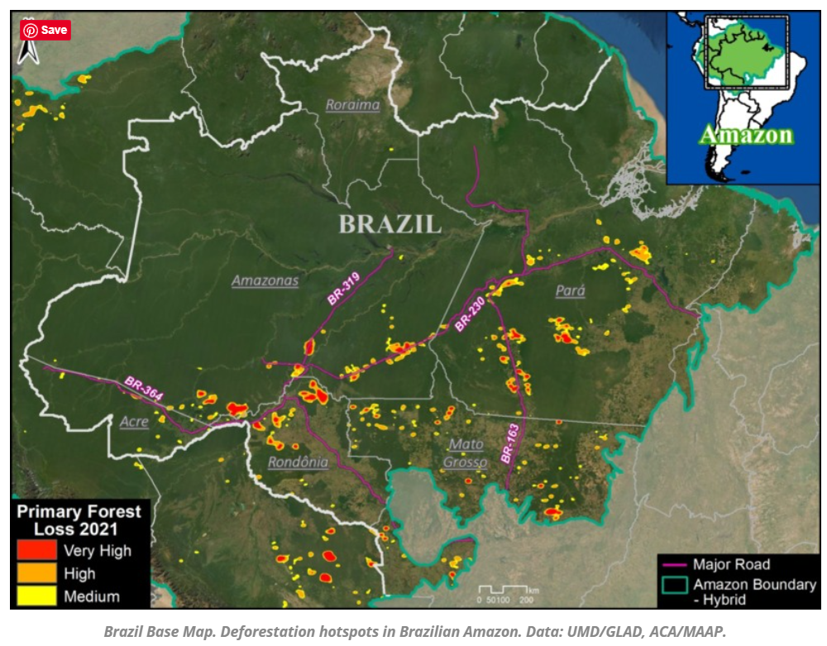
Is there a pattern?
Why might the pattern exist?
So what…
…could be done?
…should be done?
…might the future look like?
https://www.maaproject.org/2022/amazon-hotspots2021/

Slide 12
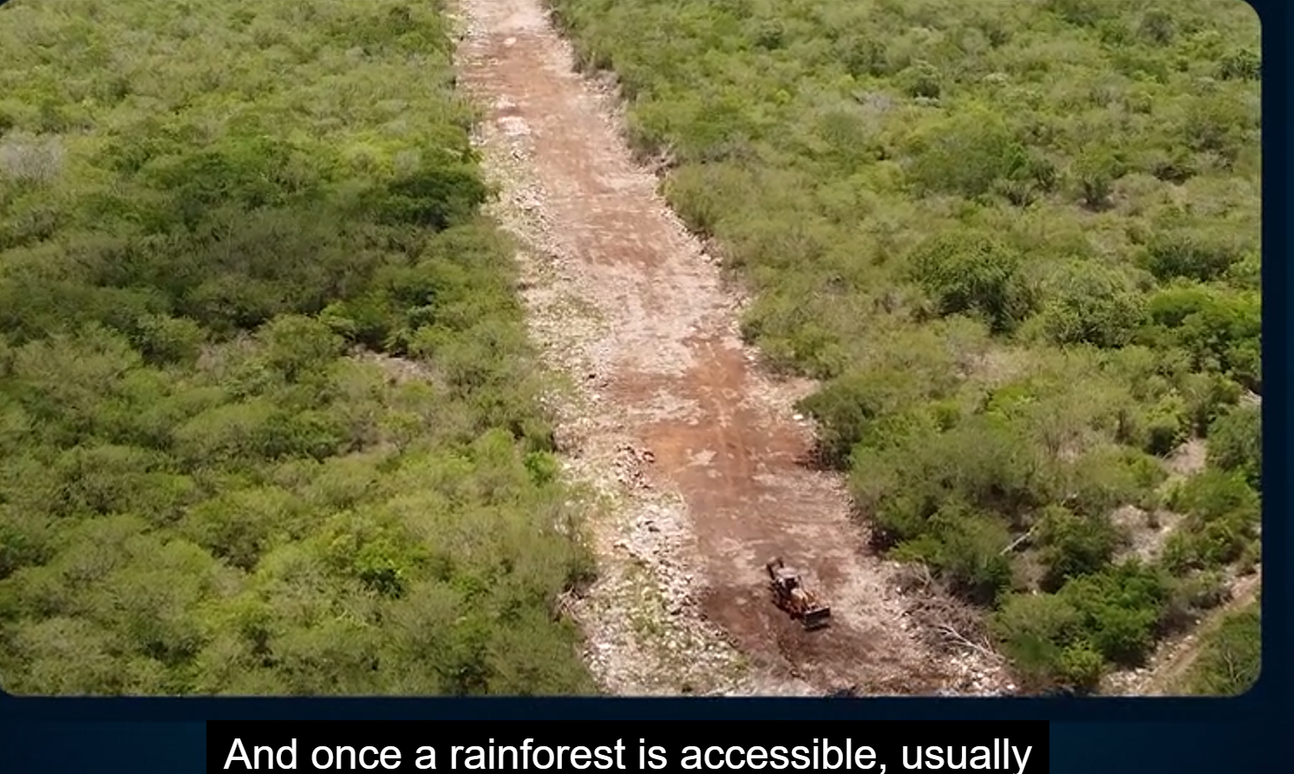
Access >>> the start of a damaging feedback cycle
Also try: https://timeforgeography.co.uk/videos-list/ecosystems/threats-to-tropical-rainforests/

Slide 13
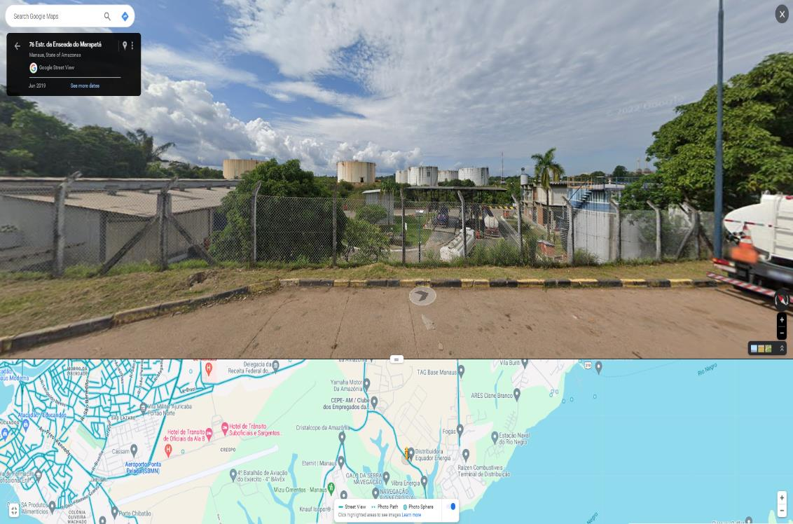
Does the Amazon need industry?

Slide 14
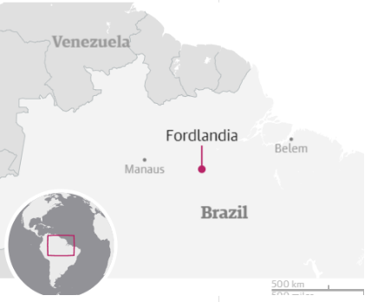
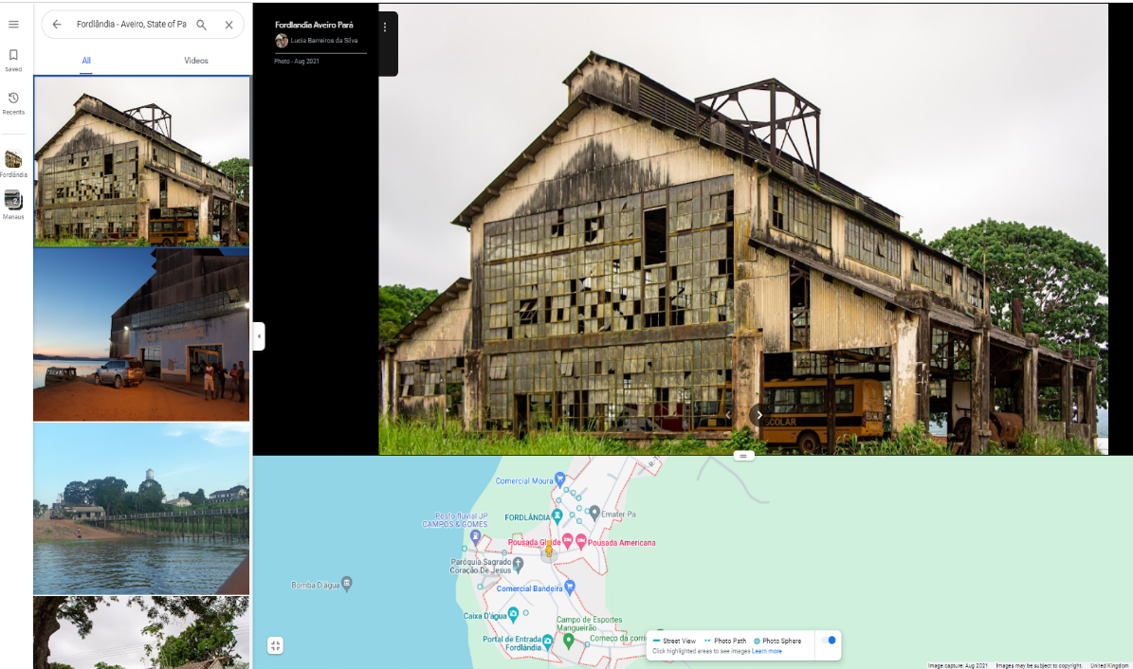
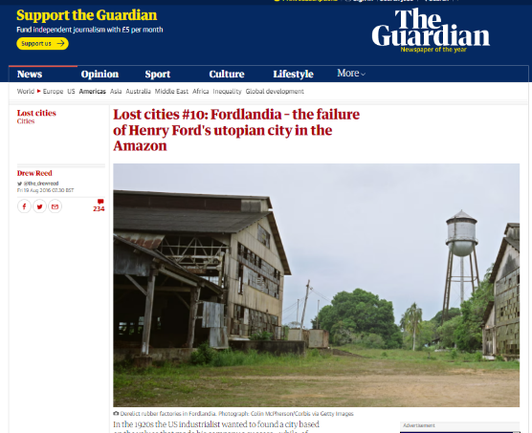
Will some buildings be abandoned?
https://www.theguardian.com/cities/2016/aug/19/lost-cities-10-fordlandia-failure-henry-ford-amazon

Slide 15
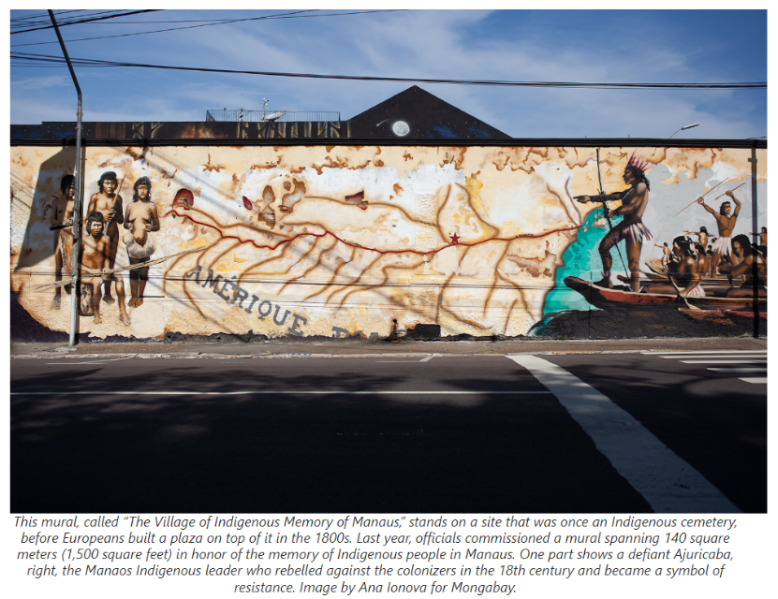
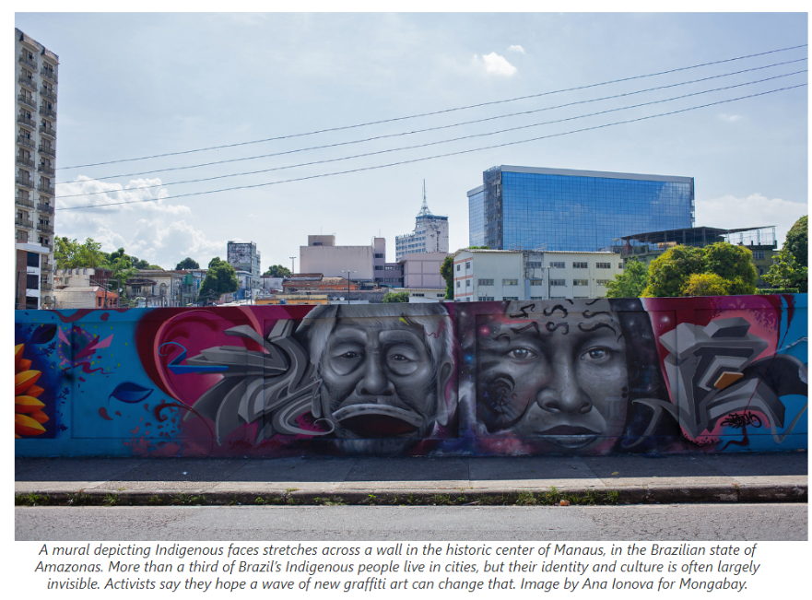
Will there be graffiti… or street art?
https://news.mongabay.com/2022/04/history-on-the-walls-graffiti-brings-manauss-indigenous-roots-to-light/

Slide 16
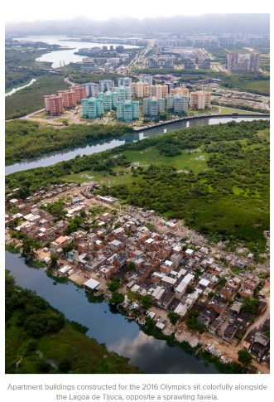
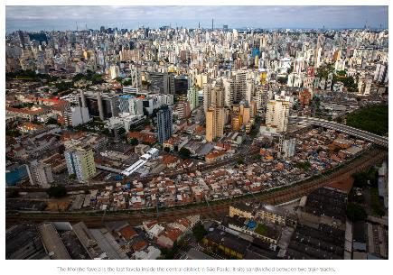
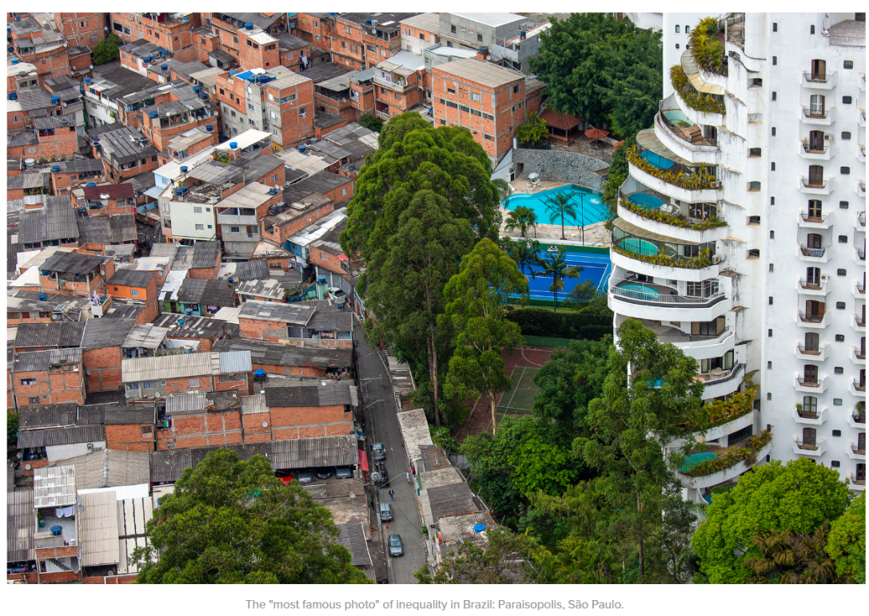
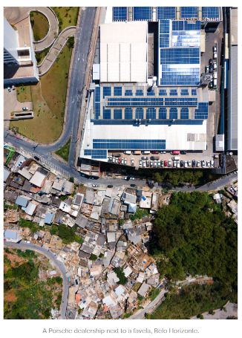
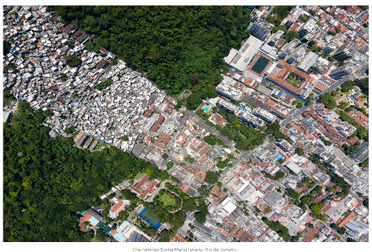
Is there inequality?
So
what…
https://unequalscenes.com/brazil

Slide 17
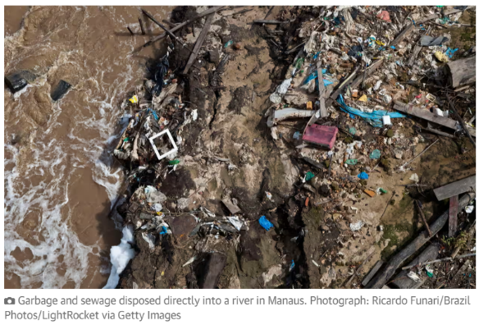
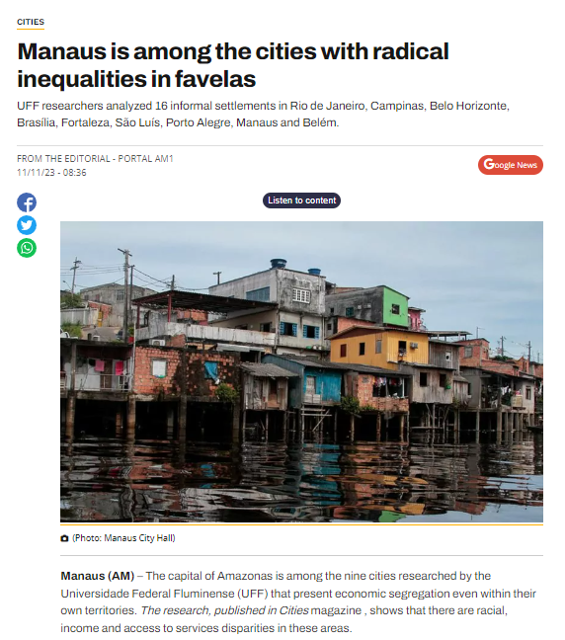
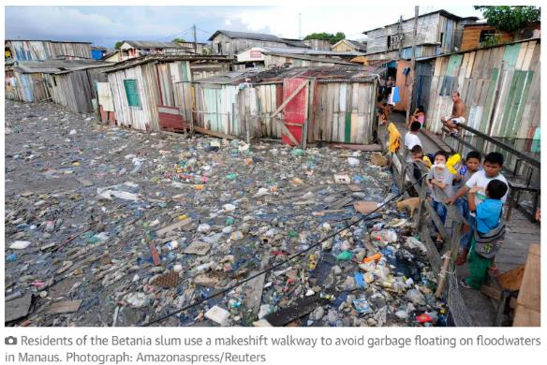
One story, one narrative?
So
what…
https://www.theguardian.com/cities/2019/jul/23/the-jungle-metropolis-how-sprawling-manaus-is-eating-into-the-amazon
https://amazonas1.com.br/manaus-esta-entre-as-cidades-com-desigualdades-radicais-nas-favelas/

Slide 18
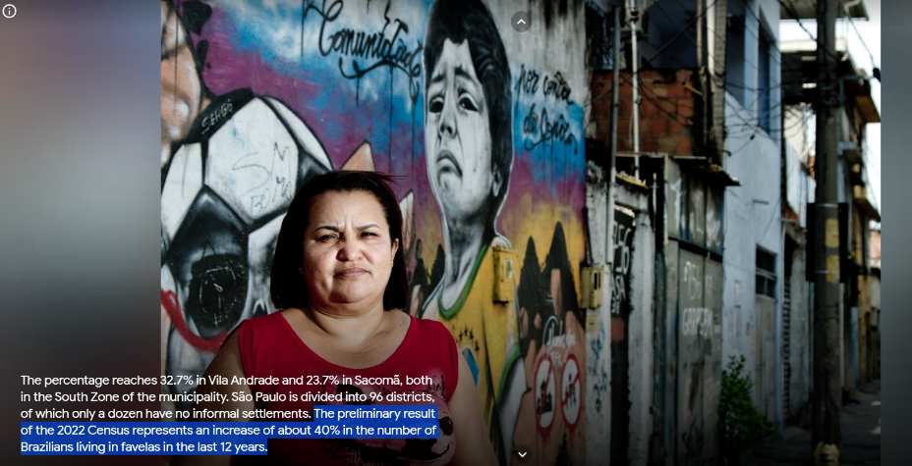
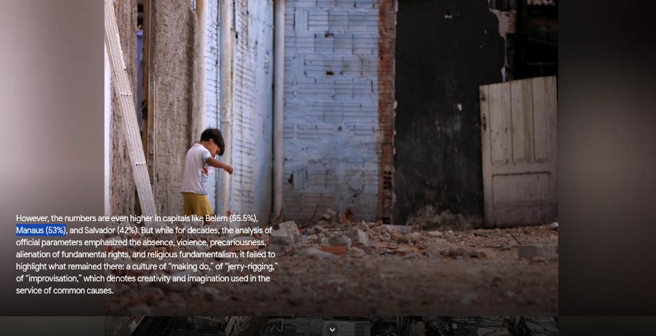
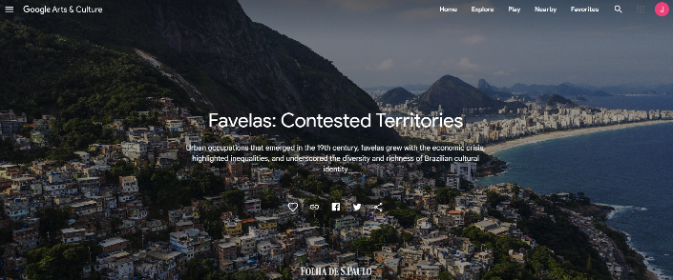
https://artsandculture.google.com/story/ngWh2teCeiXOSQ

Slide 19
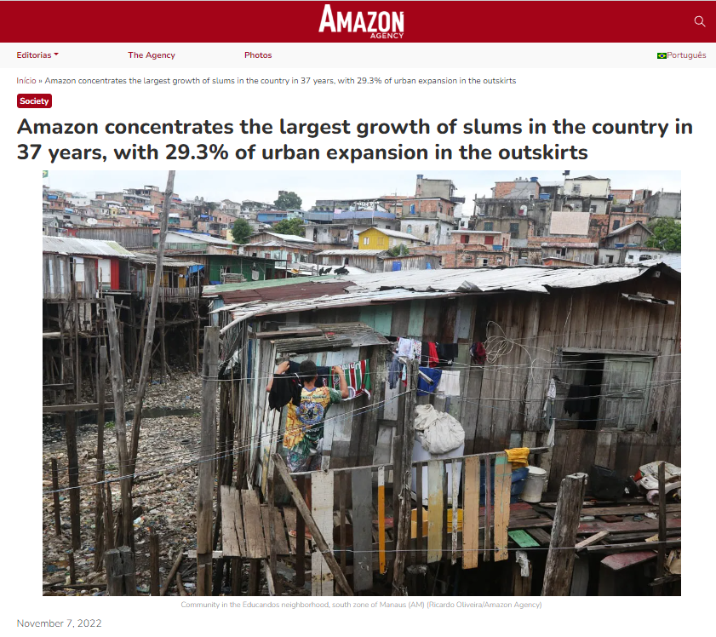
November 7, 2022
11:11 Marcela Leiros – AMAZON AGENCY
MANAUS – The Amazon leads the percentage of slum growth in the country, with 29.3% of urban expansion in informal areas, in the biome, in 37 years. The data are from the MapBiomas survey on urbanized areas, made from the analysis of satellite images captured between 1985 and 2021, and released this week. Manaus, capital of the state of Amazonas, is at the top of the ranking, with almost 10 thousand hectares. The study showed that the informal areas, popularly called slums, totaled 106 thousand hectares, and most of the urbanized area in these locations is concentrated in the capital cities. Besides Manaus, another Amazon capital tops the list: Belém (PA) is in third place, with 5 thousand occupied hectares.
https://aamazonia.com.br/amazon-concentrates-the-largest-growth-of-slums-in-the-country-in-37-years-with-29-3-of-urban-expansion-in-the-outskirts/?lang=en

Slide 20
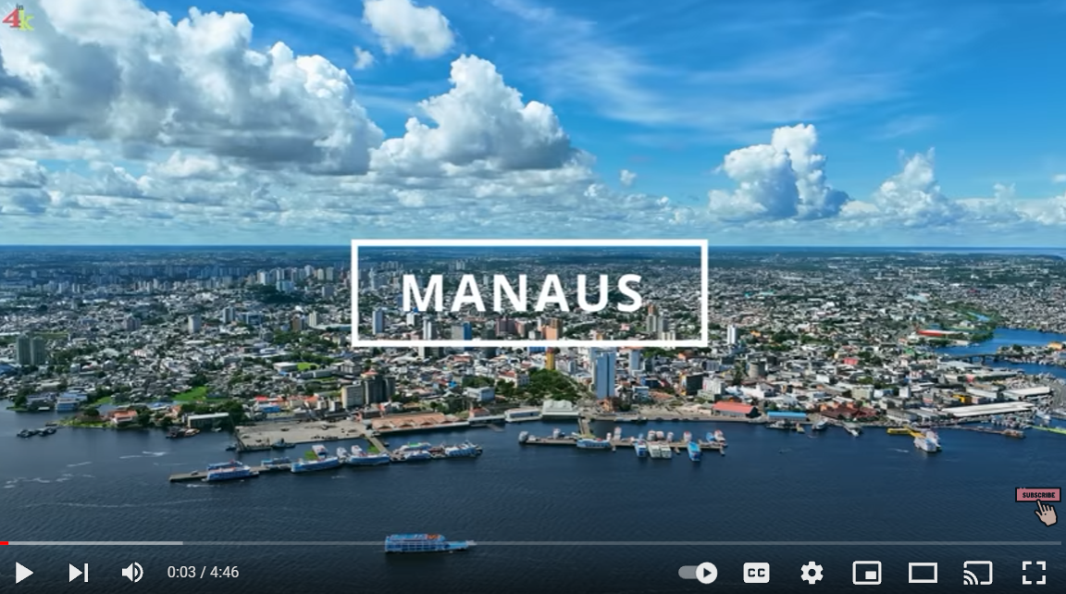
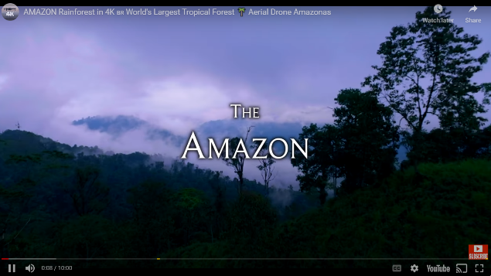
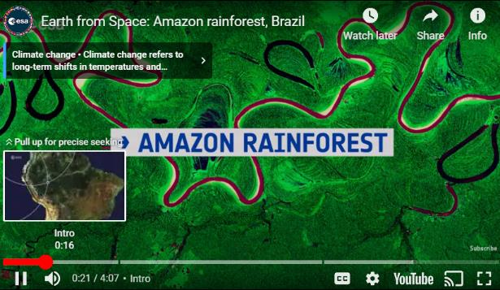
Drone footage: what are they unlikely to show?

Slide 21
‘Place’ study can be full of pitfalls
Unintentionally reinforce cultural or place stereotypes
Introduce bias… maybe in relation to personal negative or positive experiences.
Limited perspective of a place, especially if never been there.
Introduce inaccurate information
Consider how to present balanced view avoiding stereotypes
Ask yourself: ‘What are my views and experiences of this place?’ in person and through media.
How will multiple perspectives be introduced?
Fact check and use trusted sources

Slide 22
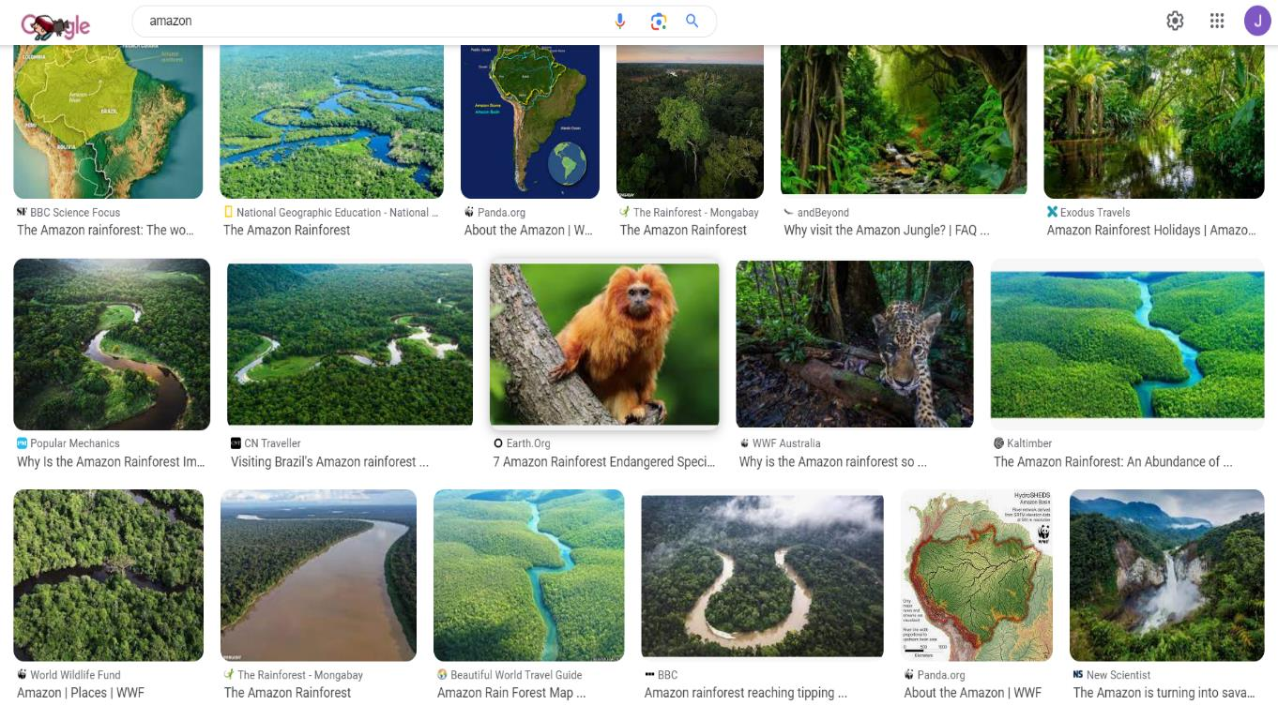
Beware of ‘the Google’
Notes:
Restrictive- stereotypical- sponsored – want warts-and-all!

Slide 23
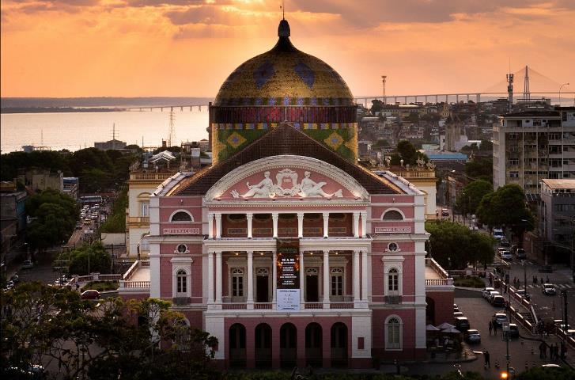
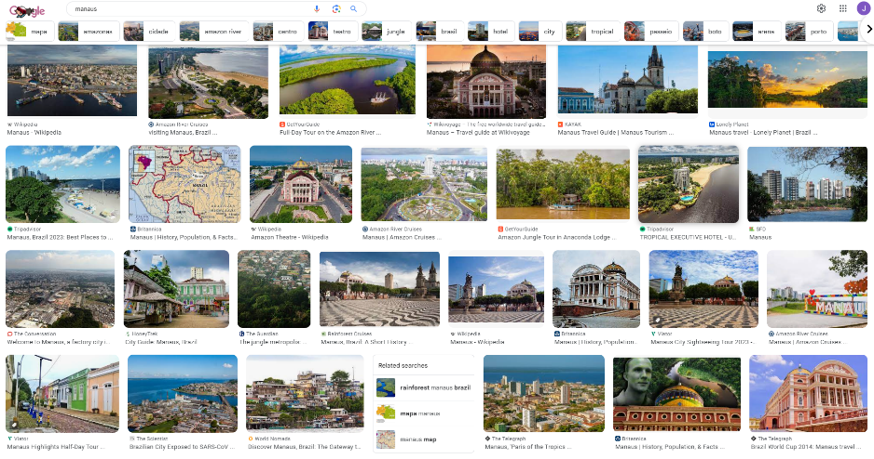
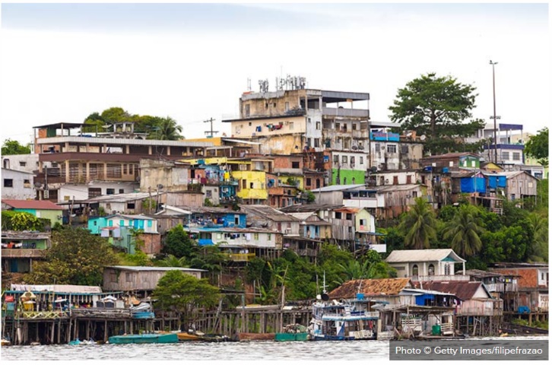
Which Manaus would you like to visit?
https://en.wikivoyage.org/wiki/Manaus
https://www.worldnomads.com/explore/south-america/brazil/manaus-amazon-gateway
Next door neighbour – Cairo from the Pyramids

Slide 24
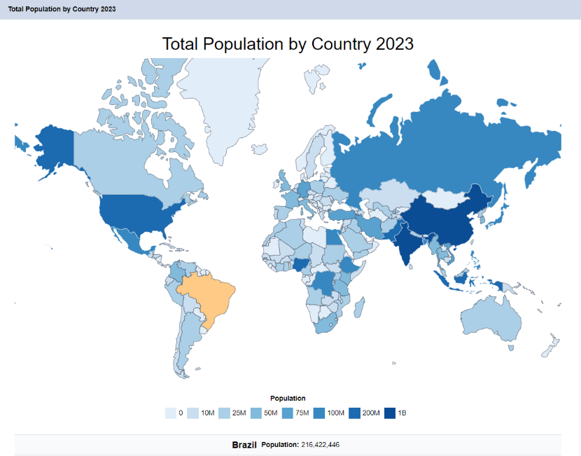
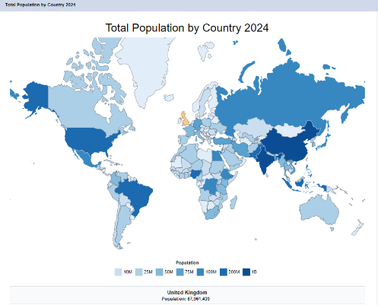
Is the population more or less than the UK?
What about in terms of density?
https://worldpopulationreview.com/countries

Slide 25
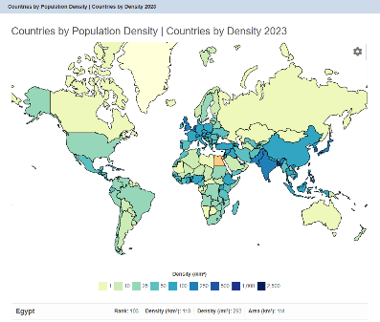
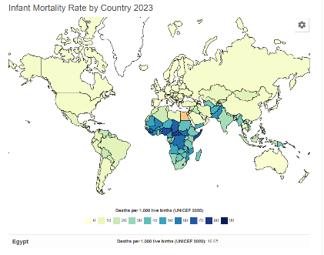
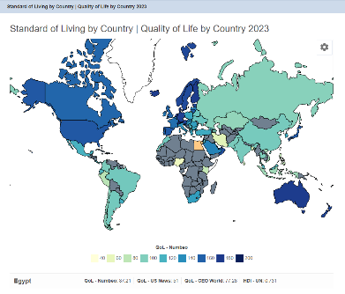
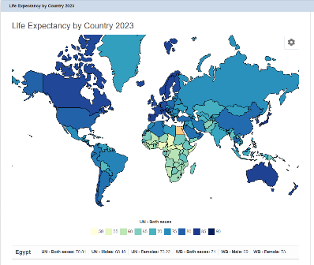
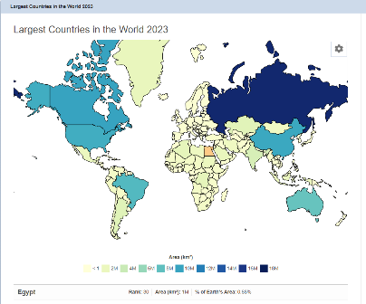
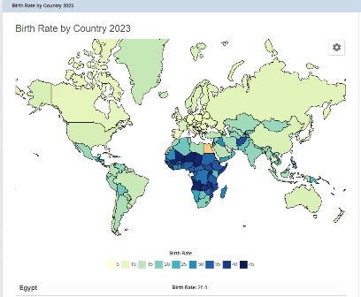
So what…
https://worldpopulationreview.com/country-rankings/countries-by-density
https://worldpopulationreview.com/country-rankings/infant-mortality-rate-by-country
https://worldpopulationreview.com/country-rankings/standard-of-living-by-country
So what…
So what…
https://worldpopulationreview.com/country-rankings/life-expectancy-by-country
https://worldpopulationreview.com/country-rankings/largest-countries-in-the-world
https://worldpopulationreview.com/country-rankings/birth-rate-by-country

Slide 26
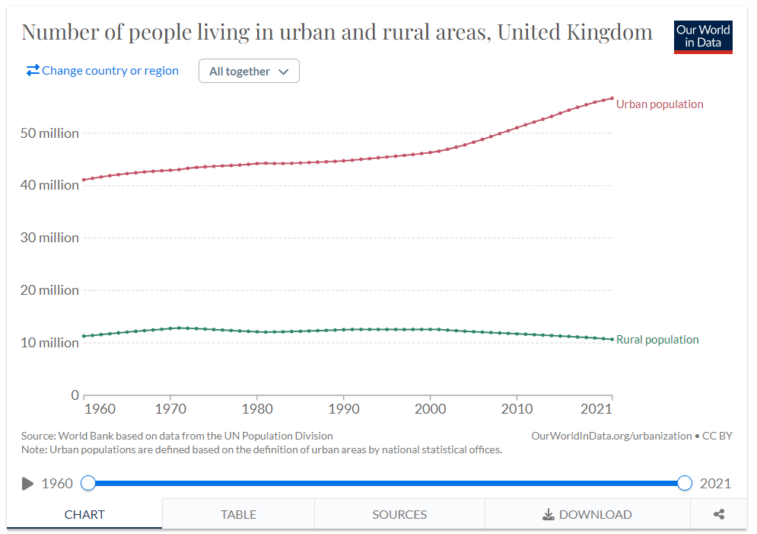
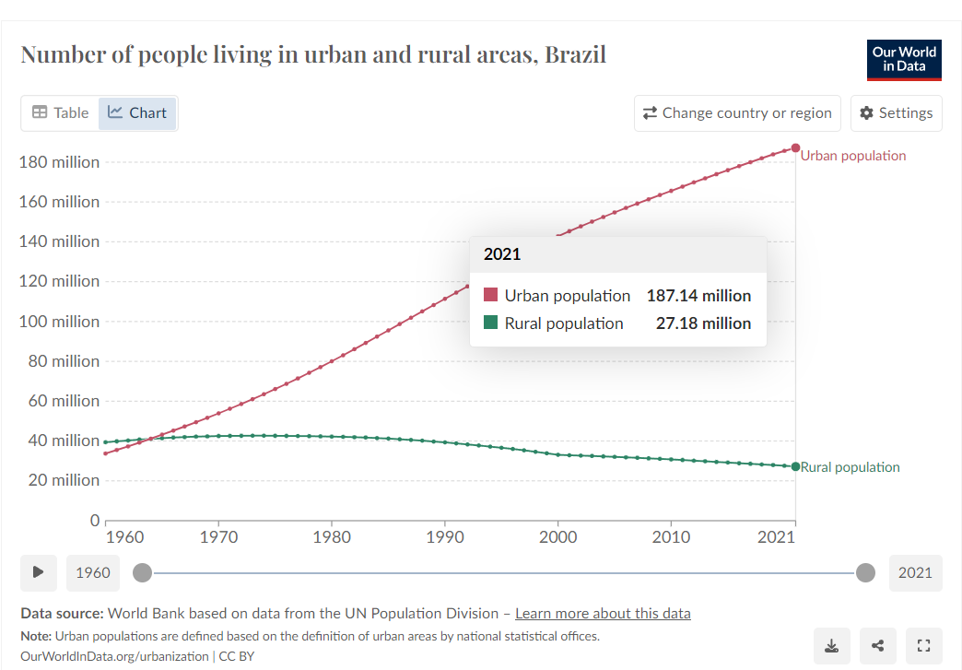
https://ourworldindata.org/urbanization
So what…

Slide 27
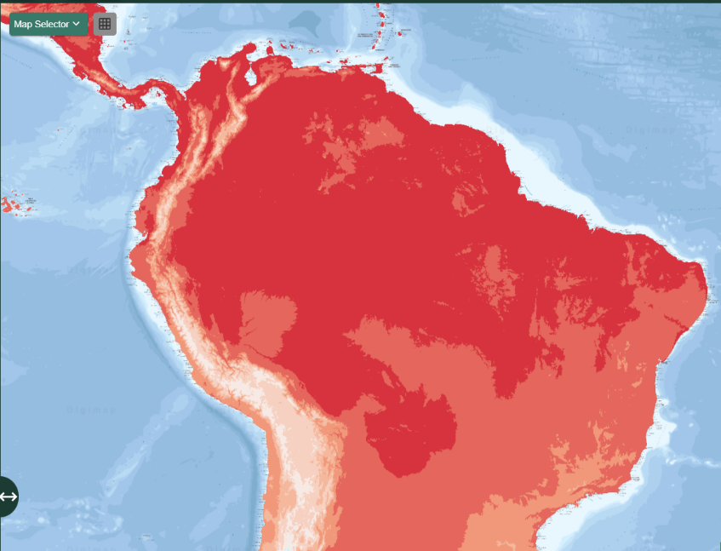

What might be represented?
1970-2000 Avg. Temp
2010-2018 Avg. Temp
So what…?

Slide 28

What might it be like by 2030…40…50?

Slide 29






Protected areas
Access to potable water
So
what…
Indigenous territories
So
what…
So
what…
Time zones
Light pollution
arcgis.com/apps/instant/atlas/index.html?appid=0cd1cdee853c413a84bfe4b9a6931f0d

Slide 30
What’s being compared here?
So what…
How about now?
https://weatherspark.com/

Slide 31


Best time to visit?
https://weatherspark.com/
What else would be useful to know?

Slide 32
Where would you prefer to live?
https://weatherspark.com/

Slide 33


Within Amazon basin?
https://weatherspark.com/

Slide 34



So what…
https://www.gapminder.org/dollar-street

Slide 35


My life elsewhere
https://www.mylifeelsewhere.com/
So what…

Slide 36


https://www.mylifeelsewhere.com/
So what…

Slide 37




Are we lovin’ it?
Find an image that interests you. Click through to see the image and rotate for best view.
Expand the map to create half and half
,
https://www.google.co.uk/maps/@-3.107911,-60.0237122,3a,75y,150.63h,102.61t/data=!3m9!1e1!3m7!1suzNmdAm0wCvde3eztK0nZA!2e0!7i16384!8i8192!9m2!1b1!2i32?entry=ttu

Slide 38



McDonald restaurants 2018
So what…
https://worldmapper.org/

Slide 39




Bouncy Maps
https://www.bouncymaps.com/

Slide 40

Making connections
What time will the lamppost come on?
Who uses the bridge most?
Where might the bridge come from?
How big is the settlement?
Does the stream ever flood?
What might this view be like in 50 year's time?
Why are the railings important?
How will the view change with the time of year?
Where else do we know like this?

Slide 41



Coari, Amazonas, Brazil

Slide 42



Click on the town name in Google Maps to find out some information and a link to Wikipedia…
Click on the top image to take you through to any others.

Slide 43

Coari

Slide 44


Geographical concepts
Organising concepts
Time
Scale
Diversity
Interconnections
Interpretations
Place
Key concepts
Space
Earth Systems
Environment
GA: A framework for the school geography curriculum, Oct 2022
Notes:
Knowledge can be subdivided and two of the categories are substantive and disciplinary…
Substantive: ‘…facts and information about phenomena in the world (often called world knowledge), such as rivers, mountains, cities, countries and landscapes, but also more abstract features such as economic systems, community beliefs and imaginative place representations.’ Curriculum framework
Disciplinary: thinking, working and applying like geographers… including building understanding of concepts that thread through the substantive facts and figures.

Slide 45
Geographical concepts
Place- home, community, landscape, sense of place, different types, sizes and locations.
Space- location, distribution, pattern, interaction, distance, physical and human geographical features
Environment- interactions between physical and human, ecosystems, environmental change and impact, resources and sustainability,
Scale- size of investigation: micro to macro, local to global, personal to planetary, zoom in and out to consider interconnections and interactions
Diversity- similarity, difference, comparison, contrast, awareness of cultures, identities, values, futures
Interconnections- linking people, places, environments, spaces, events, cause & effect
Interpretation- changing narratives, differing values, attitudes, representations & viewpoints, contrasting imaginations, considering bias, trustworthiness & accuracy
Time- when processes operate, introduces ideas of stability, dynamism, continuity and change
Earth systems- physical processes/cycles, dynamic changes: biological/chemical, landforms/landscapes
Adapted from, GA: A framework for the school geography curriculum, Oct 2022
Notes:
Expanded definitions- but by no means complete.

Slide 46

Hiding in plain sight…
‘The curriculum in some schools did not match the scope and ambition of the national curriculum. Most often, this was because the aims of the national curriculum had been overlooked or because place and/or geographical skills were not being taught.’
Ofsted Geography Report, September 2023

Slide 47
Questions stimulated by concepts
Amazon | Time | Scale | Diversity | Interconnection | Interpretation
Place | How has the Amazon changed in recent times? | How large is the Amazon basin? | Is the landscape the same for the whole river course? | Why do people visit Amazonia? | Is Manaus a great city to visit / live in?
Space | Do more people live in rural or urban locations? | Which continent is the Amazon in? | How is rural and urban life similar and different? | Why is the Manaus important? | What human and physical features can be seen on a map?
Earth systems | How might the Amazon be affected by climate change? | Where does the Amazon river begin… in Brazil? | Is the climate the same across the whole basin? | How does the Amazon river effect the region? | What challenges and benefits does life in a rainforest present?
Environment | What are the effects of an increasing population? | Which regions can be found in S. America? | How is life different along the river? | What does the Amazon region produce? | Is deforestation always a bad thing?

Slide 48
Questions stimulated by concepts
Activity
Country/region | Time | Scale | Diversity | Interconnection | Interpretation
Place
Space
Earth systems
Environment

Slide 49
Building enquiry questions
Where on Earth is the Amazon Basin? Which countries/continent is it in? Is it shared equally? Where can similar river basins be found? What effect does the river have on landscape/people?
What makes the Amazon Basin special?
What can we find out about the daily life of people in Manaus?
How would life in Coari compare to Manaus and the UK?
What challenges does the region face?
Is deforestation always a bad thing?
Would you rather live in Coari, Manaus or your town and why?
Enquiry questions work best if they are open ended and use interrogatives and conditional question stems such as why, how, what if.
A geographical process, issue, concept or way of working (think, practise, apply) ,as well as some geographical language, should be included or inferred within the question.
Place- home, community, landscape, sense of place, different types, sizes and locations.
Space- location, distribution, pattern, interaction, distance, physical and human geographical features
Environment- interactions between physical and human, ecosystems, environmental change and impact, resources and sustainability,
Scale- size of investigation: micro to macro, local to global, personal to planetary, zoom in and out to consider interconnections and interactions
Diversity- similarity, difference, comparison, contrast, awareness of cultures, identities, values, futures
Interconnections- linking people, places, environments, spaces, events, cause & effect
Interpretation- changing narratives, differing values, attitudes, representations & viewpoints, contrasting imaginations, considering bias, trustworthiness & accuracy
Time- when processes operate, introduces ideas of stability, dynamism, continuity and change
Earth systems- physical processes/cycles, dynamic changes: biological/chemical, landforms/landscapes

Slide 50


View and download here.

