Slide 1


WELCOME!
WelshWise Quiz 2024
Cwis ‘WelshWise’ 2024
CROESO!

Slide 2


WelshWise Quiz 2024
Cwis ‘WelshWise’ 2024
There are 8 rounds
Each round has 8 questions
Choose one round as your BONUS round. Any round can be chosen except the individual round.
You can only use your BONUS once.
The BONUS round doubles your score for that round so chose wisely!
ENJOY YOURSELF!!
Mae yna 8 rownd
Mae gan bob rownd 8 cwestiwn
Dewiswch un rownd fel rownd BONWS. Gall unrhyw rownd gael ei dewis heblaw'r rownd unigol
Gallwch ddefnyddio’r BONWS unwaith yn unig.
Mae’r rownd BONWS yn dyblu eich sgôr am y rownd yna, felly dewiswch yn ddoeth!
MWYNHEWCH!!

Slide 3

Round 1
Where are these famous landmarks?
Rownd 1
Rownd 1 Ble mae'r tirnodau enwog hyn?

Slide 4
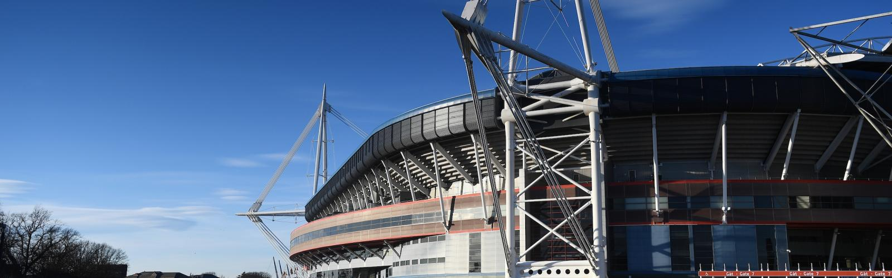
1. In which city? / Ymha ddinas?
Notes:
Source: Visit Wales
https://www.visitwales.com/sites/visit/files/styles/o_herostandard_fullwidth_xl_min_1x/public/media-library/2021-01/SVW-C85-1617-0027_0.jpg?h=c3635fa2&itok=jYG0FuWr

Slide 5
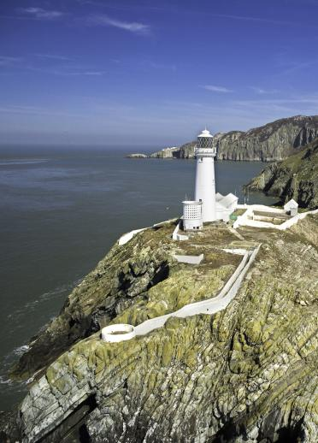
2. On which island? / Ar ba ynys?
Notes:
Source: Visit Wales
https://www.visitwales.com/sites/visit/files/styles/o_articleimagegroup__portrait__1_xl_min_1x/public/media-library/2018-12/N131-048-D.jpg?h=4f12b131&itok=lK1j6DqY

Slide 6
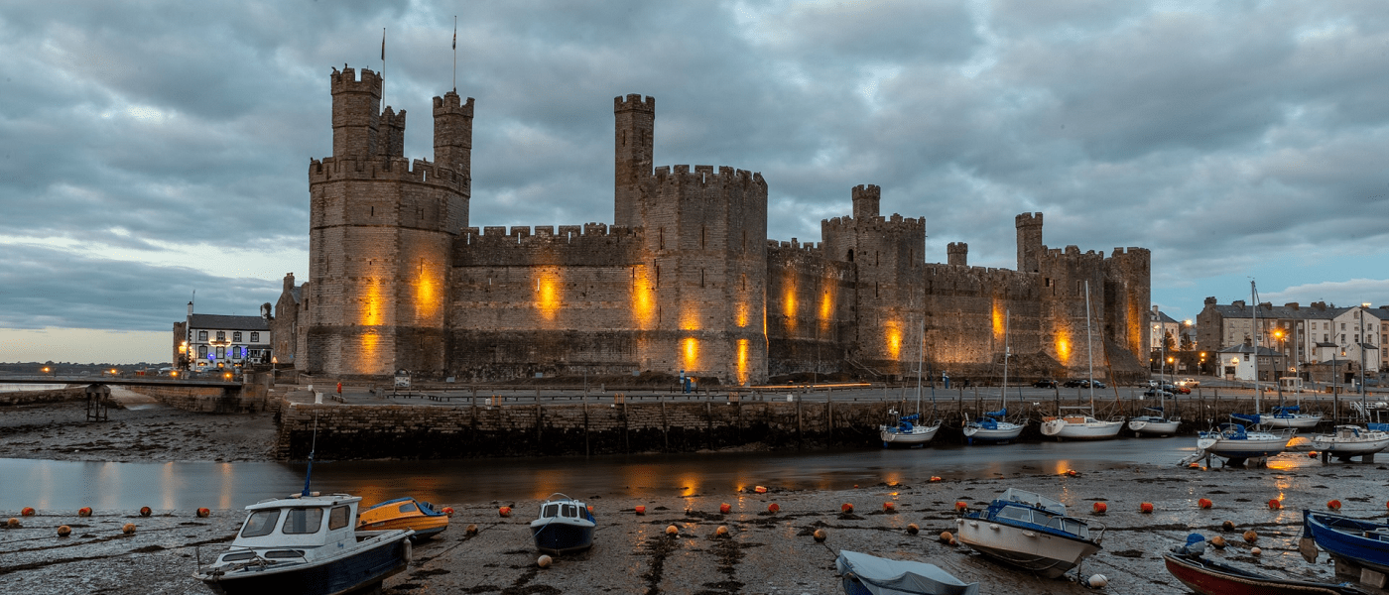
3. Which landmark? / Pa dirnod?
Notes:
Source: Visit Snowdonia
https://www.visitsnowdonia.info/caernarfon-castle

Slide 7
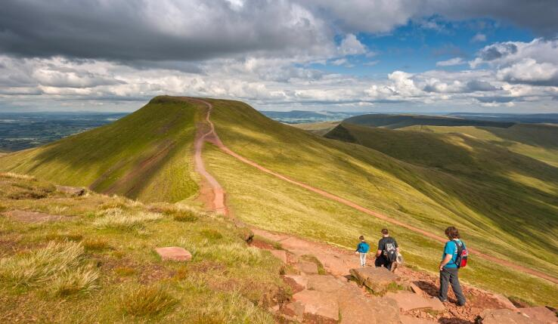
4. Which mountain? / Pa fynydd?
Notes:
Source: Visit Wales
https://www.visitwales.com/sites/visit/files/styles/o_articleimagegroup__landscape__2_xl_min_1x/public/media-library/2022-11/SVW-C06-1213-0015.JPG?h=2e4af638&itok=kAa-3rJ9

Slide 8
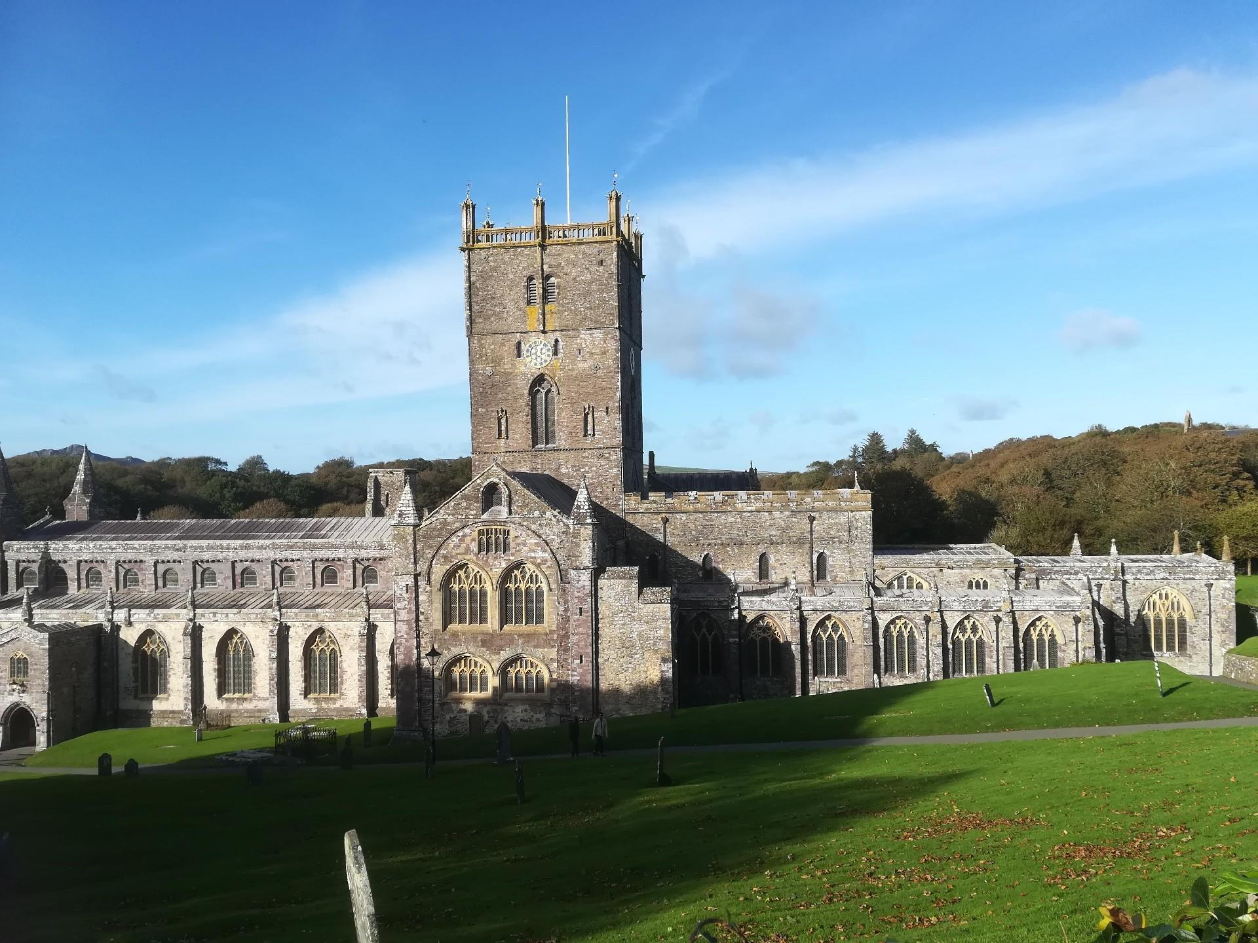
5. In which city? / Ymha ddinas?
Notes:
Source: Visit Wales
https://visitwalesimages.thedms.co.uk/eandapics/MW/vlarge/0866745_1_3.jpg

Slide 9
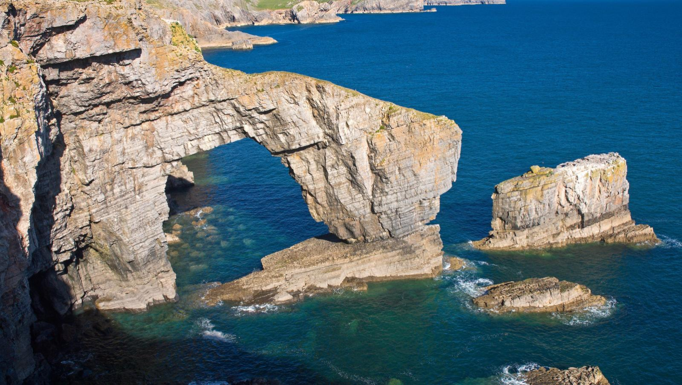
6. Which national park? / Pa Barc Cenedlaethol?
Notes:
Source: Visit Wales
https://www.visitwales.com/sites/visit/files/styles/o_articleimage_fullbleed__16_9_xl_min_1x/public/media-library/2021-01/SVW-C09-0708-0107.jpg?h=6925e8ec&itok=fZ9hGwAI

Slide 10
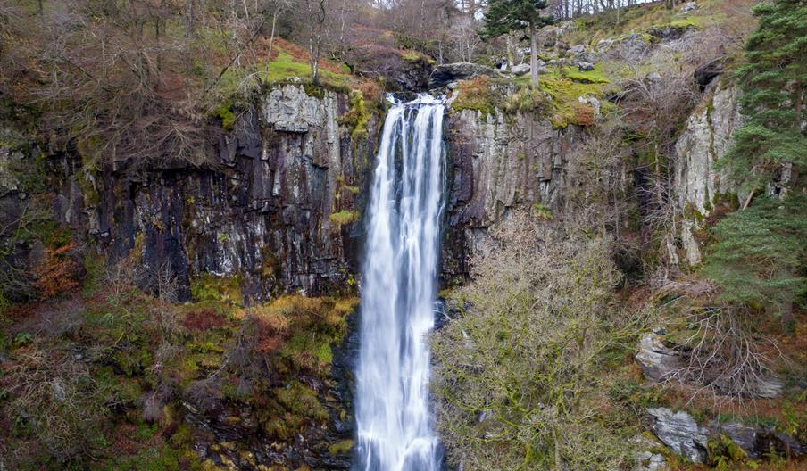
7. Which waterfall? / Pa raeadr?
Notes:
Source: Visit Wales
https://eu-assets.simpleview-europe.com/visitmidwales/imageresizer/?image=%2Fdmsimgs%2Fpistyll-rhaeadr-01_1547686446.jpg&action=ProductDetailImage

Slide 11
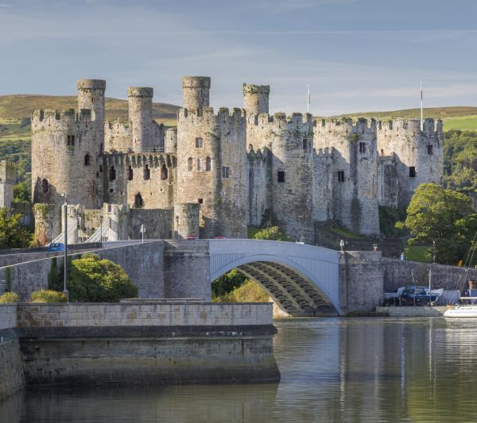
8. Which river? / Pa afon?
Notes:
Source: Cadw
https://cadw.gov.wales/visit/places-to-visit/castell-conwy

Slide 12

Round 2
Natural Disasters
Rownd 2
Peryglon Naturiol
Notes:
https://creazilla.com/nodes/38635-tsunami-disaster-clipart

Slide 13
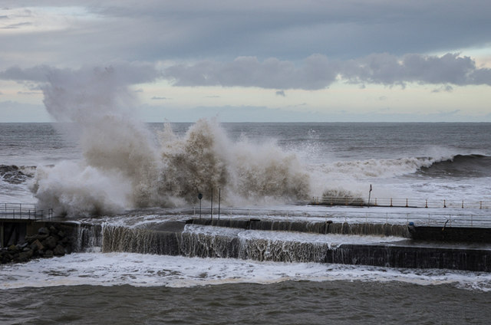
1.
Which severe storm affected Wales in January 2024?
Pa storm effeithiodd ar Gymru yn Ionawr 2024?
Notes:
https://www.geograph.org.uk/photo/3803167
https://www.walesonline.co.uk/news/wales-news/storm-ciarn-maps-show-hour-28021604
Storms Ciara, Dennis and Jorge

Slide 14

2.
Which tectonic natural disaster do scientists predict may affect coastal areas in Wales?
Pa drychineb dectonig allai effeithio ar arfordir Cymru yn ôl gwyddonwyr?
Notes:
https://upload.wikimedia.org/wikipedia/commons/2/22/Tsunami_wave_hitting_city.svg
Tsunami

Slide 15

3.
Which oil tanker caused an environmental disaster off the Pembrokeshire coastline in 1996?
Pa dancer olew suddodd oddi ar arfordir Penfro yn 1996 gan achosi trychineb amgylcheddol?
Notes:
https://www.wannapik.com/vectors/24687
Sea Empress Oil Tanker

Slide 16
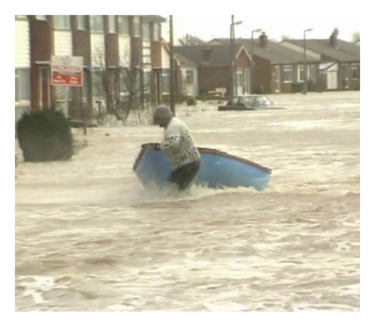
4.
In 1990 where did a storm plus spring tide force a sea wall to collapse and cause severe flooding?
Yn 1990, ymhle yr achosodd storm a llanw uchel i amddiffynfeydd ddymchwel gan achosi llifogydd difrifol?
Notes:
Towyn, Kinmel Bay

Slide 17

5.
Which natural hazard? Disaster? is thought by scientists to be Wales’s biggest threat?
Pa berygl neu drychineb naturiol yw bygythiad mwyaf i Gymru yn ôl gwyddonwyr?
Notes:
https://www.shutterstock.com/image-vector/flood-buildings-icon-house-water-waves-2262728565?irclickid=SzMUEjwbLxyPW0GWfOw0ex0CUkH3TdRRnWaFXM0&irgwc=1&pl=39452-1636534&utm_campaign=freevector.com&utm_content=1636534&utm_medium=Affiliate&utm_source=39452&utm_term=freevector.com
Flooding

Slide 18
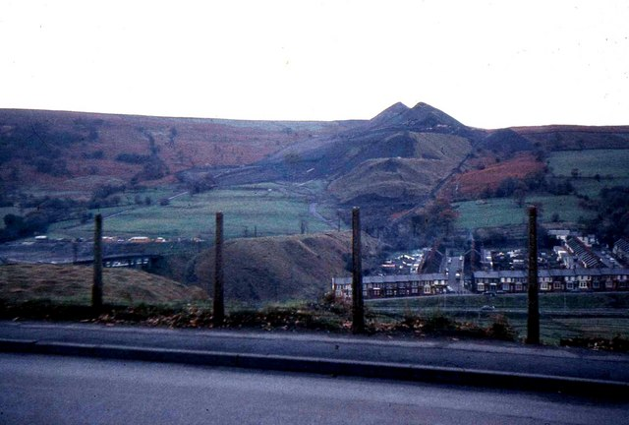
6.
Which Welsh mining village suffered a catastrophic landslide in October 1966?
Pa bentref glofaol yng Nghymru brofodd drychineb gatastroffig ym mis Hydref 1966?
Notes:
https://www.geograph.org.uk/photo/673825
Aberfan

Slide 19
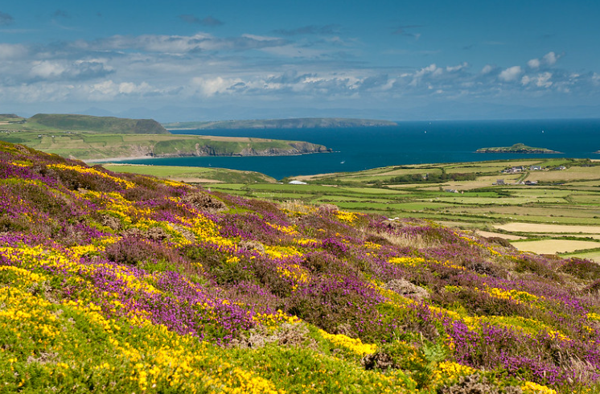
7.
What type of natural disaster hit Llŷn Peninsula in 1984?
Pa fath o drychineb naturiol brofodd Penrhyn Llŷn yn 1984?
Notes:
https://www.flickr.com/photos/echadwick/7790296866/
Earthquake

Slide 20

8.
How many properties in Wales are at risk of flooding?
Sawl darn o eiddo yng Nghymru sydd mewn perygol o lifogi arfordirol?
A 120,000
B 245,000
C 550,000
D 1 million
Notes:
245,000 properties in Wales are at risk of flooding
https://freerangestock.com/photos/120357/disaster-flood-risk-home-storm-water-vector-icon.html

Slide 21
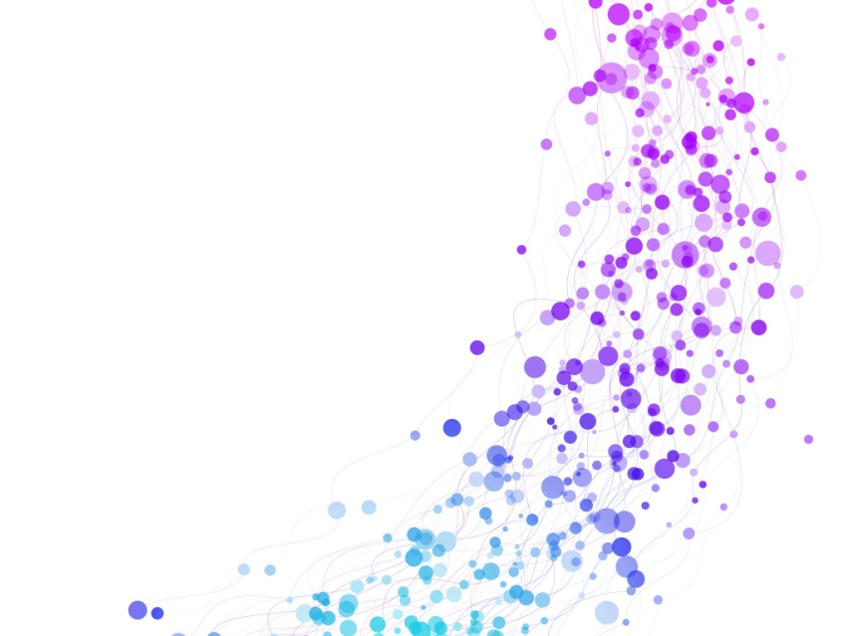
Round 3
Wales in the World
Individual round
Rownd 3
Cymru yn y Byd
Rownd unigol
Notes:
https://creazilla.com/nodes/38635-tsunami-disaster-clipart

Slide 22
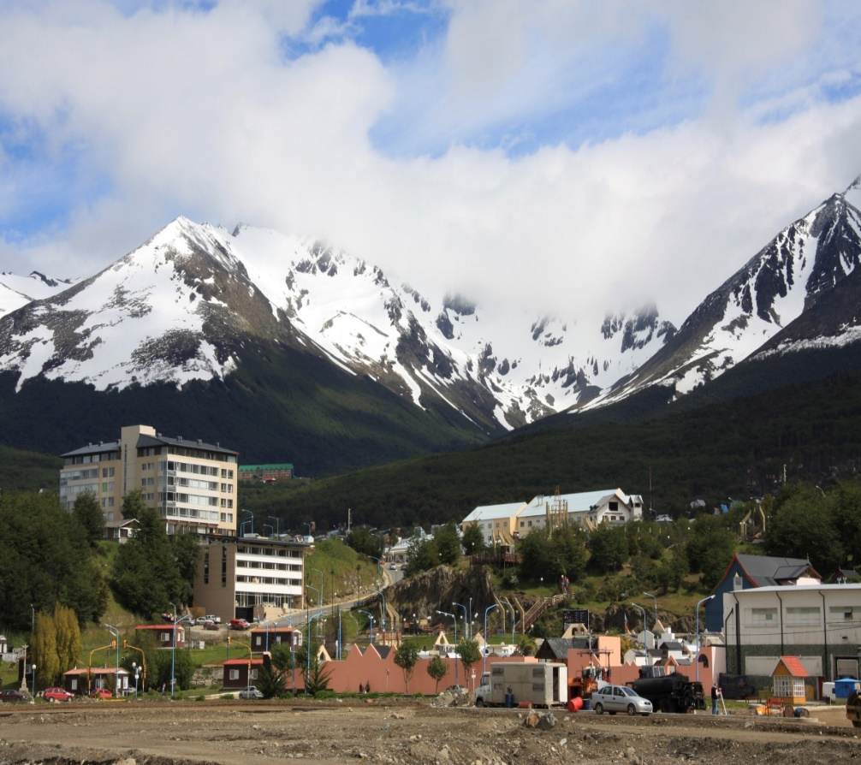
1.
To which region in South America did 1,000 Welsh people emigrate in 1865?
I ba ranbarth yn Ne America y mudodd dros 1,000 o Gymry yn 1865?
Notes:
4494063 © JosÃ© Gama | Dreamstime.com
Welsh is mainly spoken in Chubut Province, Argentina

Slide 23
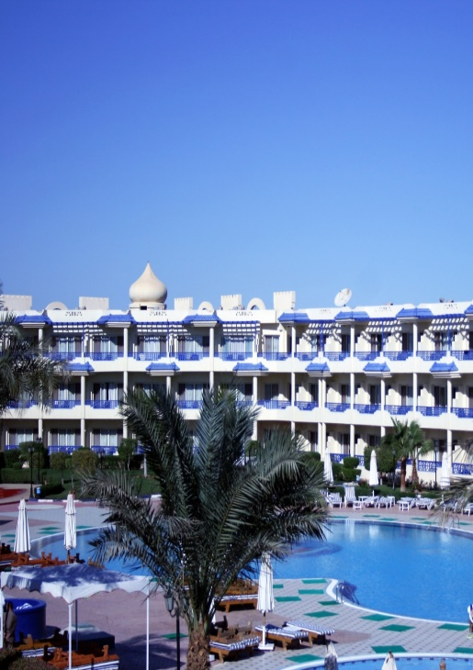
2.
To which country is the longest direct flight from Cardiff Airport?
I ba wlad aiff yr hediad uniongyrchol hiraf o Faes Awyr Caerydd?
A Turkey / Twrci
B Saudi Arabia
C Egypt / Yr Aifft
D Dubai (UAE)
Notes:
To Sharm El Sheikh . The flight time is around 5 hours and it is not a regular flight. The shortest flight is to Dublin at 1 hour exactly.
5604364 © Tanya Keisha | Dreamstime.com

Slide 24
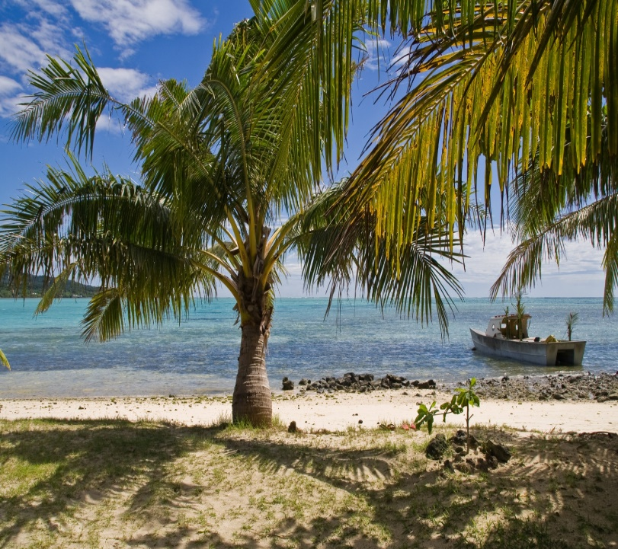
3.
Samoa has beaten Wales at rugby 4 times, including in 2 World Cups. In which ocean is Samoa located?
Mae Samoa wedi curo Cymru mewn rygbi 4 gwaith. Ymha gefnfor mae Samoa wedi’i leoli?
A South Atlantic / De Iwerydd
B South Pacific / De’r Pasiffig
C Indian / India
D Arctic / Arctig
Notes:
6252973 © Martin Krause | Dreamstime.com
Other well-known South Pacific rugby playing islands include Fiji and Tonga

Slide 25

4.
On the World Wide Web what is the domain name for a welsh based website?
Ar y We Byd-eang beth ydy’r enw a roddir i wefan a sefydlwyd yng Nghymru?

Slide 26
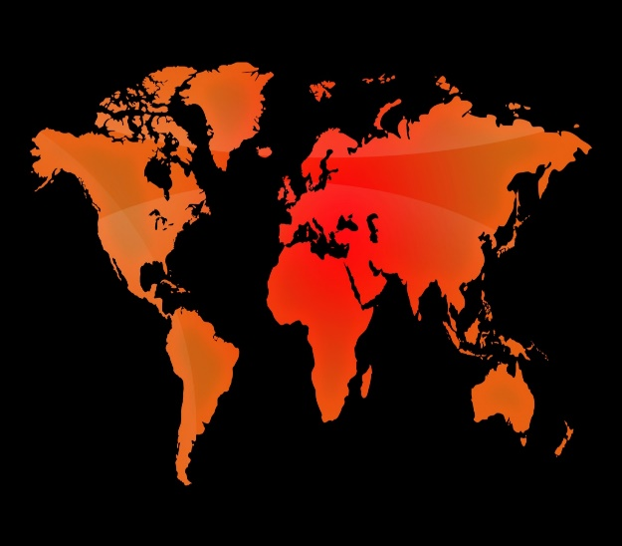
5.
Wales is the 150th largest country in the world.
Which country is closest to Wales in size?
Pa wlad yw’r agosaf at Gymru o ran maint?
A Germany / Yr Almaen
B Romania
C El Salvador
D Liechtenstein
Notes:
2580147 © Oleksandr Svitlovskyi | Dreamstime.com
The area of Wales is 21,018km2. El Salvador is 21,041km2 and Israel is 20,770km2

Slide 27
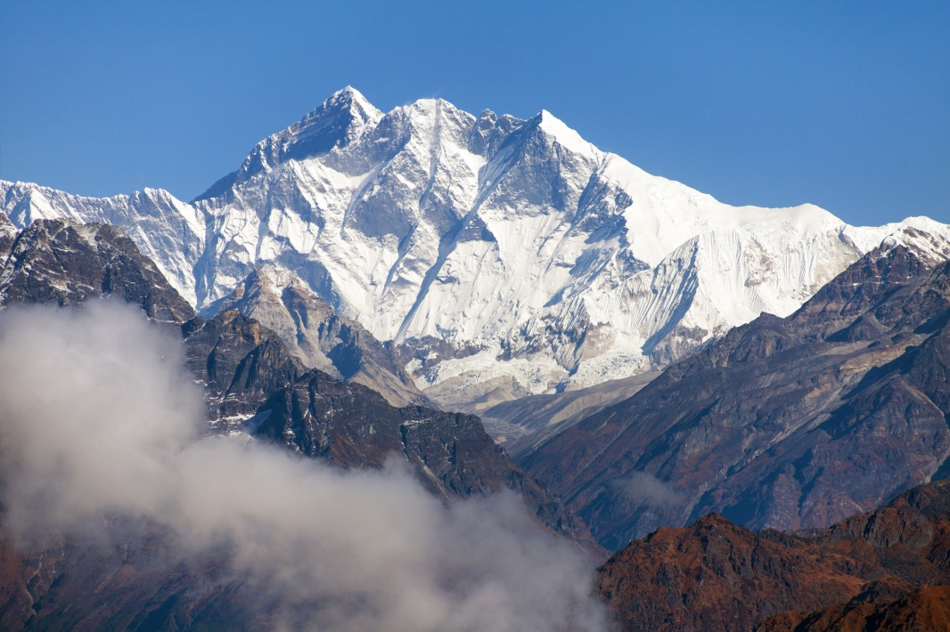
6.
What is the connection between Sagarmatha (Mount Everest) and Wales?
Beth yw’r cysylltiad rhwng Sagarmatha (Everest) a Chymru?
Notes:
It’s named after Sir George Everest, Surveyor General of India who mapped the mountain and its surrounding area in the 19th Century. He was born in Crickhowell!
149482138 © Daniel Prudek | Dreamstime.com

Slide 28
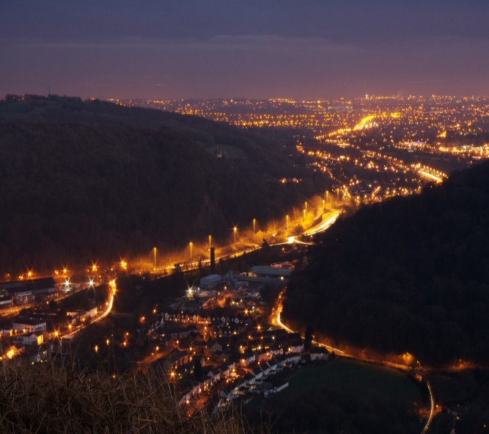
7.
Which of these countries do NOT have a settlement called Cardiff?
Pa un o’r gwledydd yma sydd HEB anheddiad o’r new Cardiff?
A Australia / Awstralia
B New Zealand / Seland Newydd
C USA / UDA
D South Africa / De Affrica
Notes:
But the South African city of Cape Town does have a suburb called Llandudno!
15447750 © Owen Mather | Dreamstime.com

Slide 29

8.
Who is the only Welsh actor to date to play
James Bond?
Pwy yw’r unig actor Cymreig i chwarae rhan James Bond?
A Daniel Craig
B Sean Connery
C Pierce Brosnan
D Timothy Dalton
Notes:
Timothy Dalton was born in Colwyn Bay. Of all the actors to play Bond, only Roger Moore and Daniel Craig are English. Sean Connery was Scottish, Pierce Brosnan is Irish and George Lazenby is Australian!
2326643 © Johan Knelsen | Dreamstime.com

Slide 30

Round 4
Fieldwork
Rownd 4
Gwaith Maes

Slide 31

1.
When geographers go into the field they
often try to test a statement to find out how
true it is.
What is this statement called?
Wrth fynd allan i’r maes, mae
daearyddwyr yn aml yn ceisio
profi gosodiad i weld os yw’n wir ai peidio.
Beth yw’r enw ar osodiad fel hwn?

Slide 32

2.
What ‘R’ should you consider before going out to do fieldwork?
Pa ‘R’ ddylid ei ystyried yn ofalus cyn mentro ar waith maes?

Slide 33
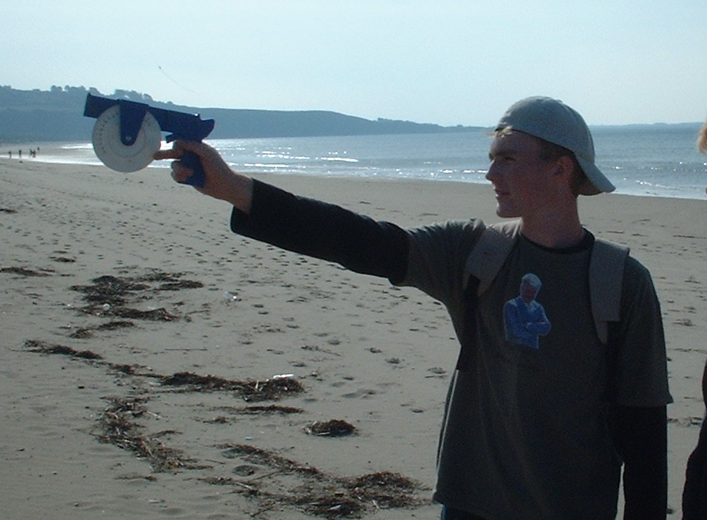
3.
What units are being used to measure
Here?
Pa unedau sy’n cael eu defnyddio i
fesur yma?

Slide 34
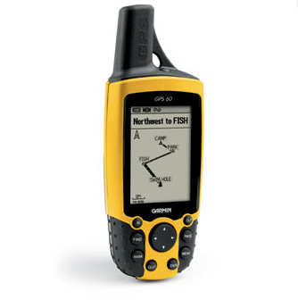
4. A student has used a GPS system to locate themselves precisely at their fieldwork sites. What do the initial GPS stand for?
Mae disgybl wedi defnyddio system GPS i leoli ei hun yn gywir ar ei safleoedd gwaith maes. Am beth mae GPS yn sefyll?
A Geographical Prediction System
B Global Positioning System
C General Position System
D Geographic Precise System

Slide 35
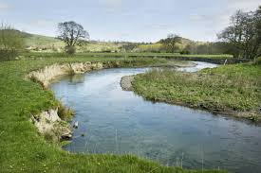
5.
What type of sampling takes measurements at equal intervals?
Pa fath o samplu sy’n mesur ar gyfnodau cyfartal?
Random / Ar Hap
Stratified / Haenedig
Systematic / Systematig
Convenience / Cyfleus

Slide 36

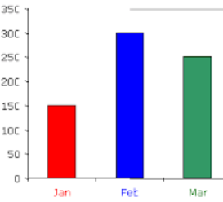
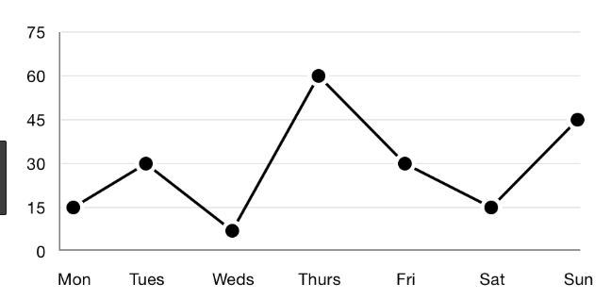
6.
Which type of graph is the most appropriate to
display how river speed changes with distance
from the source to the mouth?
Pa fath o graff sydd fwyaf addas i ddangos sut mae cyflymder yr afon yn newid gyda phellter o’r tarddiad i’r aber?
A ) Pie Chart / Siart Cylch
B) Bar Chart / Siart Bar
C) Line Graph/ Graff Llinell

Slide 37
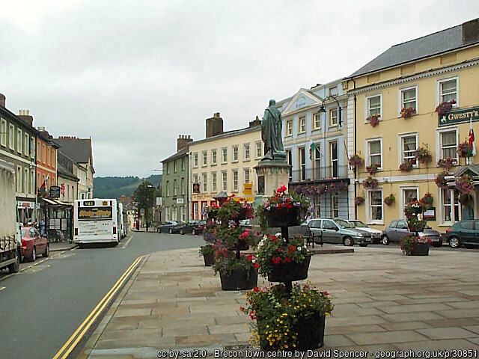
7.
What is this method of analysis called?
Beth yw enw’r dull dadansoddi hwn?
Tall, well-kept buildings keep historic character
Pub/hotel for visitors and local community
Shops – small businesses serve local people
Parked cars - spaces for local shoppers to use services
Special parking for disabled increases access for all.
Planters with flowers improve attractiveness of area
No parking. Yellow lines help reduce congestion
Open space helps sense of community meeting places . Possibly old market centre
No litter helps the town look attractive
Notes:
For huge range of all kinds of photographs of anywhere go to https://www.geograph.org.uk/

Slide 38
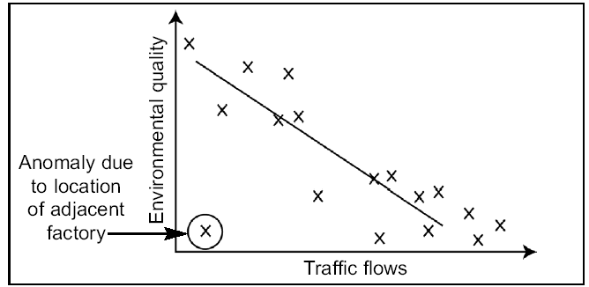
What is the nature of the relationship between environmental quality and traffic flow on this graph?
A Inappropriate
B Positive
C. Negative
D. No relationship
A Amhriodol
B Positif
C Negyddol
D Ddim yn dangos
Beth yw cryfder a natur y berthynas rhwng ansawdd yr amgylchedd a llif traffig ar y graff?
Notes:
38

Slide 39


Break
Egwyl

Slide 40

Round 5
Digimap in Wales
Rownd 5
Digimap yng Nghymru
Notes:
https://www.facebook.com/photo/?fbid=520777416517086&set=a.520777389850422

Slide 41
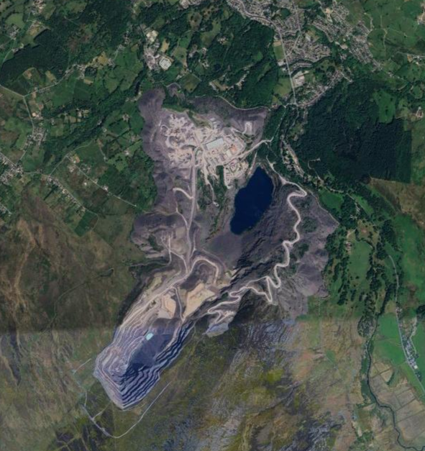
1.
What is the main activity in this area?
Beth yw’r prif weithgaredd yn yr ardal hon?
Notes:
Penrhyn slate quarry near Bethesda North Wales
https://www.google.com/maps/place/Bethesda,+Bangor+LL57+4YG/@53.1633349,-4.0679022,4177m/data=!3m1!1e3!4m6!3m5!1s0x4865063fad3c7591:0x2a5d4b1e84eba3b!8m2!3d53.1676156!4d-4.0656182!16s%2Fg%2F1tgs0brv!5m1!1e4?entry=ttu

Slide 42
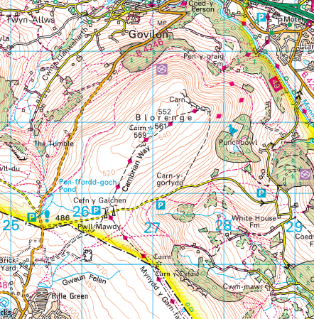
2.
In which direction would you walk from the top to descend on the gentlest slope?
I ba gyfeiriad fyddech chi’n cerdded o’r copa i lawr y llethr mwyaf esmwyth?
Notes:
https://digimapforschools.edina.ac.uk/roam/map/schools

Slide 43
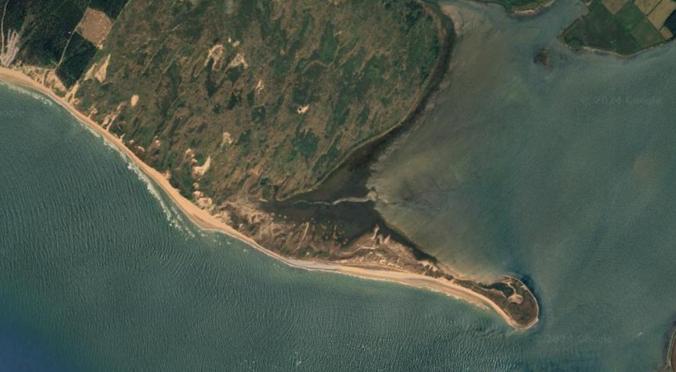
3.
What natural coastal landform is this?
Pa dirffurf arfordirol naturiol yw hwn?
Notes:
https://www.google.co.uk/maps/place/Fairbourne+LL38+2EJ/@53.1344738,-4.3455741,4180m/data=!3m1!1e3!4m6!3m5!1s0x48657f115a9f71b3:0xc1adb6c3a8687ed!8m2!3d52.696651!4d-4.054346!16zL20vMDJ6MXdf?entry=ttu

Slide 44
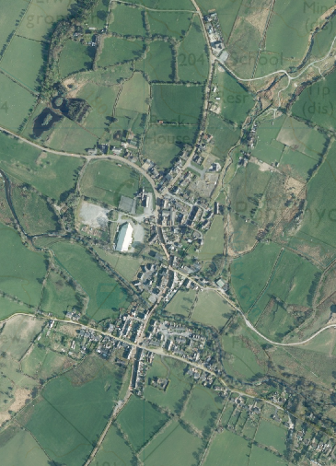
4.
What word would you use to describe the shape of this settlement?
Pa air fyddech chi’n ei ddefnyddio i ddisgrifio ffurf yr anheddiad yma?
Notes:
https://digimapforschools.edina.ac.uk/roam/map/schools

Slide 45
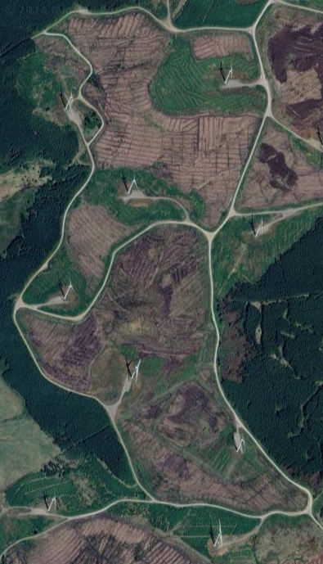
5.
What kind of green energy is produced here?
Pa fath o ynni gwyrdd sy’n cael ei gynhyrchu yma?
Notes:
https://www.google.co.uk/maps/search/pen+y+cymoedd+wind+farm/@51.6819137,-3.5775052,2160m/data=!3m1!1e3?entry=ttu

Slide 46
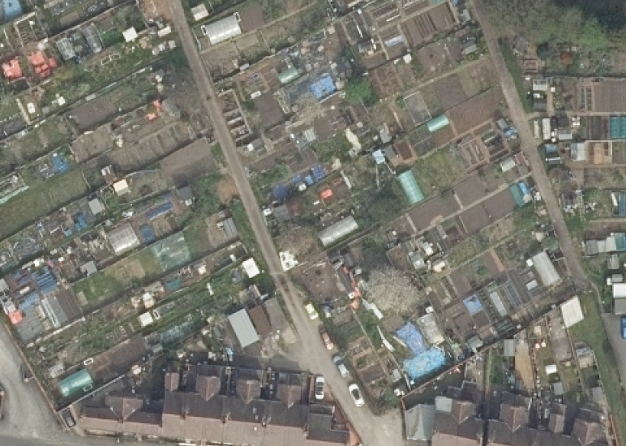
6.
What is the land use here?
Beth yw’r defnydd tir yma?
Notes:
https://digimapforschools.edina.ac.uk/roam/map/schools
In Wrexham – allotment gardens

Slide 47
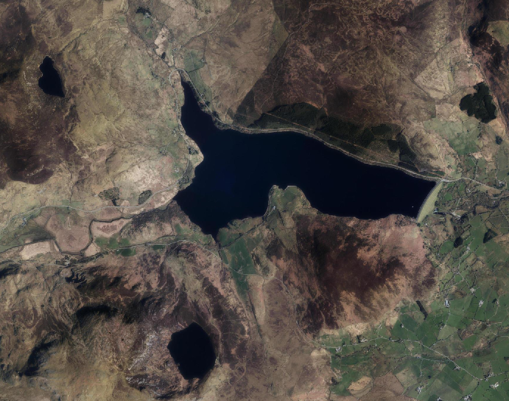
7.
Is lake X natural or man-made?
A yw llyn X yn naturiol neu wedi ei greu gan ddyn?
X
Notes:
https://digimapforschools.edina.ac.uk/roam/map/schools
Llyn Celyn

Slide 48
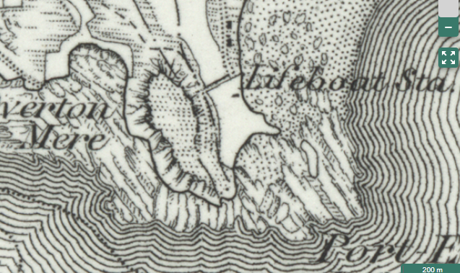
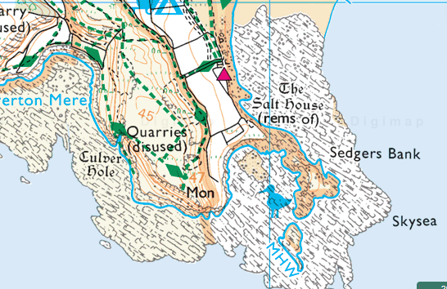
8.
How has this coastline changed between 1890s and 2020s?
Sut mae’r arfordir hwn wedi newid rhwng y 1890au a’r 2020au?
1890s
2020s
Notes:
https://digimapforschools.edina.ac.uk/roam/map/schools

Slide 49

Round 6
Tourism
Rownd 6
Twristiaeth
Individual round
Rownd unigol
Notes:
https://www.dreamstime.com/stock-illustration-wales-symbols-heart-shape-concept-colorful-sketch-collection-travel-background-image49116050

Slide 50
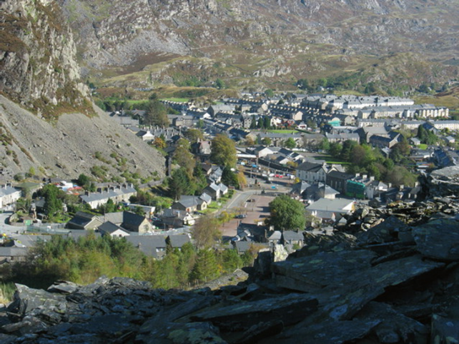
1.
Which international prize was won by the slate mining communities in North West Wales in 2021?
Pa wobr ryngwladol enillodd cymunedau’r chwareli yng Ngogledd-orllewin Cymru yn 2021?
A UNESCO world
heritage site
B RBA Stirling Prize
C Nobel Prize
D Pulitzer prize
Notes:
CC BY-SA 2.0
RBA Royal Institute of British Architects
UNESCO - United Nations Educational, Scientific and Cultural Organization

Slide 51
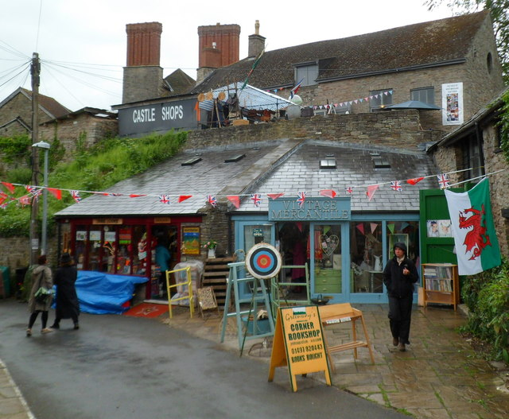
2.
Where in Wales can tourists visit the world's largest antiquarian and second hand book centre?
Ymhle yng Nghymru mae canolfan llyfrau ail-law mwya’r byd?
Notes:
https://www.geograph.org.uk/photo/2983246

Slide 52
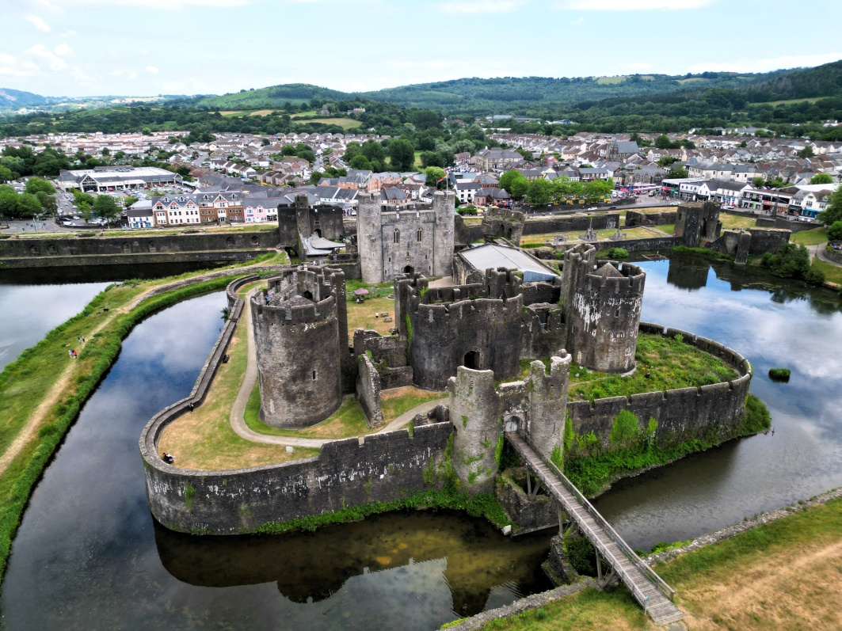
3.
Wales is famous for its impressive castles. How many did Edward 1 build?
Sawl castell Cymreig adeiladodd Edward 1af?
A 10
B 17
C 30
D 47
Notes:
https://commons.wikimedia.org/wiki/File:Castell_Caerffili_o%27r_awyr_-_aerial_%28drone%29_view_of_Caerphilly_Castle_-_2023_30.jpg
Edward 1 defeated Llewelyn ap Fawr in 1282. The king left no stone unturned in his campaign to subdue Wales once and for all, initiating an unprecedented, no-expense-spared programme of castle-building.

Slide 53
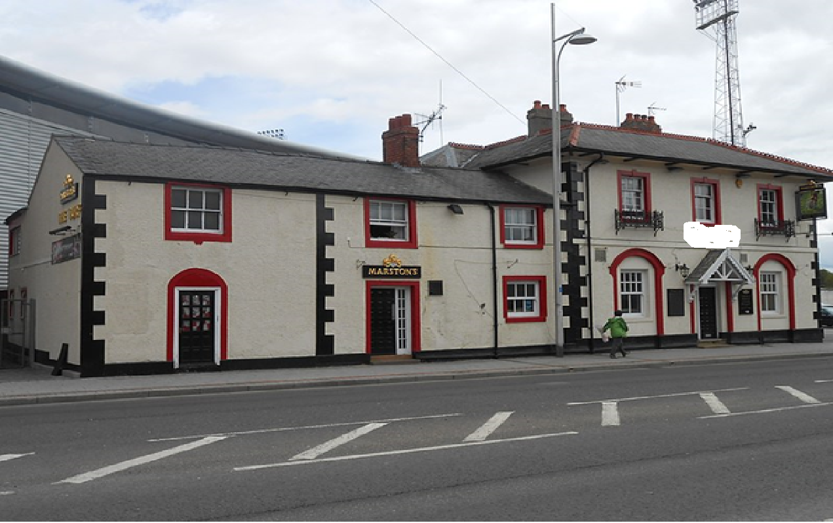
4.
Which pub attracted over 1000 Americans in early 2023?
Pa dafarn ddenodd dros 1000 o Americanwyr yn 2023?
Notes:
https://commons.wikimedia.org/wiki/File:The_Turf,_Wrexham_%282%29.JPG
The Turf has become somewhat of a local Welsh landmark as Jones and his bar are featured in FX's Welcome to Wrexham docuseries. Ryan Reynolds and Rob McElhenney owners of Wrexham football club film this series and it has a massive following across the globe following the fortunes of Wrexham football club men and ladies teams.

Slide 54
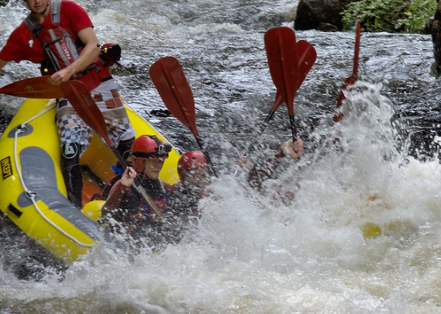
5.
Where in Wales is the National White Water Centre?
Ymhle yng Nghymru mae’r Ganolfan Dŵr Gwyn Cenedlaethol?
Notes:
https://www.flickr.com/photos/philcilcain/9392126514/
Canolfan Tryweryn, the National White Water Centre, is the UK's original and best whitewater rafting and canyoning venue. With over 40 years’ experience, it has wild rafting and canyoning sessions.

Slide 55
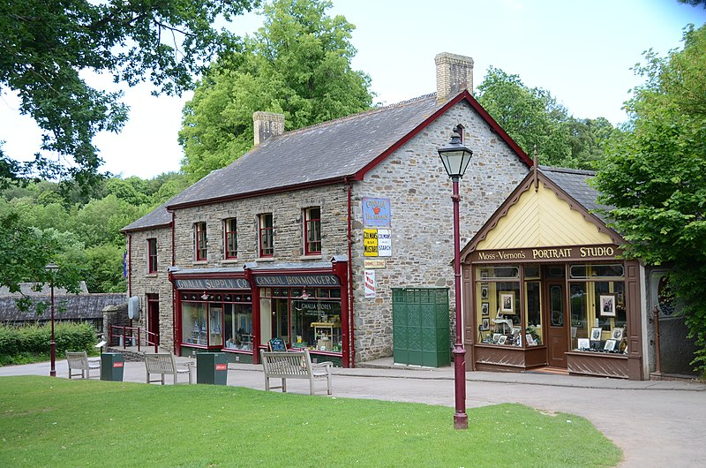
6.
Which museum explores Welsh history through people’s everyday lives?
Pa amgueddfa sy’n olrhain hanes Cymru trwy fywydau pob dydd ei phobl?
Notes:
https://commons.wikimedia.org/wiki/File:Gwalia_Stores_and_Moss-Vernon%27s_Portrait_Studio,_St_Fagans.jpg
Since 1948 over forty original buildings from different historical periods have been re-erected in the 100-acre parkland, among them houses, a farm, a school, a chapel and a splendid Workmen's Institute.

Slide 56
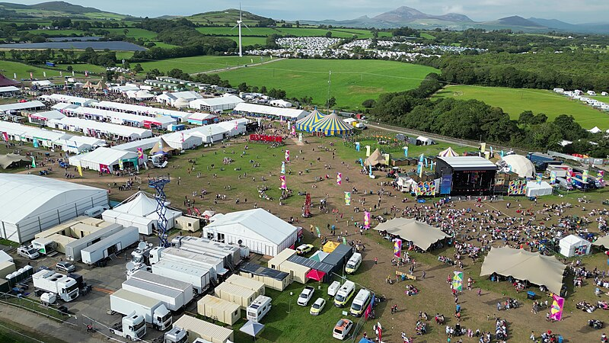
7.
The National Eisteddfod is a travelling festival
held in a different place each year. Near which village was the 2023 Eisteddfod held?
Gerllaw pa bentref y cynhaliwyd Eisteddfod Genedlaethol 2023?
Notes:
https://commons.wikimedia.org/wiki/File:Eisteddfod_Genedlaethol_Cymru_Ll%C5%B7n_ac_Eifionydd_2023_o%27r_awyr_09.jpg
Boduan is a village in Gwynedd, Wales, about 4 miles from Pwllheli. It is in the historic county of Caernarfonshire. It was due to host the National Eisteddfod in 2021 but due to the COVID-19 pandemic, it is instead hosted the 2023 event.

Slide 57
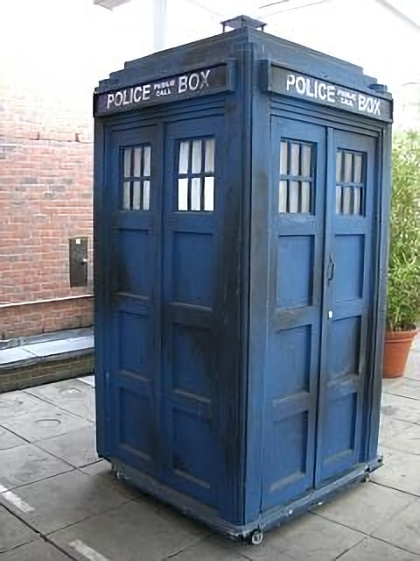
8.
Where in Wales would you go on a Doctor Who walking tour?
Ble yng Nghymru fyddech chi'n mynd ar
daith gerdded Doctor Who?
Notes:
https://commons.wikimedia.org/wiki/File:TARDIS2.jpg

Slide 58
Round 7
7
Extreme Wales
Rownd 7
Cymru Eithafol

Slide 59
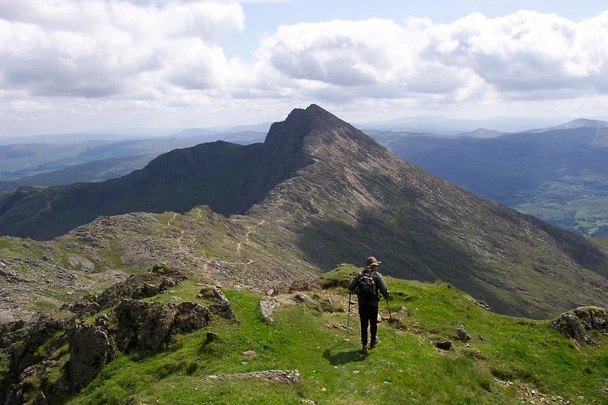
1.
What is the height of Yr Wyddfa (Snowdon) to the nearest 50m?
Beth yw uchder yr Wyddfa i’r 50m agosaf?
Notes:
1085m
https://www.rawpixel.com/image/5955313/free-public-domain-cc0-photo

Slide 60
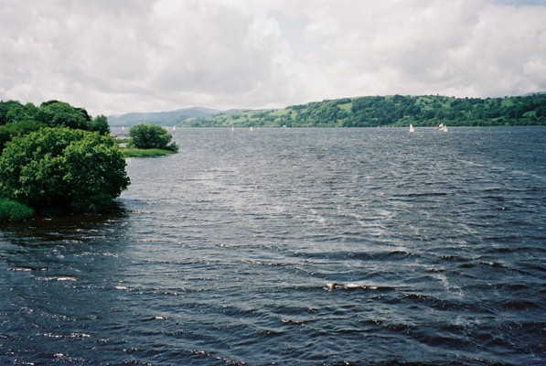
2.
What is the name of Wales’ largest lake?
Beth yw enw llyn mwyaf Cymru?
A Bala Lake / Llyn Tegid
B Llangorse lake / Llyn Llangors
C Lake Vyrnwy / Llyn Efyrnwy
D Llyn Padarn
Notes:
Bala/Tegid 4.84 km² Llangorse / Syfadden 153 ha Vyrnwy 4.53 km² Fawr 10ha
https://commons.wikimedia.org/wiki/File:Bala_Lake_-_geograph.org.uk_-_135933.jpg

Slide 61
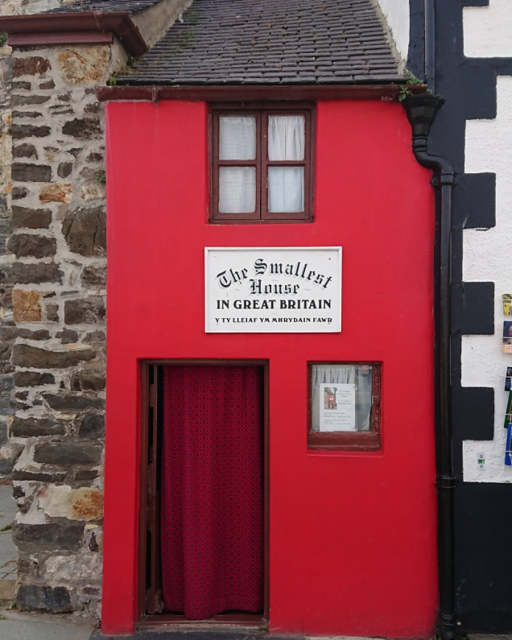
3.
Where is the smallest house in Wales?
Ymhle mae’r tŷ lleiaf yng Nghymru?
Notes:
Conwy
https://commons.wikimedia.org/wiki/File:Smallest_House_In_Great_Britain.jpg

Slide 62
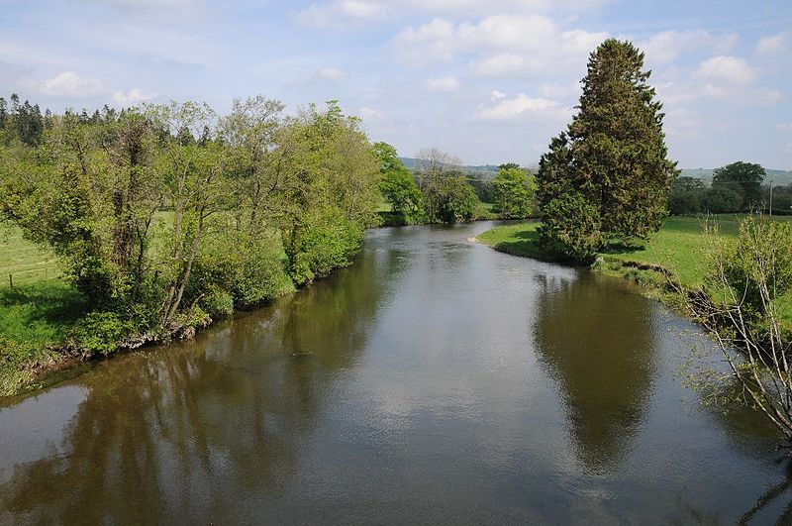
4.
Which is the longest river that flows entirely within Wales?
Pa un yw’r afon hiraf sy’n llifo’n gyfangwbl yng Nghymru?
A Wye
B Severn
C Towy
D Dee
A Gwy
B Hafren
C Tywi
D Dyfrdwy
Notes:
Severn / Harfen 354kms Wye/Gwy 217kms Dee/Dyfrdwy 113 kms Towy / Tywi 121 kms
https://upload.wikimedia.org/wikipedia/commons/a/af/Afon_Twyi-River_Towy_-_geograph.org.uk_-_3997259.jpg

Slide 63
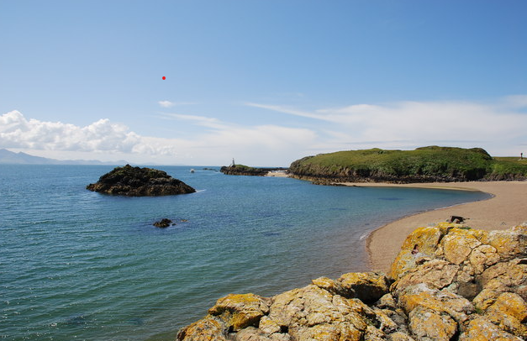
5.
Wales has over 50 islands.
Which one is the largest?
Pa un yw ynys fwyaf Cymru?
A Caldey Island
B Anglesey
C Skomer island
D Cardigan island
A Ynys Bŷr
B Ynys Môn
C Ynys Sgomer
D Ynys Aberteifi
Notes:
https://www.geograph.org.uk/photo/491156
Caldey / Bŷr 2.10 km² Anglesey / Môn 710km² Skomer 2.92km² Cardigan / Aberteifi 38ha

Slide 64
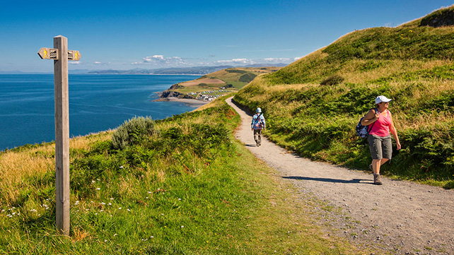
6.
What is the official length of the Wales Coastal Path? (to the nearest 50 kms)
Beth yw hyd y Llwybr Arfordir Cenedlaethol?(i’r 50km agosaf)

Slide 65
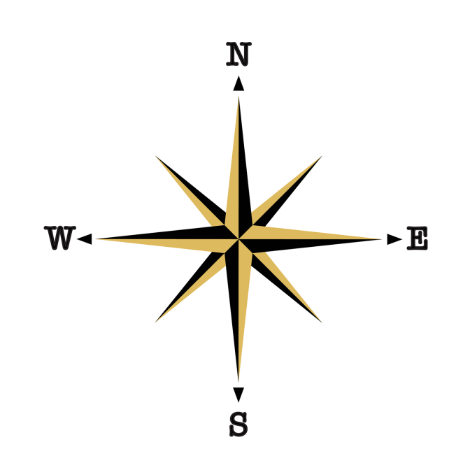
7.
List these three places in the order of most northerly, most easterly and most westerly.
Rhestrwch y tri lle hyn yn nhrefn y mwyaf gogleddol, mwyaf dwyreiniol a mwyaf gorllewinol.
A Chepstow/Cas-gwent (51⁰N, 2⁰W)
B Treginnis (51⁰N, 5⁰W)
C Talacre (53⁰N, 3⁰W)

Slide 66

8.
Where is the longest high street in Wales?
Ble mae stryd fawr hiraf Cymru?
A Wrexham / Wrecsam
B Cardiff / Caerdydd
C Bangor / Bangor
D Swansea / Abertawe
Notes:
Bangor 1.265km long
https://www.rawpixel.com/image/6483620/vector-background-tree-public-domain

Slide 67

Round 8 Wales in the News!
Complete the headlines…
Rownd 8 Cymru yn y newyddion
Cwblhewch y penawdau

Slide 68

1. Tata Steel ending union talks over 2,800 jobs in a heavy industry

Slide 69


2. Welsh congestion as traffic slows to
20mph

Slide 70

3. Council won't fence off Llandudno's wild goats as report details previous brutal plan
Notes:
This cheeky herd actually won their battle with Llandudno council after it was ruled they couldn't be legally contained. They've been running rampant in the town and its accompanying mountains for more than 100 years and took over the streets in 2020 during lockdown. People have been trying to find a way to clamp down on their behaviour for years and in the 90s it was briefly considered whether they could be shot – but they've won the battle for now.

Slide 71

4. Johnny Depp dropping by to visit Dylan Thomas' house in Swansea

Slide 72

5. Controversy over reclamation of UK’s largest open cast coal mine
Notes:
Open cast coal mine
Residents at Ffos-y-Fran , near Merthyr are worried that the giant open cast coal mine will not be fully restored as promised.
It was granted permission by the Welsh government in 2005, to be a "land reclamation scheme".
That meant the site - the size of 400 football pitches and 656ft (200m) deep in places - was to be turned back to green hillside for the community's benefit after the coal was dug out.
Mining stopped in November 2023, with 115 staff made redundant.
The company in charge - r (South Wales) Ltd - has warned of "insufficient funds" to carry out the original restoration plan.

Slide 73

6. Pigs trashing a village
Notes:
These pigs staged their own breakout when they escaped from a field near Rhosllanerchrugog, close to Wrexham. They pitched up on the Maes-Y-Gornel estate and found a large grass patch outside a block of flats, churning it up before their owner found them.

Slide 74

7. Two beaches in Wales have bathing water quality classed as poor
Notes:
The bathing water quality has been classified in every single one of Wales's coastal areas, with two considered 'poor‘. A total of 109 designated bathing waters were sampled and classified in Wales, with 80 achieving the highest possible ranking, 20 being classified as good, seven sufficient, and two the worst ranking of poor - Watch House Bay and Ogmore-by-Sea. https://www.walesonline.co.uk/news/wales-news/water-quality-ratings-wales-beaches-29162415

Slide 75

8. Vaughan Gething becomes new First Minister of Wales
Notes:
https://www.bbc.co.uk/news/uk-wales-politics-68605899
Mr Gething, the first black leader of a national government in Europe, said he wanted to lead a Wales "full of hope, ambition and unity".
He was backed by 27 Senedd members, Tory Andrew RT Davies had 13 votes and Plaid Cymru's Rhun ap Iorwerth 11.
Mr Gething's name was then sent to the King who gave his approval, allowing the new first minister to officially take office.

Slide 76


Well done!
Da iawn!

Slide 77

Tie breakers / Gwahanu’r goreuon!

Slide 78

1. Which national park in Wales is the most populated?
Pa Barc Cenedlaethol yng Nghymru sydd â’r boblogaeth fwyaf?
Notes:
https://www.flickr.com/photos/romanpopelar/51663499408

Slide 79

2. Which important government “factory” is located in Llantrisant?
2. Pa ‘ffatri’ lywodraethol bwysig sydd wedi ei lleoli yn Llantrisant?
Notes:
https://commons.wikimedia.org/wiki/File:The_Royal_Mint,_Llantrisant.jpg

Slide 80

3. Which mountain in Powys is the source of water for the River Severn, Britain’s longest river?
3. Pa fynydd ym Mhowys yw tarddle’r Afon Hafren, afon hiraf Prydain?
Notes:
https://commons.wikimedia.org/wiki/File:Boggy_pool_on_the_plateau_between_the_Plynlimon_tops_-_geograph.org.uk_-_182516.jpg

Slide 81

4. What separates Anglesey from mainland
Wales?
4. Beth sy'n gwahanu Ynys Môn oddi
wrth dir mawr Cymru?
Notes:
https://commons.wikimedia.org/wiki/File:Ynys_Gored_Goch_in_the_Menai_Strait_between_Gwynedd_and_Anglesey_in_Wales_%28Cymru%29_23.jpg

Slide 82

5. Which borderlands town has a Welsh bridge and an English bridge over the
River Severn?
5. Pa dref ar y gororau sydd gyda phont Gymreig a phont Saesnig dros yr Afon Hafren?
Notes:
https://commons.wikimedia.org/wiki/File:Location_map_United_Kingdom_Shrewsbury_Central.png

